Slide 1
Ann
Swaine
1821-1883

Slide 2
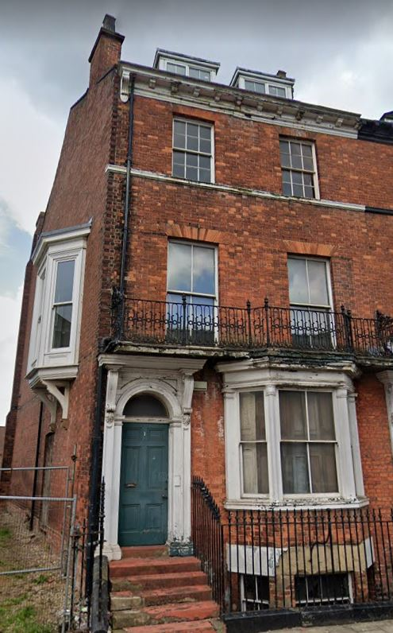
Personal Life
1, The Crescent, York on Google Maps.
‘Active and clear thinking woman’
‘Divided her time between philanthropy, feminism, publishing, translation, and domestic and familial duties’ (Brown, 2004)
1881 census - ‘no proper trade or education,’ living in her father’s household with 3 servants
The Yorkshire Gazette’s report on Swaine’s death.
Notes:
Ann Sykes Swaine (1821- 1883) was the eldest of 4 daughters born to Edward Swaine and Martha Sykes.
Swaine was a British writer, suffragist and philanthropist concerned with improving higher education for women.
Lived at 1, The Crescent in York, off Blossom Street - here is where she cared for her father for the last 28 years of her life.
Described as an ‘active and clear thinking woman’ who ‘divided her time between philanthropy, feminism, publishing, translation, and domestic and familial duties’ (Brown, 2004)
The 1881 census described Swaine as having ‘no proper trade or education’ and she is listed as living in her father’s household with 3 servants - suggests Swaine’s frustration with the opportunities available to women. (Ancestry.co.uk)
The Yorkshire Gazette reported Swaines death after a ‘two day illness’ on Saturday 23rd June 1883. (British Newspaper Archive)

Slide 3
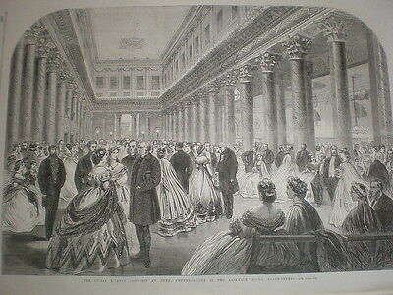
Involvement in York Suffrage Movement
The Festival Concert Rooms in the 1860’s - where Ann Swaine spoke in 1883.
One of the 3 women in York to have signed the first mass women’s suffrage petition to the House of Commons in June 1866 (Waters, 2018; 179)
Spoke at various suffrage meetings e.g April 1880 in Victoria Hall Goodramgate, 1883 in the Festival Concert Rooms etc. (Crawford, 2006, pg 52-53)
Anne’s father, Edward Swaine, often spoke arguing for universal male suffrage but the exclusion of women from the franchise
Notes:
The earliest women in York known to have lent their names to the women’s suffrage campaign were Emma Fitch, Agnes Smith and Ann Swaine who were among 1,499 signatories of a petition presented to the House of Commons in June 1866.” (Waters, 2018; 179)
On the 1st April 1880, a suffrage meeting was held at Victoria Hall on Goodramgate - Ann Swaine spoke at this meeting alongside Lydia Rous. (Crawford, 2006, pg 52)
In 1883, just prior to her death, Swaine spoke on the platform at the Festival Concert Rooms amongst many others. (Crawford, 2006, pg 53)
Edward Swaine, Ann’s Father, often spoke and showed his support at these meetings.
Interesting to note that Edward Swaine wrote a pamphlet arguing for universal suffrage for men and the exclusion of women from the franchise - estimated to have been published in 1849 therefore perhaps his views on women’s suffrage changed.

Slide 4
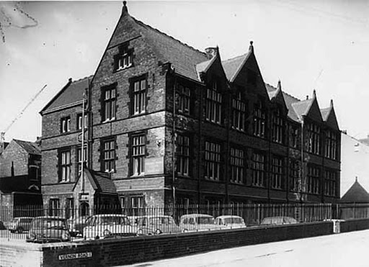
Involvement in Local Education
The Yorkshire College of Cookery - it was likely Swaine was involved in this institution.
Swaine was honorary secretary of the Yorkshire Ladies’ Educational Association and a member of the Ladies’ Council of Education of Yorkshire
The YLCE was also influential in the opening of the Yorkshire College of Cookery in 1874 - likely that Ann Swaine was involved in this.
Swaine supported campaigns for the extension of university education to women and is also described as being ‘active in local education ‘ (Brown, 2004)
Swaine involved in her local school: Unitarian Sunday School
The YLCE still in operation today -Swaine’s influence is still clear in our modern society
Notes:
Swaine was honorary secretary of the Yorkshire Ladies’ Educational Association and a member of the Ladies’ Council of Education of Yorkshire
YLCE was established in 1875 by a group of prominent Yorkshire women who recognise the need to help other women living in overcrowded and unhealthy conditions in the industrial areas
The YLCE was also influential in the opening of the Yorkshire College of Cookery in 1874 - it is likely that Ann Swaine was involved in this because there’s lots of references to her local involvement in cooking education.
The YLCE is still in operation - demonstrates how Swaine and other Yorkshire women of the 19th century influenced today’s society
Swaine supported campaigns for the extension of university education to women and is also described as being ‘active in local education ‘ (Brown, 2004)
Swaine was very involved in the Sunday School Association - this concerned free school education and is linked with Unitarianism

Slide 5
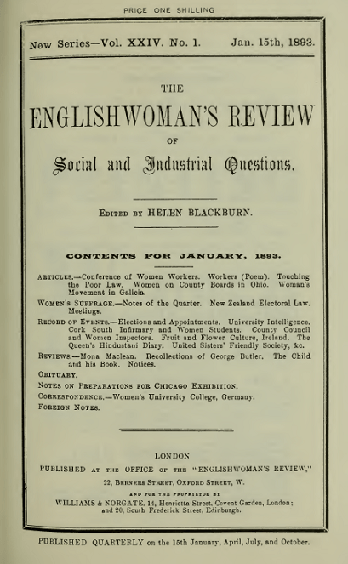
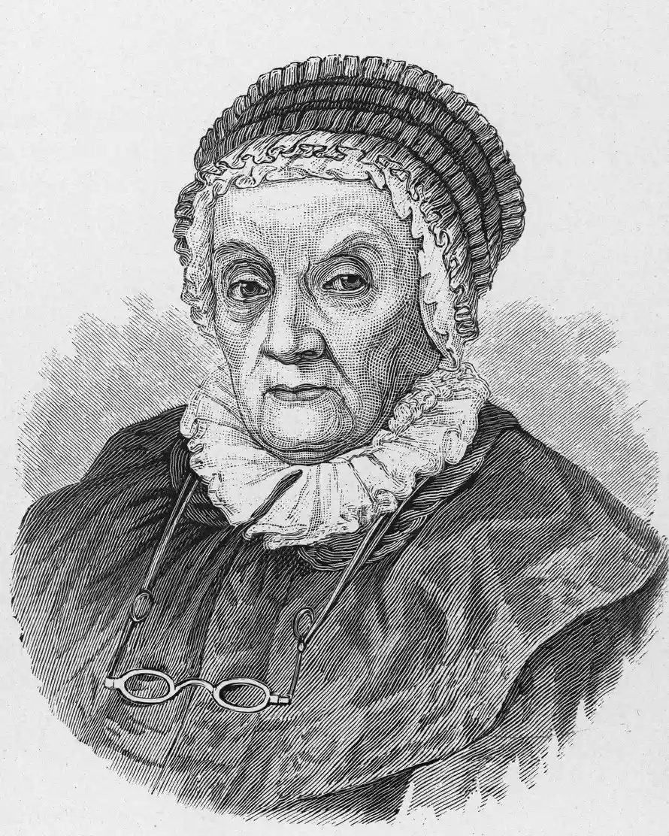
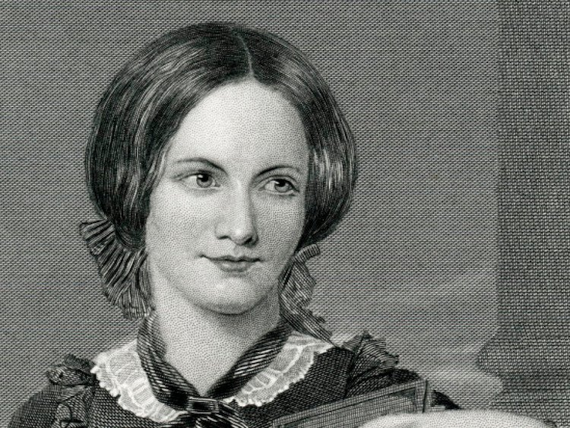
Works/ Writing
The Englishwoman’s Review, one of the first feminist journals, commented on Swaine’s writing after her death
In 1882, the Sunday School Association published Swaine’s ‘Remarkable Women as Examples for Girls’ - a collection of short biographies on notable women.
The Englishwoman’s Review (a feminist periodical 1866-1910) commented after her 1883 death in an obituary on how Swaine’s writing showed her ‘pragmatism’ and ‘common sense’.
They refer to her collection of biographies as ‘characterised by clear good sense and unsensational treatment’ (The Englishwoman’s Review, 1883, 331-332)
Swaine’s ‘remarkable women’ included Charlotte Bronte and Caroline Herschel alongside many others.

Slide 6
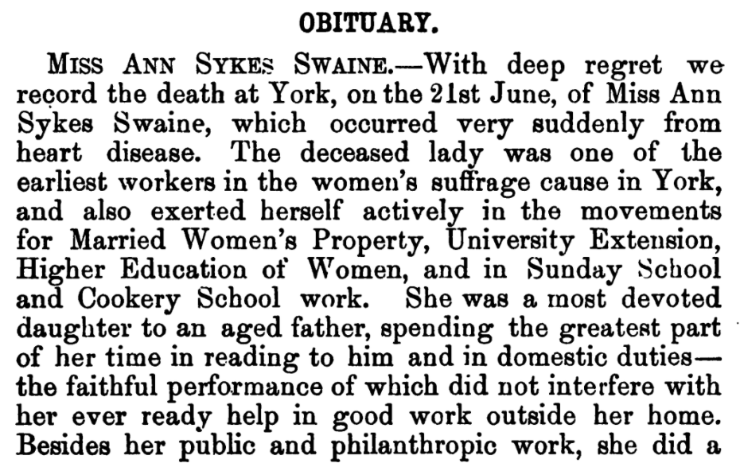
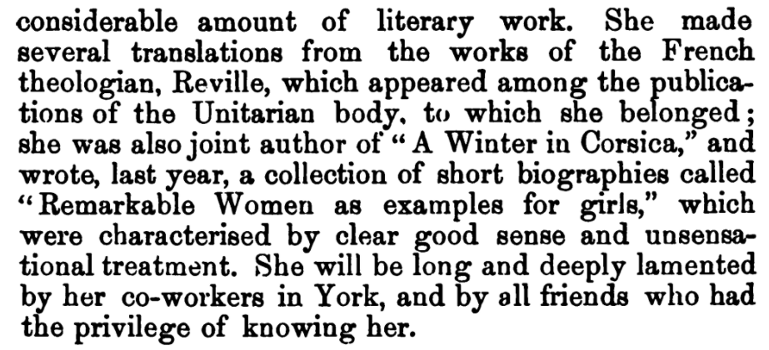

Slide 7
References
Ann Sykes Swaine in the 1881 England Census,” Ancestry, accessed June 16, 2021, https://search.ancestry.co.uk/cgi-bin/sse.dll?indiv=1&dbid=7572&h=25928886&tid=&pid=&queryId=be2829dce0ad73b551708cf1065b3085&usePUB=true&_phsrc=mnr13&_phstart=successSource.
“Births, Marriages, and Deaths,” Yorkshire Gazette June 23, 1883, 6.
Brown, H. (2004) Swaine, Ann Sykes, Oxford Dictionary of National Biography Available at: https://doi.org/10.1093/ref:odnb/56272 https://www.britishnewspaperarchive.co.uk/viewer/bl/0000266/18830623/015/0006
Crawford, E., 2006. The Women's Suffrage Movement in Britain and Ireland: A Regional Survey. [London]: Routledge.
Leeds Mercury - Wednesday 04 October 1882 - Review of her book ‘Remarkable Women as Examples for Girls’ published in 1882.
Obituary,” The Englishwoman’s Review 14, (1883): 331-332.
Waters, M., 2018. The Campaign for Women’s Suffrage in York and the 1911 Census Evasion. Yorkshire Archaeological Journal, 90(1), pp.178-194.

