Slide 1
Annie Coultate
Team 2
Ania Kaczynska, Emilia Obszanska, Abbie Edson, Megan Evans
HERStory: Making Invisible Women Visible

Slide 2
DELETE THIS SLIDE LATER
Fonts used:
Titles: Playfair Display Normal;
Subtitles: Robotica Light;
Also, I know that we agreed to make this presentation using mostly images and less text. I added slides with Titles such as “General Introduction” or “Birth and Early Career” just so it’s easier for us to write scripts:) We will delete these slides later!

Slide 3
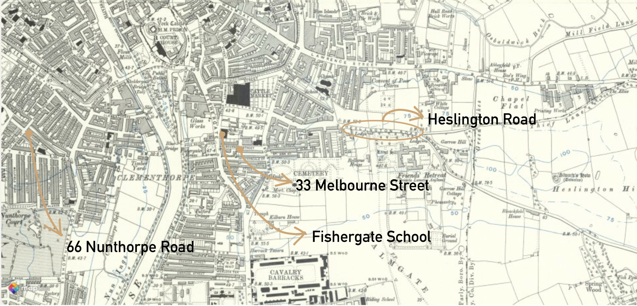
Map of York 1888-1913 with marked significant locations in Annie Coultate’s life

Slide 4
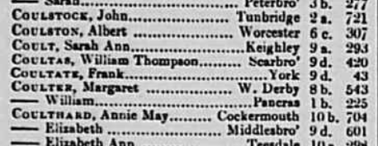
Birth and Early Career
England & Wales Marriages 1881.
Mentions Frank Coultate from York.
Frank Coultate’s marriage record—1881
Notes:
Born in 1856 in York as Annie Delacy
On 5th Jan 1881 she married Frank Coultate
She had a son, Harry Coultate in 1882 and a daughter Florence Annie Coultate in 1883
On the left is the census record from 1891 when she and her family lived with her brother Charles Delacy on Heslington Road.
On the right is her marriage record to Frank in 1881.

Slide 5
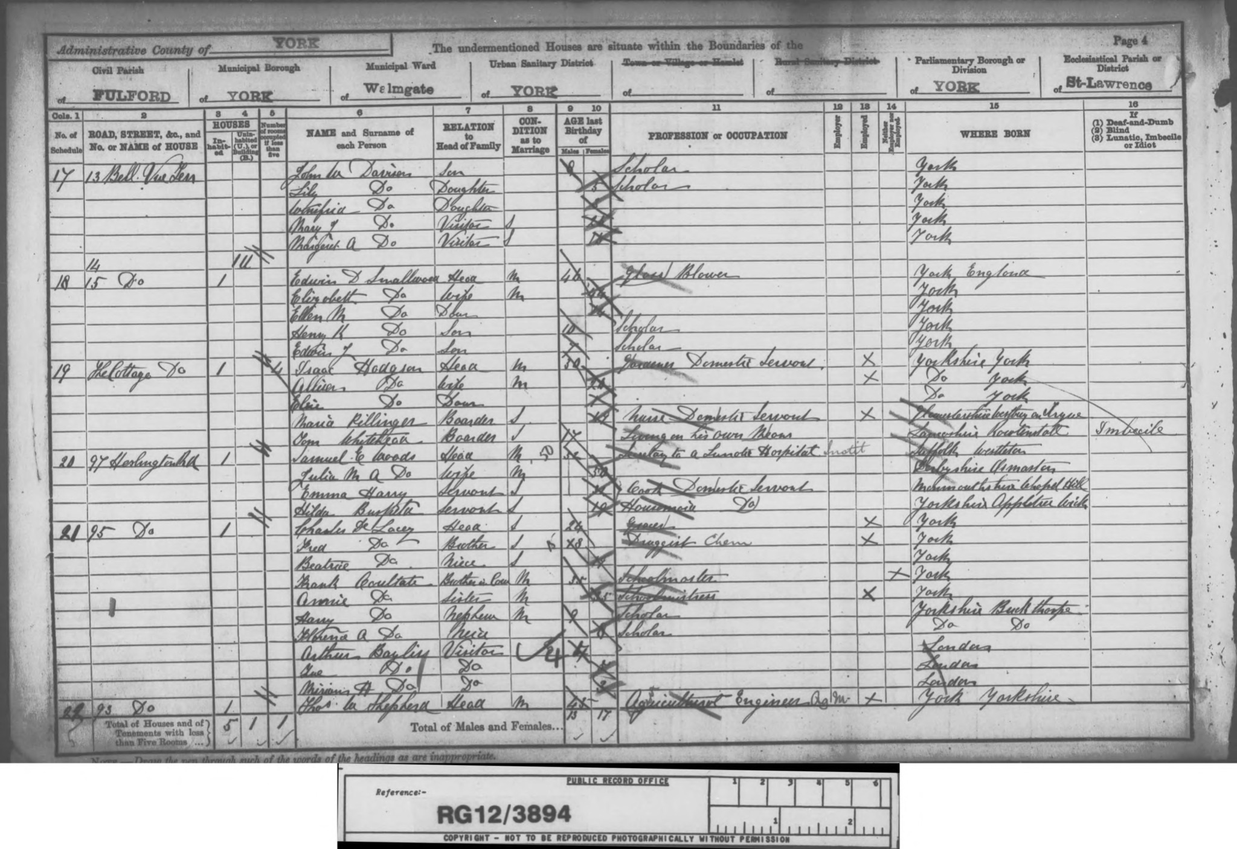
Transcription:
Name(s): Annie Surname: Coultate (maiden surname De lacy/Delacey)
Year of Birth: 1856 Location: Fulford, York
Relationship to the Head of the household: Sister
Marital status: Married to Frank Coultate (Schoolmaster, born 1856)
Birth town: York
Occupation: Schoolmistress
Full address: Heslington Road, Fulford, York
1891 England, Wales & Scotland Census; via findmypast.co.uk

Slide 6
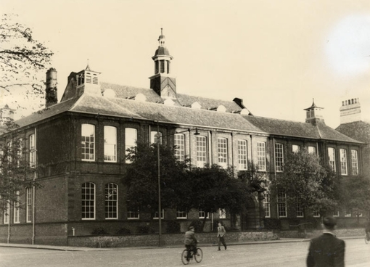
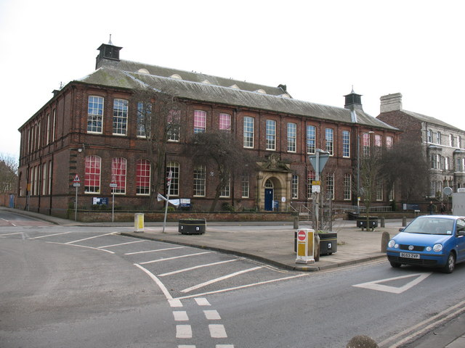
Fishergate Schoolmistress
Fishergate School 1950 (left) and 2008 (right)
Whites Directory of York: Board Schools (bottom)
(Friends of Fishergate School)-left (Gordon Hatton, 2008)- right (Whites Directory of York, pg.69)- bottom
Notes:
Annie worked as a school mistress in York
In 1895 she was the schoolmistress of George Street School. This school closed in 1895 and was replaced by Fishergate School, which is still open today.

Slide 7
White’s Directory Of York, 1895; via findmypast.co.uk

Slide 8
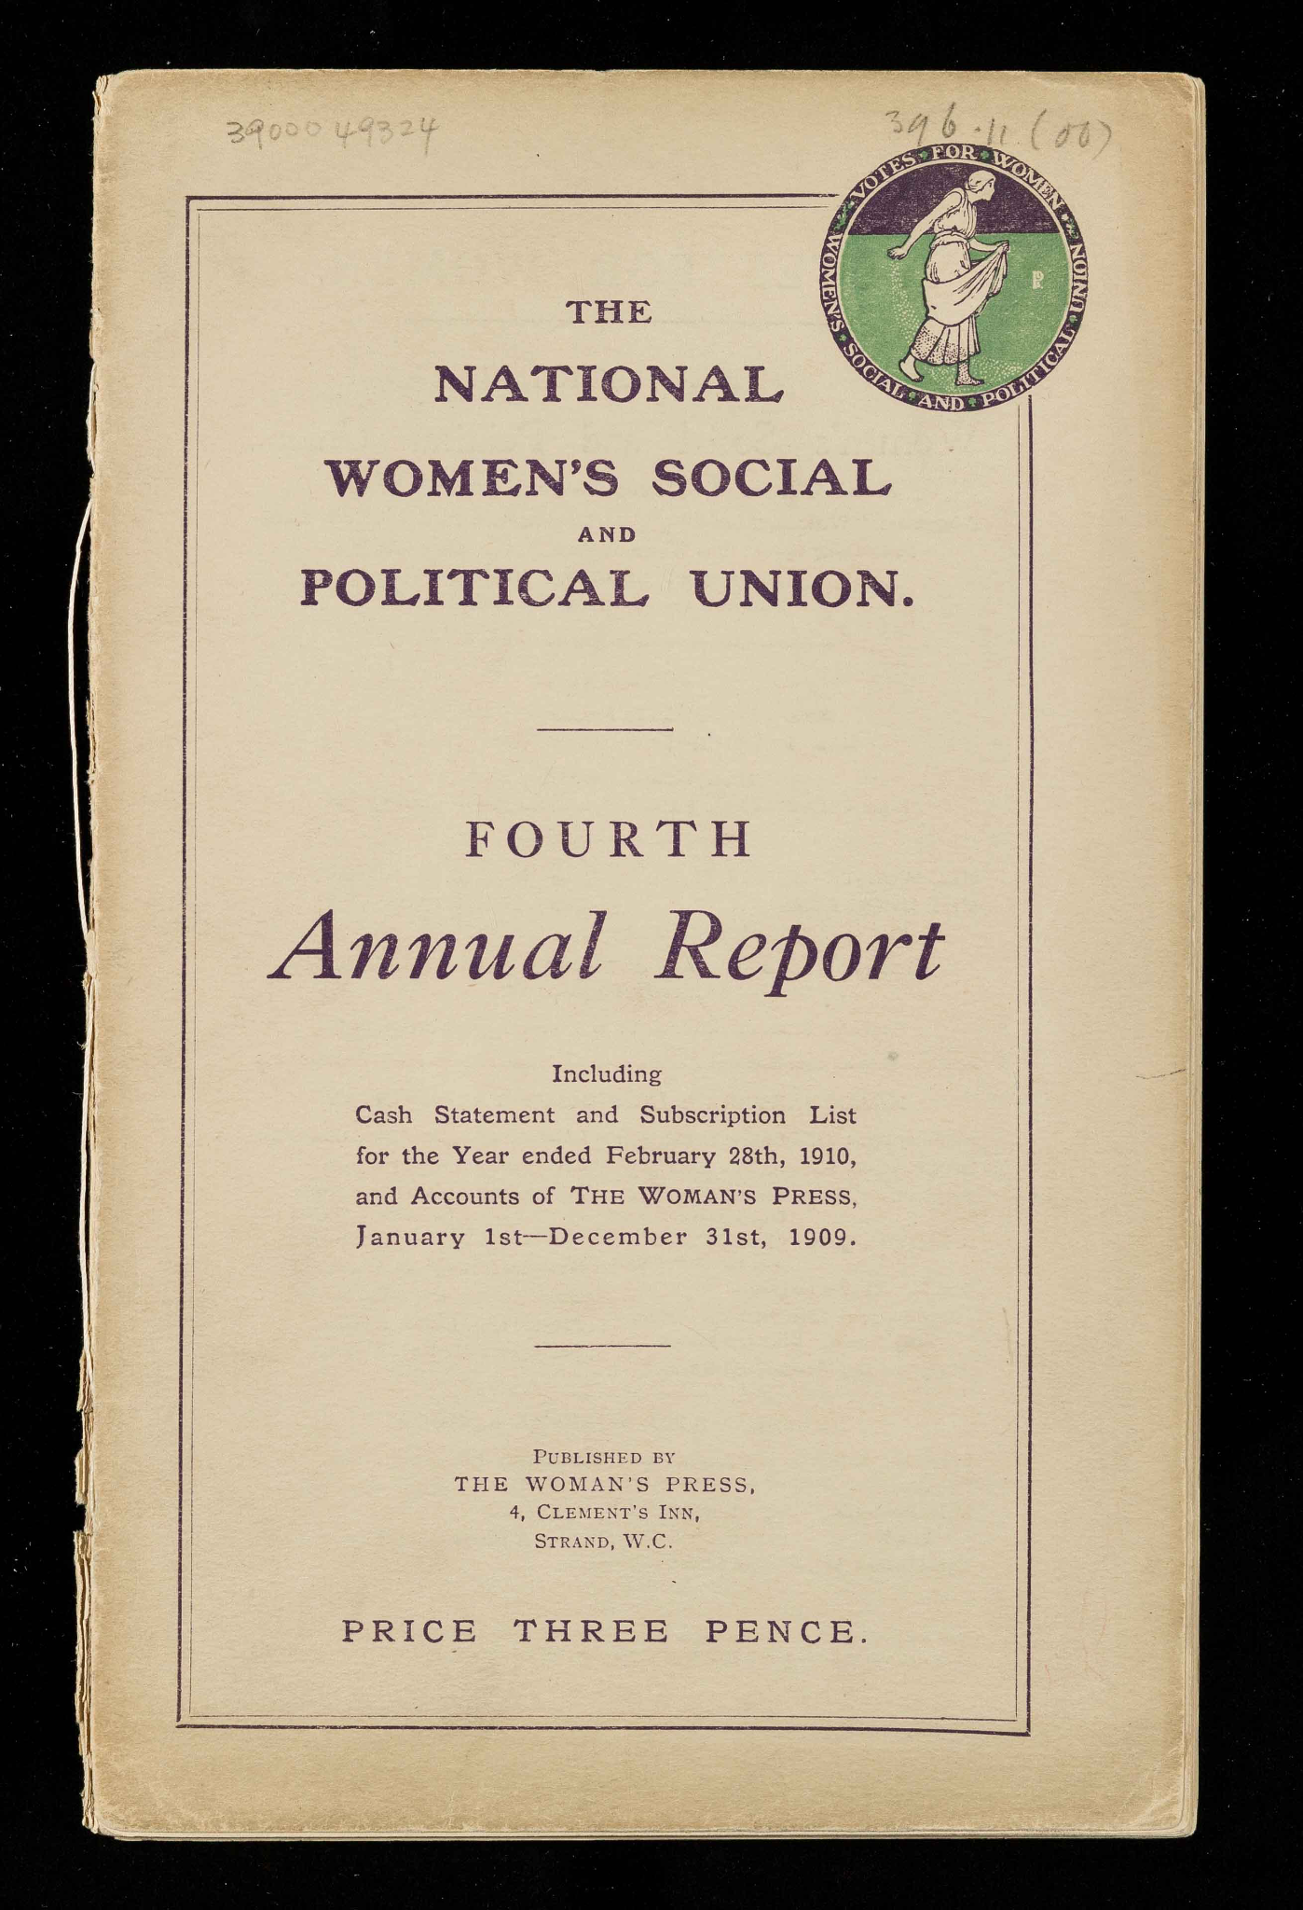
WSPU: Women’s Social and Political Union
Cover of the Fourth annual report of The National Women's Social and Political Union including cash statement and subscription list for the year ended February 28th, 1910, and accounts of the Woman's Press, January 1st-December 31st, 1909; via digital.library.lse.ac.uk

Slide 9
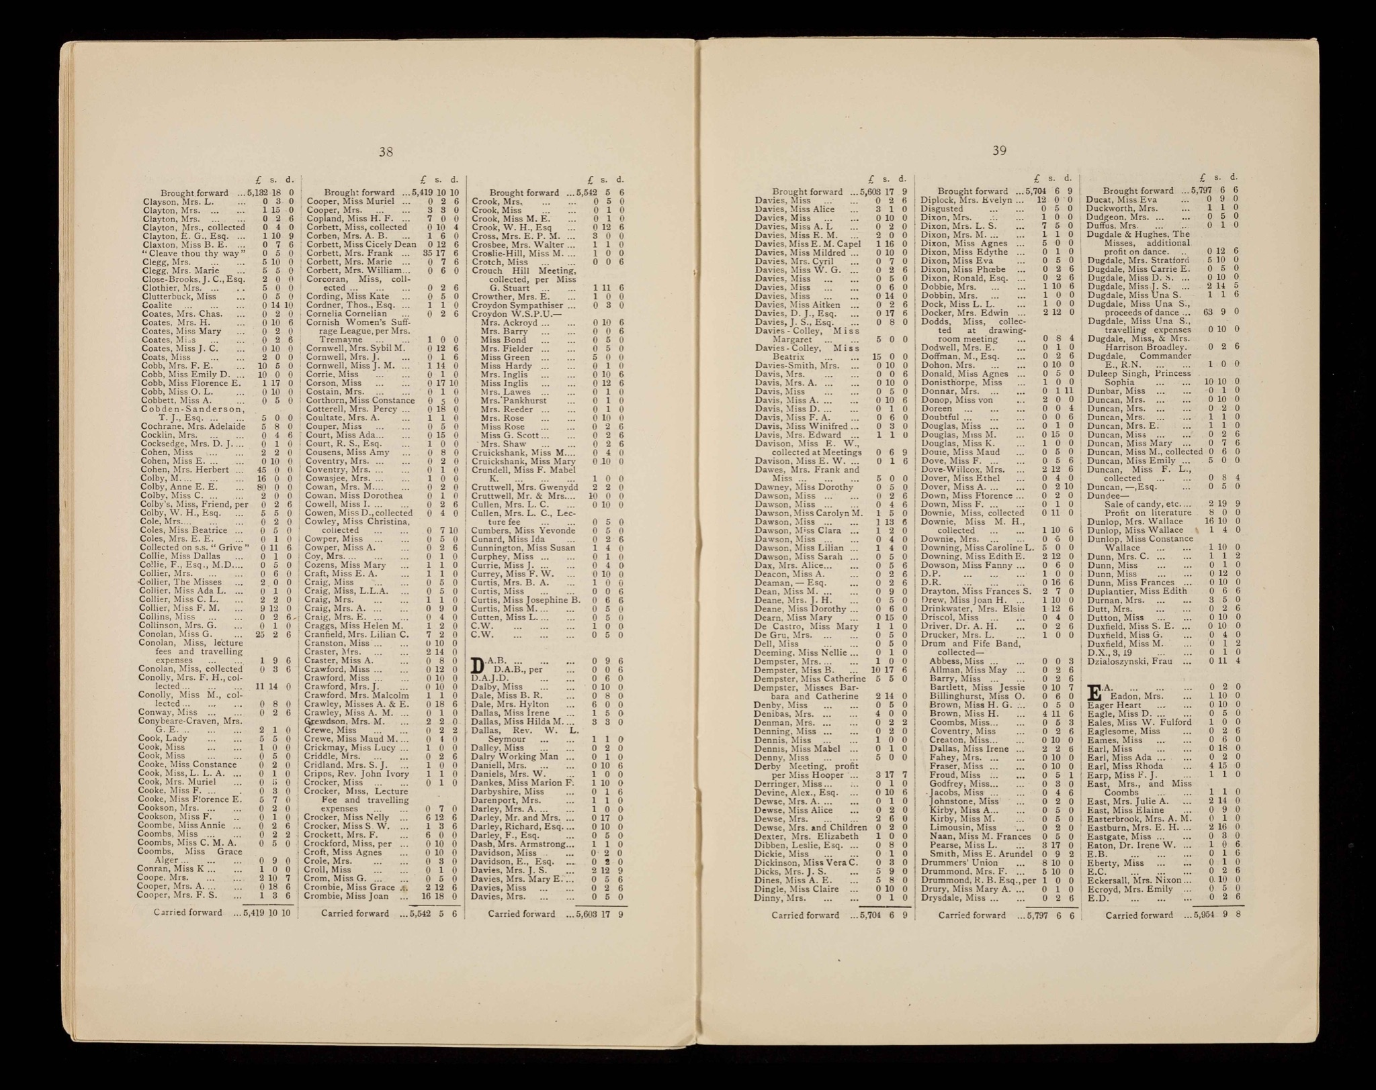
List of subscribers from the Fourth annual report of The National Women's Social and Political Union including cash statement and subscription list for the year ended February 28th, 1910, and accounts of the Woman's Press, January 1st-December 31st, 1909; via digital.library.lse.ac.uk

Slide 10
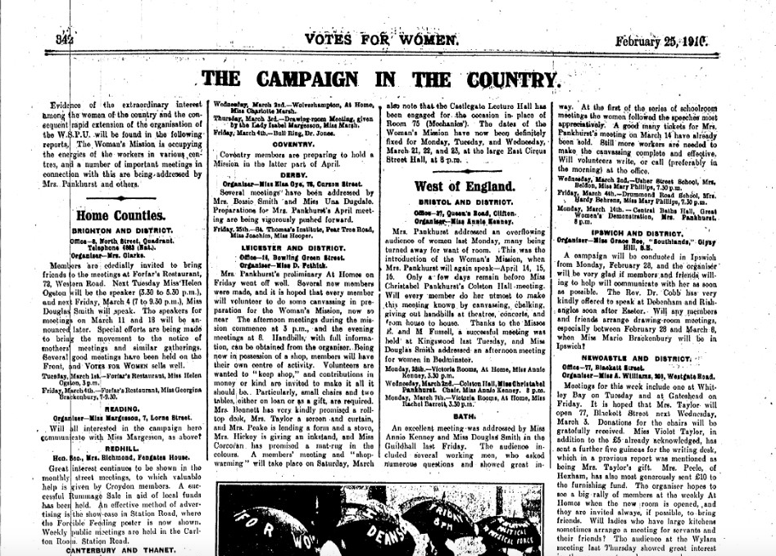
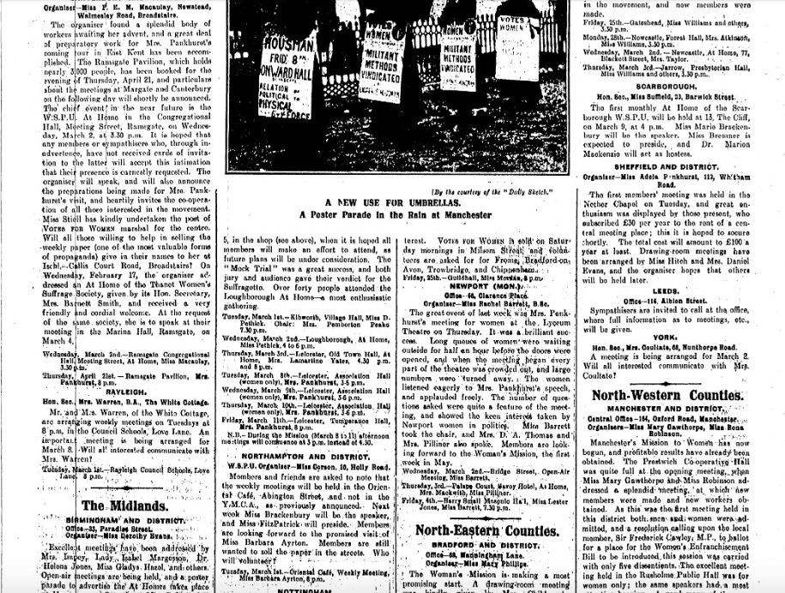
Votes For Women newspaper 25 February, 1910
Second mention of York’s branch and Annie Coultate as Honorary Secretary

Slide 11
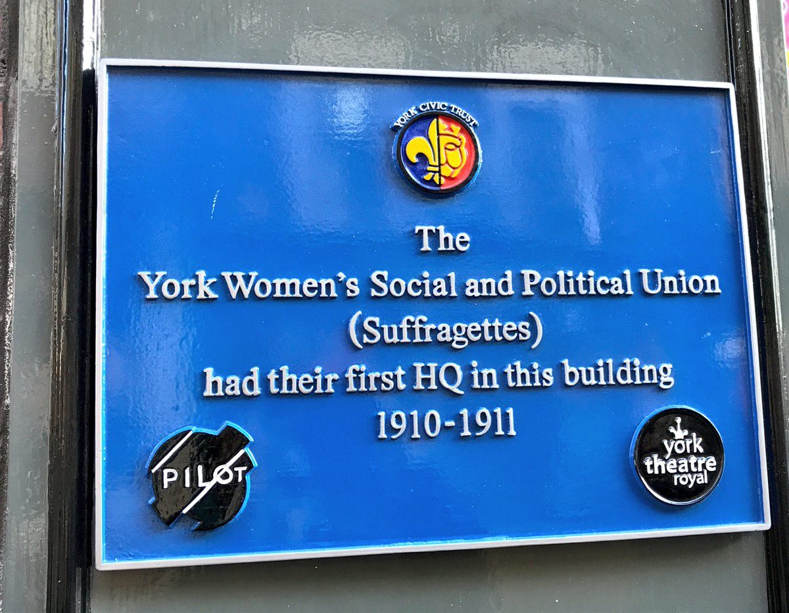
36 Coney Street, York (35 Coney Street at that time)
via yorkcivictrust.co.uk

Slide 12
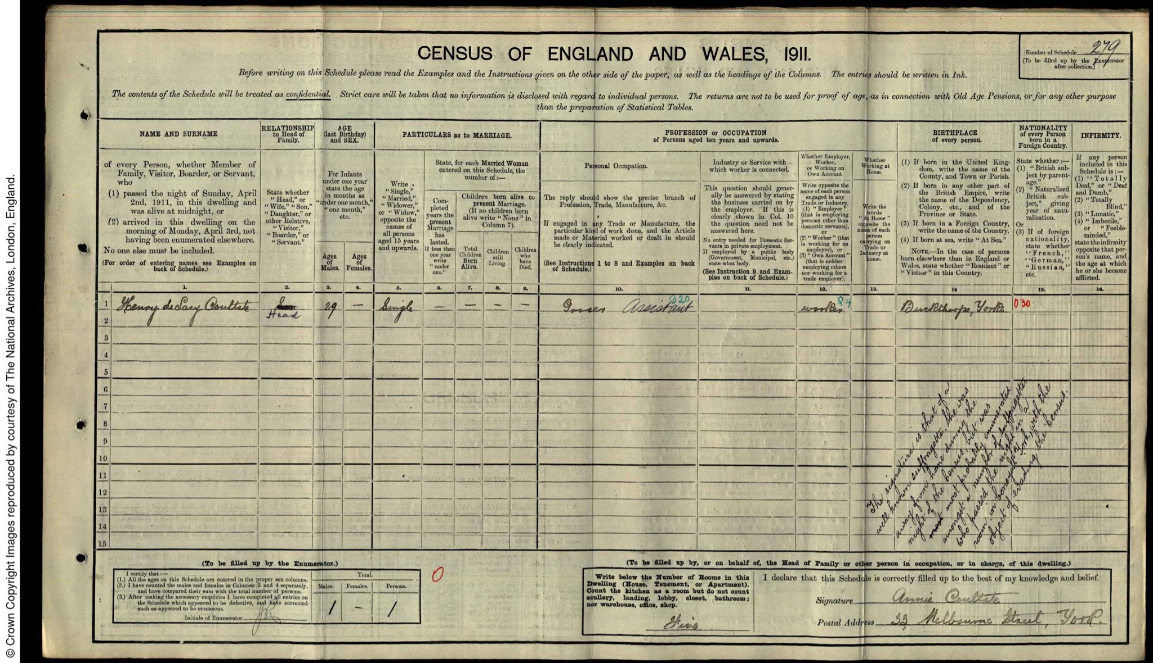
The 1911 Census in York

Slide 13
Involvement with the Suffragette Movement
Votes For Women newspaper 25 February, 1910

Slide 14
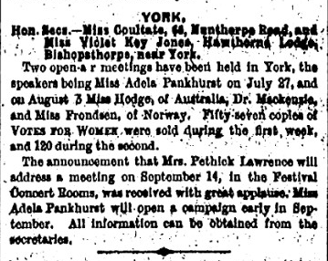
Votes For Women newspaper, York local report, 1910, 12 August

Slide 15
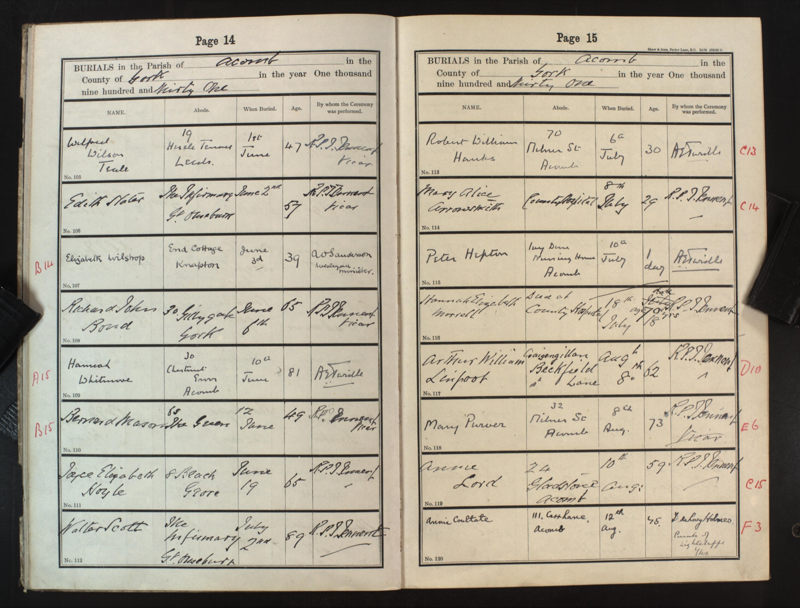
Death: 1931
First name(s) Annie
Last name Coultate
Age 75
Birth year 1856
Death year 1931
Burial year 1931
Burial date 12 Aug 1931
Burial place Acomb, St Stephen
County Yorkshire (Ainsty & City of York)
Country England
Yorkshire Burials

Slide 16
References
1891 England, Wales & Scotland Census
1911 York Census
City of York Electoral register 1906
Frank Coultate 1881 Marriage certificate
Frank Coultate Yorkshire Banns 1881
J. Liddington, Rebel Girls: Their Fight for The Vote. 2006; repr., London: Virago Press, 2013.
K. Cowman, The Militant Suffragette Movement in York. York: Borthwick Institute, 2007
Michael Waters “The Campaign for Women’s Suffrage in York and the 1911 Census Evasion”. Yorkshire Archaeological Journal 2018, 90:1, 178-194.
Suffragettes, York Civic Trust, https://yorkcivictrust.co.uk/heritage/civic-trust-plaques/suffragettes/. Accessed 26 November 2021.
Votes For Women newspaper, 12 August 1910
Votes For Women newspaper 25 February, 1910
Women’s Social and Political Union Fourth Annual Report 1910
York Electoral register 1912
Yorkshire Burials 1931

