Slide 1
Ethel Maud Steigman[n]
Circa. 1883 - unknown
Group 3 - Abi, Lauren and Madeline

Slide 2
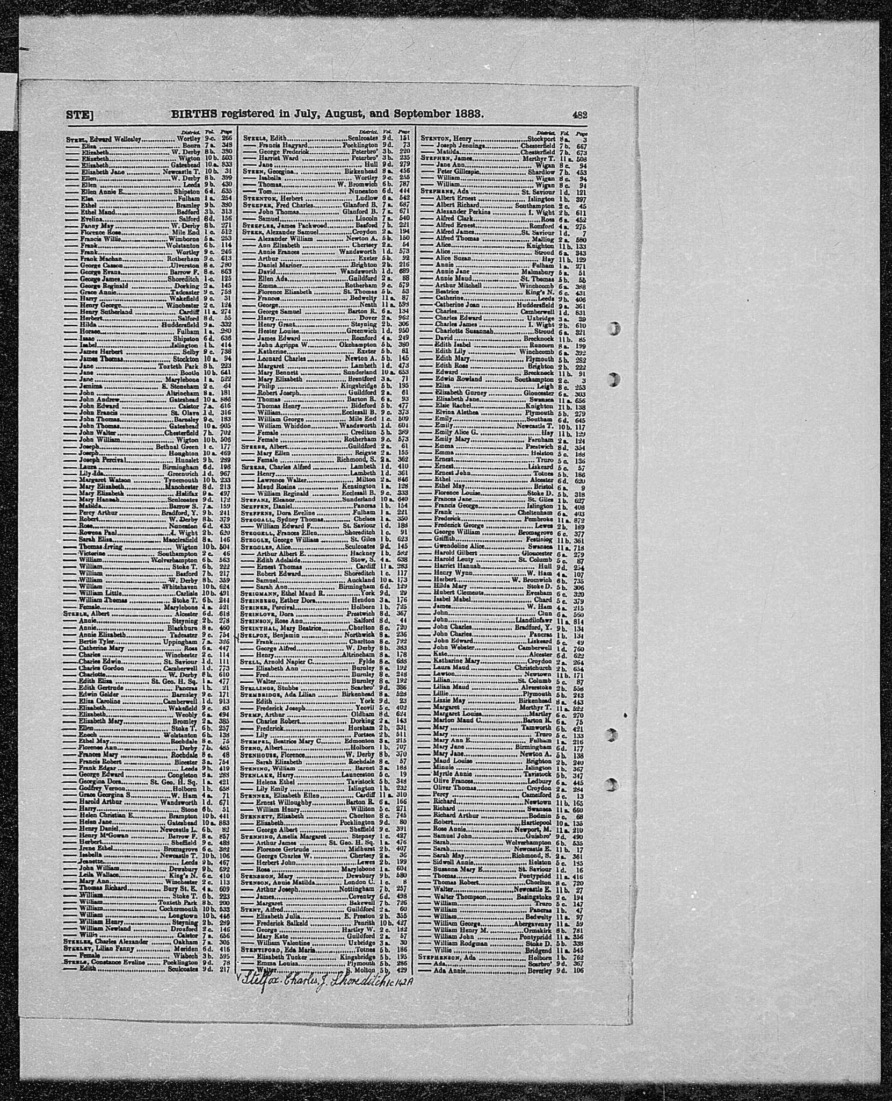
Birth records for Ethel in 1883
Source: England & Wales Birth Records 1883, p. 482, accessed from FindMyPast.com

Slide 3
Who was Ethel Maud Steigman[n]?
Grew up to become a photographic Black and White Artist
Daughter of German Immigrant parents who ran a Butchers shop
Born circa 1883 in York
“She is an interesting individual because she had to establish her life in a different society to where her parents grew up and probably faced discrimination from the community around her, yet she pursued what she was interested in, photography.”

Slide 4
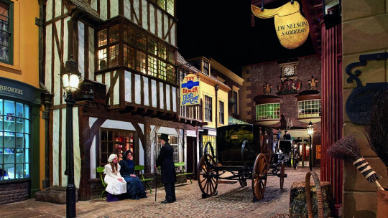
Links to the Castle Museum
Source: Visit York, https://www.visityork.org/business-directory/york-castle-museum
Notes:
The history of Ethel and her larger family could help to shape a wider picture of the impact that immigrant communities had on York’s high street’s such as Kirkgate. It has raised a number of questions for us, for example; ‘To what extent is this history currently hidden where it could be more prominent?’ And ‘Did immigrant communities fill gaps where English businesses were failing?’ The Steigman[n]'s story could prompt further research into this.
Furthermore, if archives of Steigman[n]’s work were to be found, or if we learned more about her studio, they would aid in building a greater portfolio of female artists in Victorian York, and enhance our understanding of this part of York’s mercantile history.

Slide 5
German Migration & Family Context
Previous affiliations with Britain prior to immigration
John Christian Steigman[n]
In the 1871 there were 33,000 Germans living in England and Wales
Hohenlohe in the South West of Germany, which was renamed Baden-Wurttemberg
Between 1881-1911 there were approximately 1,200 German Butchers in England

Slide 6
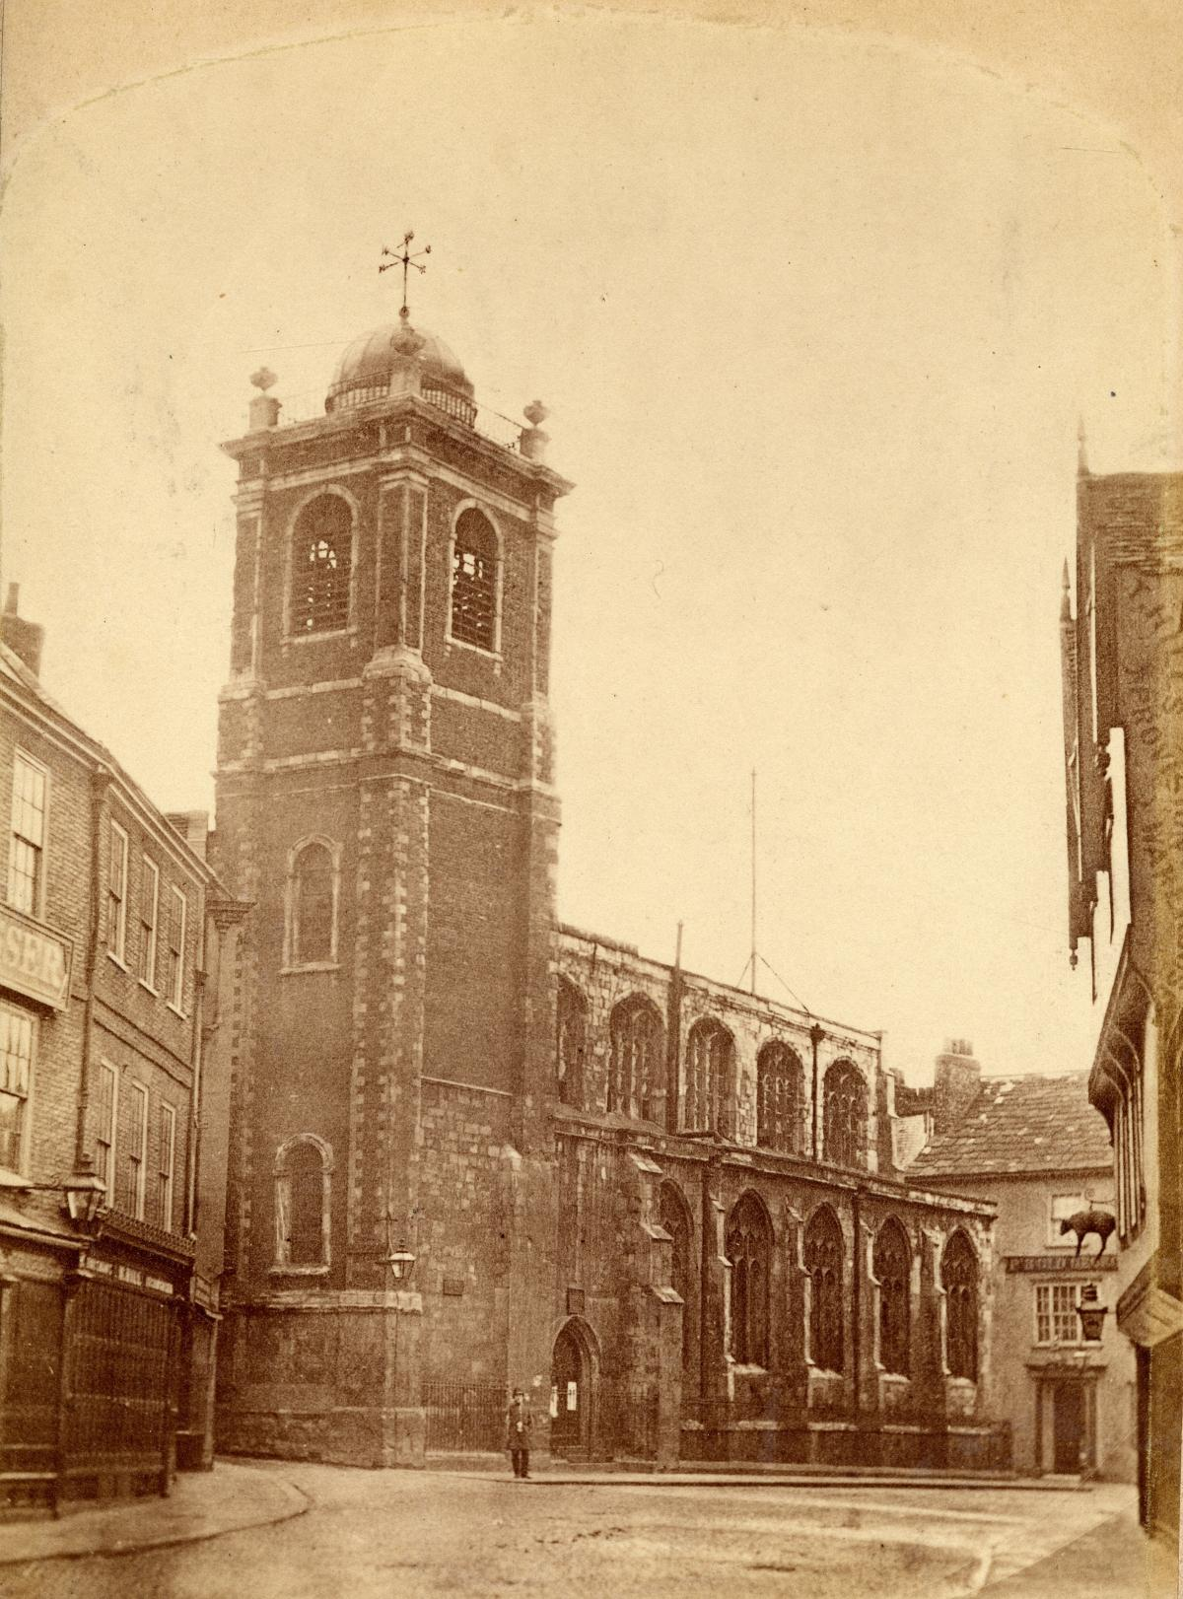
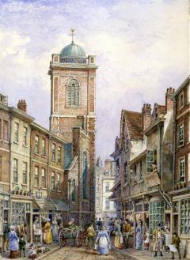
The church where Ethel’s parents were married
Sources:
(Left) St Crux Tower and Pavement from the Shambles, 1881, by William Richardson, York Art Gallery
(Right) York St Crux Church pre 1887 demolition, accessed from https://www.yorkpress.co.uk/news/16372033.going-going-gone-6-photos-showing-demolition-st-crux-130-years-ago/

Slide 7
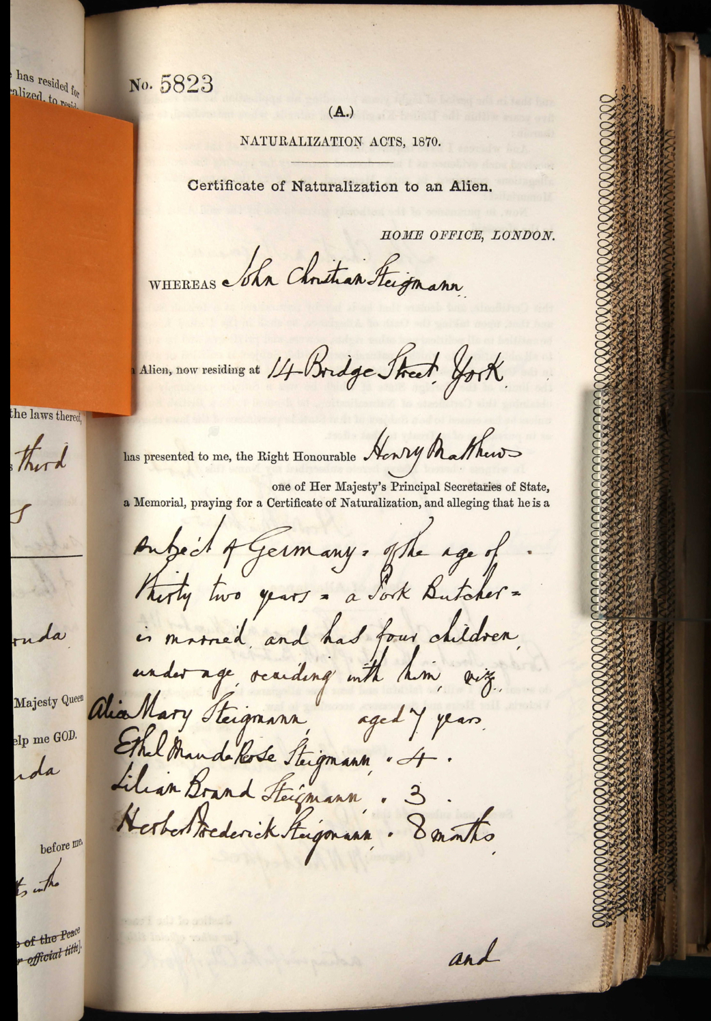
Ethel is listed as 4 years old at the time of her parents naturalisation.
Source: John Christian Steigmann
in the UK, Naturalisation Certificates and Declarations, 1870-1916 accessed from Ancestry.com

Slide 8
Family Life in York
Ethel was one of 8 children
She was born at her father’s butchers on 14 Bridge street where the family also lived
John Christian Steigman[n] was an overseer of Micklegate and part of the Royal Agricultural Society

Slide 9
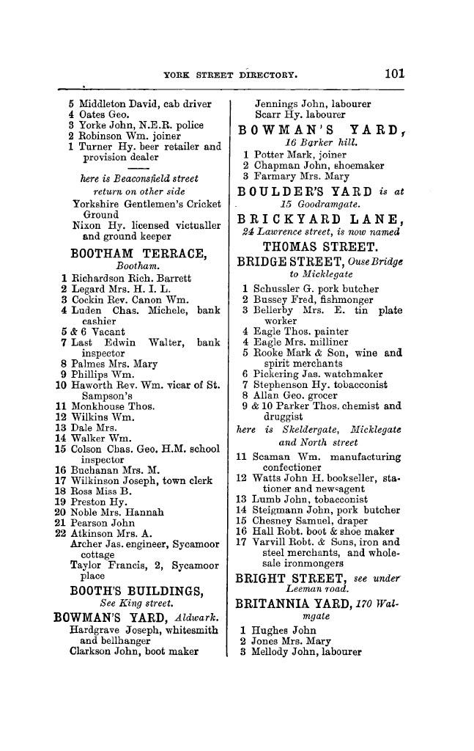
Evidence of Steigman[n]’s butchers in the York Directory
Source: White’s Directory of York 1895, accessed from University of Leicester Special Collections online

Slide 10
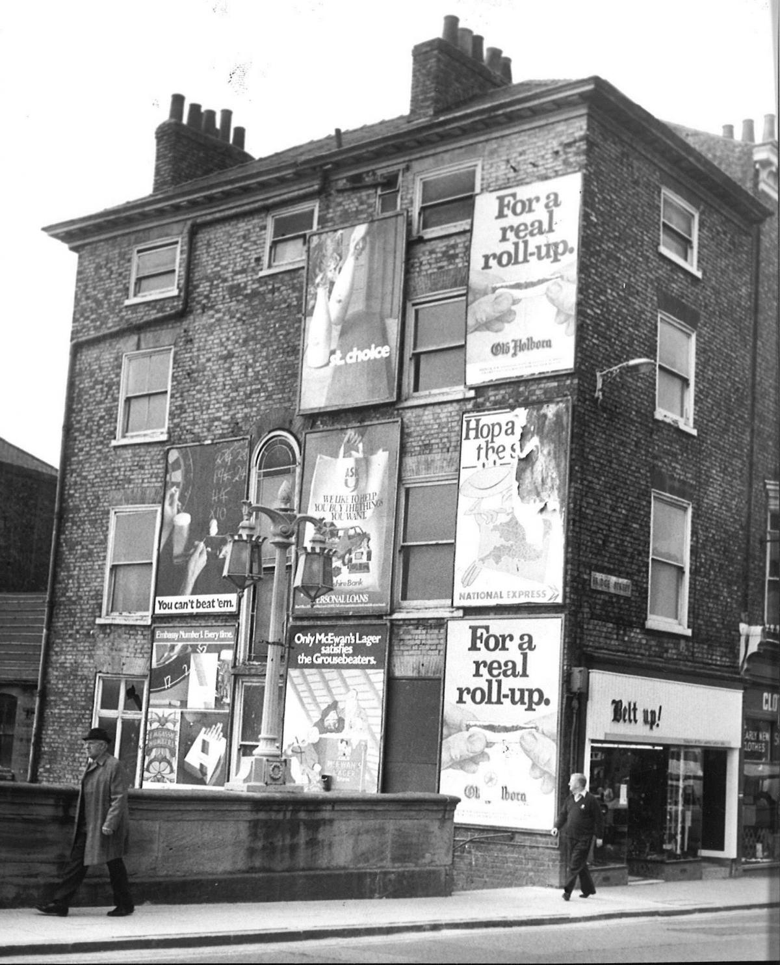
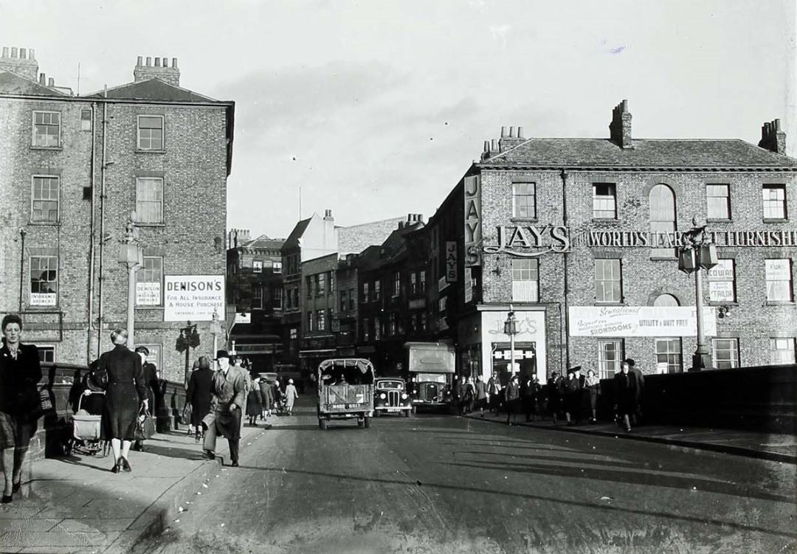
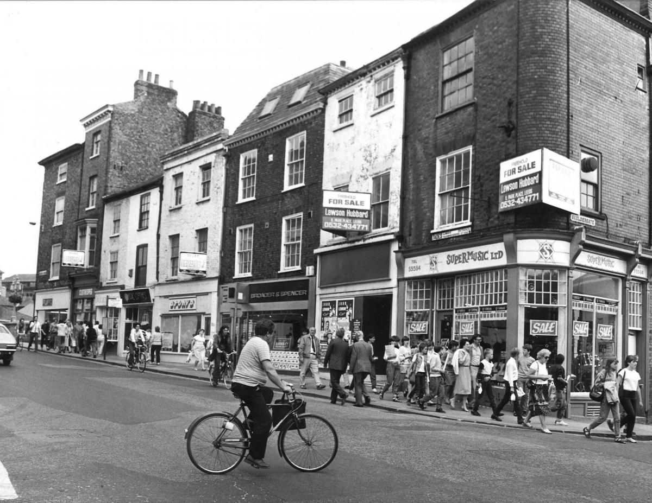
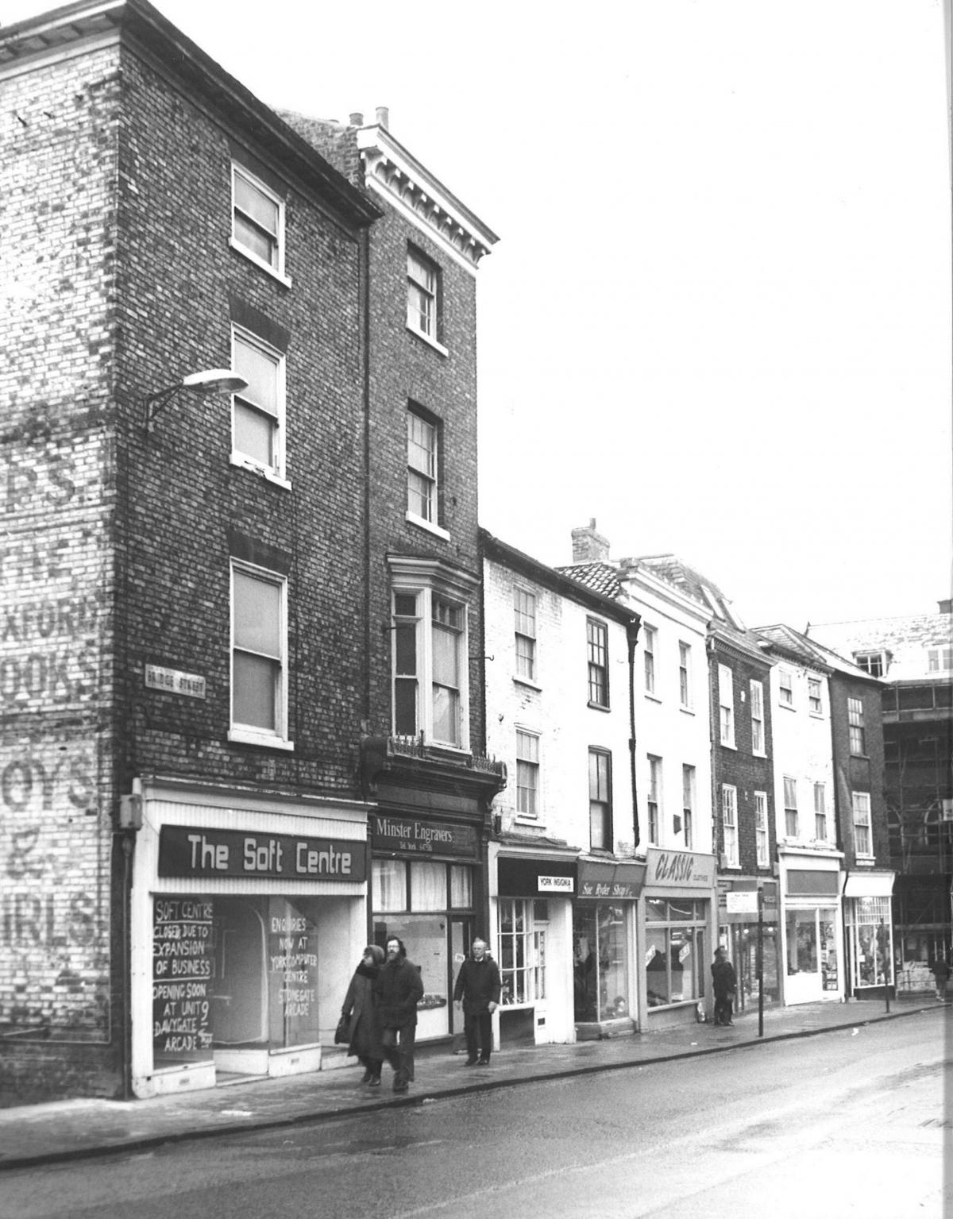
Source: images of Bridge Street, likely taken some time after the Steigman[n]’s stopped trading, accessed from https://www.yorkpress.co.uk/news/14742306.59-old-photos-of-skeldergate-bridge-street-queens-staith-and-ouse-bridge/#gallery0

Slide 11
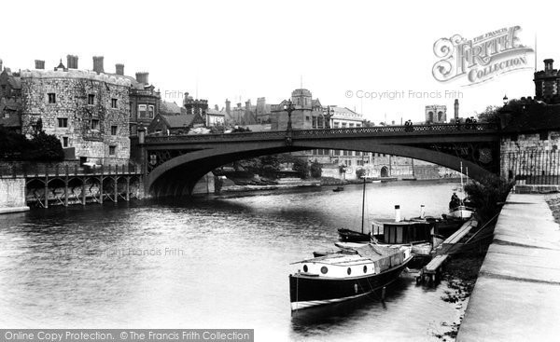
How York would have looked when the Steigman[n]’s ran the butchers on Bridge Street
Source: Lendal Bridge, c. 1909, around the time the Stiegman[s] lived in the area, accessed from https://www.britain-magazine.com/features/region/yorkshire/york/historic-york-in-pictures/

Slide 12
17 year old Ethel listed in the 1901 census
Source: 1901 Census England and Wales, Steigmann family, 10 Southlands Rd. York, accessed from FindMyPast.com

Slide 13
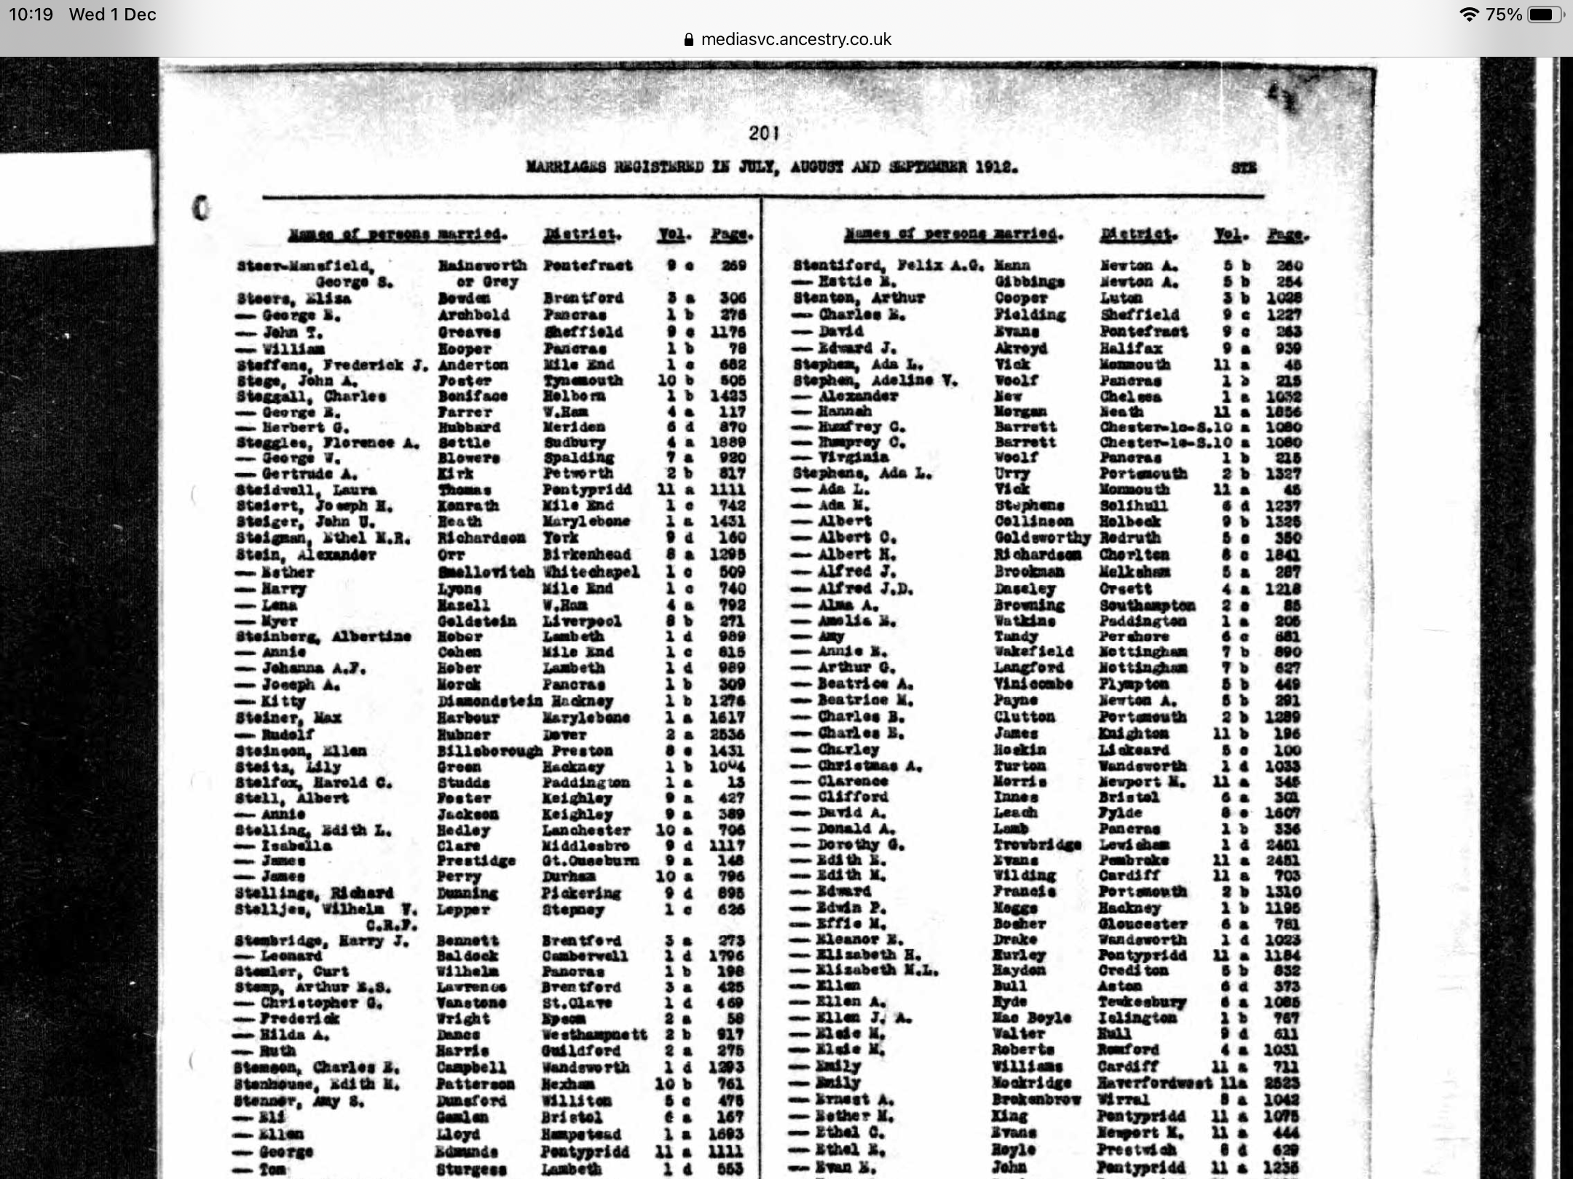
Record of Ethel’s marriage to Richardson
Source: England & Wales, Civil Registration Marriage Index, 1837-1915, accessed on Ancestry.com

Slide 14
Inscription
In Loving Memory of
John Christian Steigman
Dearly Beloved Husband & Father
Born 8th of April 1853
Died 14th of May 1902
“Lead Kindly Light”
Also Florence Frederica Steigman
Born May 10th 1889
Died July 9th 1889
Beatrice Blanche Steigman
Born July 27th 1892
Died Sept 28th 1892
“Safe in the arms of Jesus”
Also Arthur A Steigman
Killed in Action in France Oct 2nd 1916
Aged 26 years
Also Harold Edgar Died June 10
th 1925
Aged 30 Year
Also Rosine Catherine Beloved Mother
Died Sept 8th 1929 aged 68
The Memorial of the Steigman[n] family at York Cemetery
Source: Friends of York Cemetery 1st World War Military Trail, 2017

Slide 15
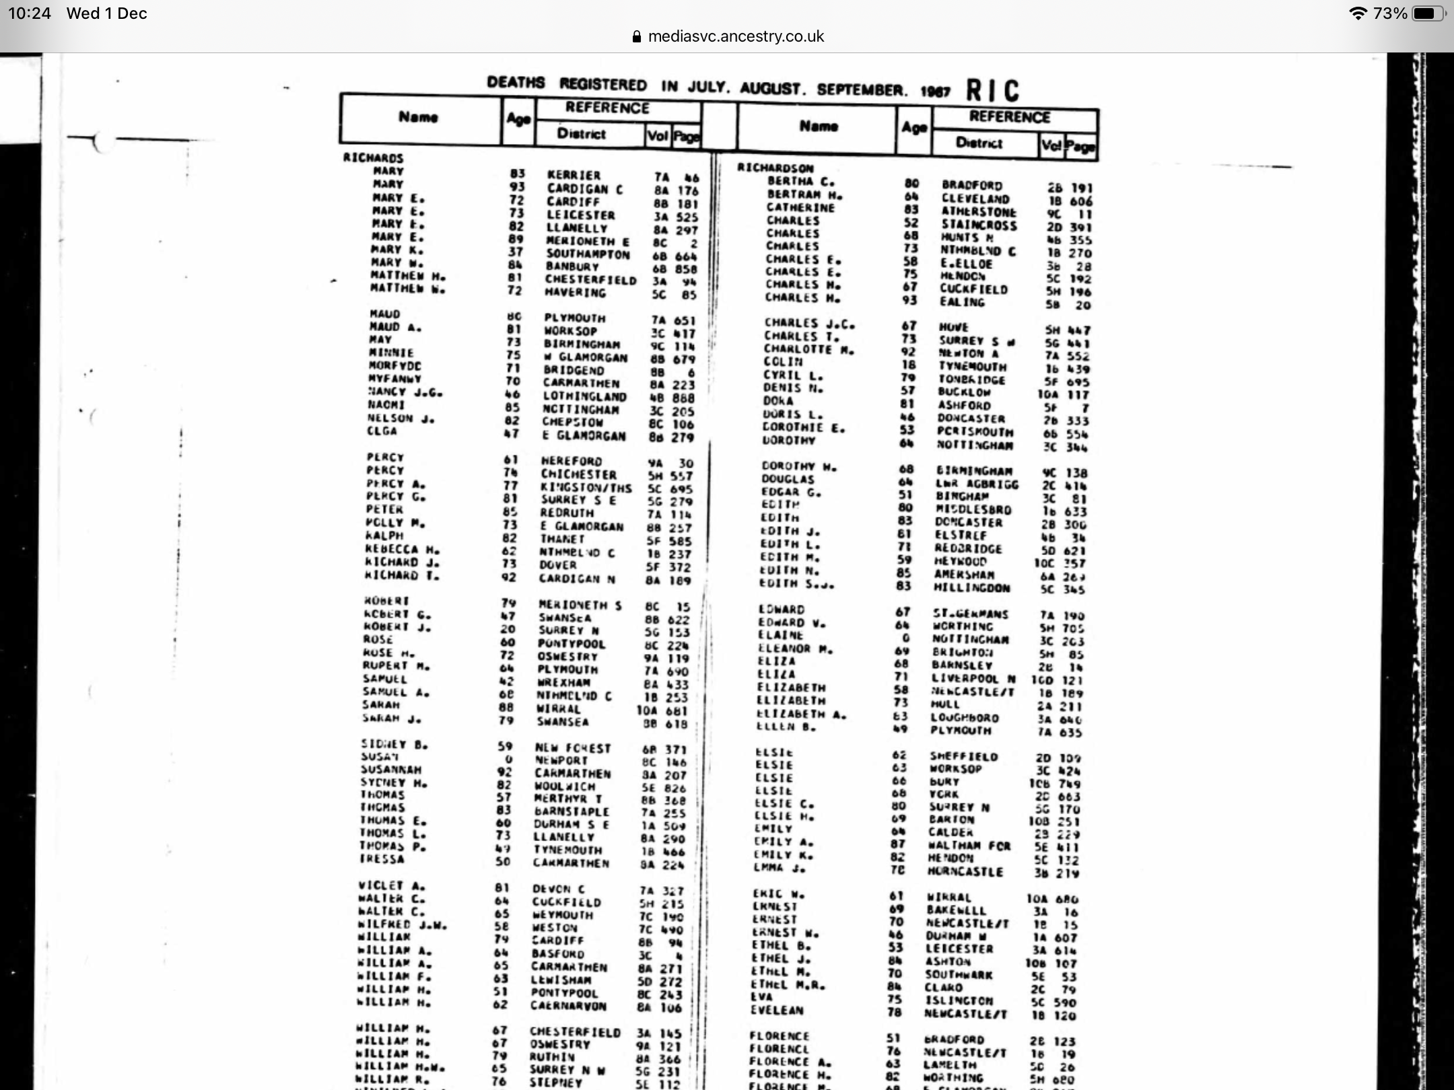
Record of Death for a Ethel M R Richardson in 1967
Source: England & Wales, Civil Registration Death Index, 1916-2007 accessed from Ancestry.com

Slide 16
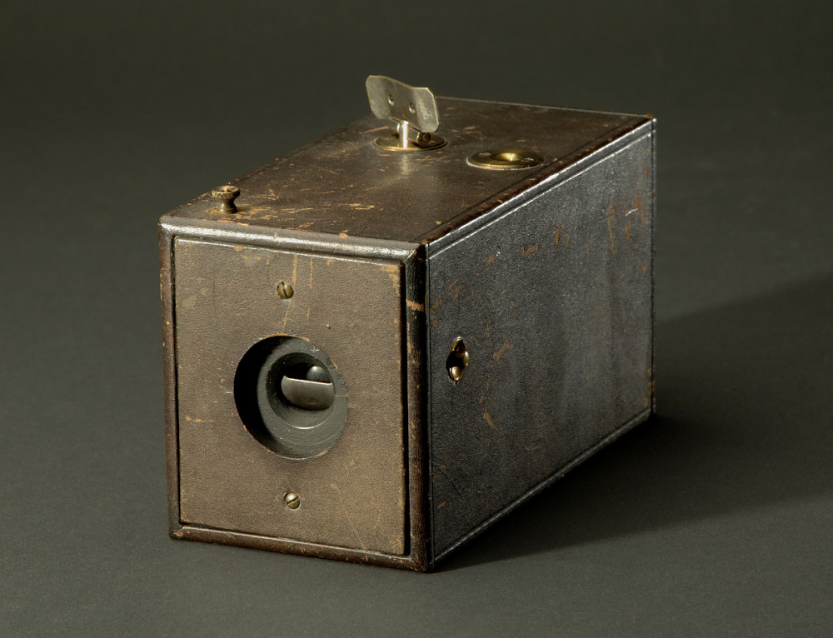
Ethel as a Photographer
Worked as a photographic black and white artist
Many working class women at the time where becoming involved in the industry as studio assistants
The invention of the Kodak camera democratizing the art
Source: 1888 Kodak Camera, Serial No. 540, accessed https://americanhistory.si.edu/collections/search/object/nmah_760118
Notes:
In the census records of 1911 Ethel is recorded as a ‘photographic black and white artist’. The death of her father in 1902 may have had a significant impact on her family life, as by 1911 her family no longer employed a maid, and it seems that all of her siblings (herself included) were working or married. It is possible then that their change in fortunes prompted Ethel to pursue a career outside of the home, to help support her family. This tells us a lot about who Ethel may have been, as she may have used her connections and resources to support her family and also challenge contemporary gender roles around women working, and all this during a period of growing anti-german sentiment.

Slide 17
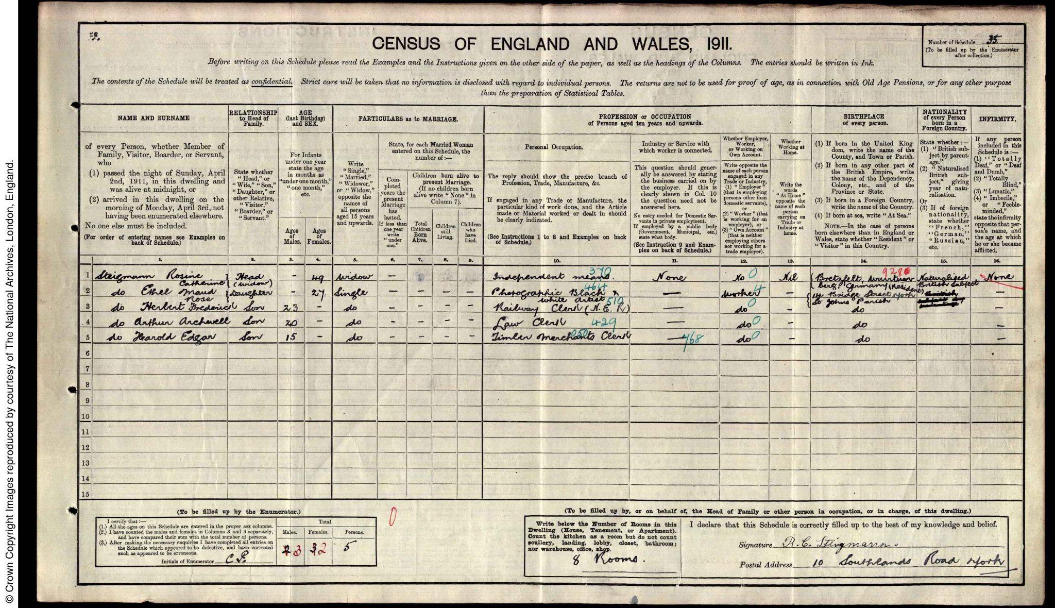
The 1911 census where Ethel lists her occupation as “Photographic black and white artist”
Source: 1911 Census England and Wales, Steigmann family, 10 Southlands Rd. York, accessed from FindMyPast.com
Notes:
As you can see from the slide, this is where the census first recorded Ethel as a photographer. The context of photography at this time may also be significant to how she became involved. Women who had previously been barred from artistic circles and unable to train in academies could engage with photography, during a time when more women challenged prevailing ideas about gender roles. Earlier photographers who were women often needed wealth and leisure time to pursue it, owing to how costly it was. But after Kodak's breakthrough camera was invented in 1888, the art became more affordable and democratised, and many camera advertisements became aimed at women, capturing the spirit of the ‘New Women’ who were seeking social and economic freedoms. Ethel fits the role of one of these ‘New Women’ perfectly.
From the 1850s, while more wealthy women experimented with photography as artists in their own right, many working class women were employed by studios as assistants.

Slide 18
Potential places Ethel may have worked in York
(Left)
Source: Directory of York 1885, accessed from University of Leicester Special Collections online
(Right)
Source: White’s Directory of York 1895, p. 481, accessed from University of Leicester Special Collections online
Notes:
As you can see on the slide, during the 1880s and 90s a number of photography studios were operating in York. As recorded in George Stevens Directory of York, there were 18 photography studios listed in York in 1885. The next decade, in 1895, there were 12, but this was in addition to two photographic dealers. This may be how Ethel was involved in the art, and could earn a wage whilst also exercising her creativity, and gain some independence. We don’t know exactly how Ethel was a photographic artist, but this opens some interesting avenues for further research.

Slide 19
Summary
Ethel provides an interesting case study into not only what it was like for women in the emerging business of photography, but also how immigrant women fought for a place in the wider community at the time of growing anti-German sentiment.
Opportunities for follow up research
Family and business legacy
Evidence of schooling
Survival of her artistic work

Slide 20
Thank You for listening!

