Slide 1
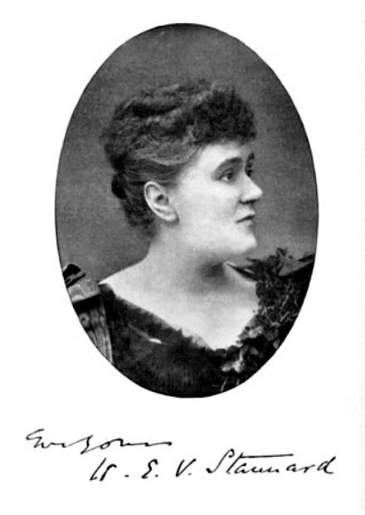
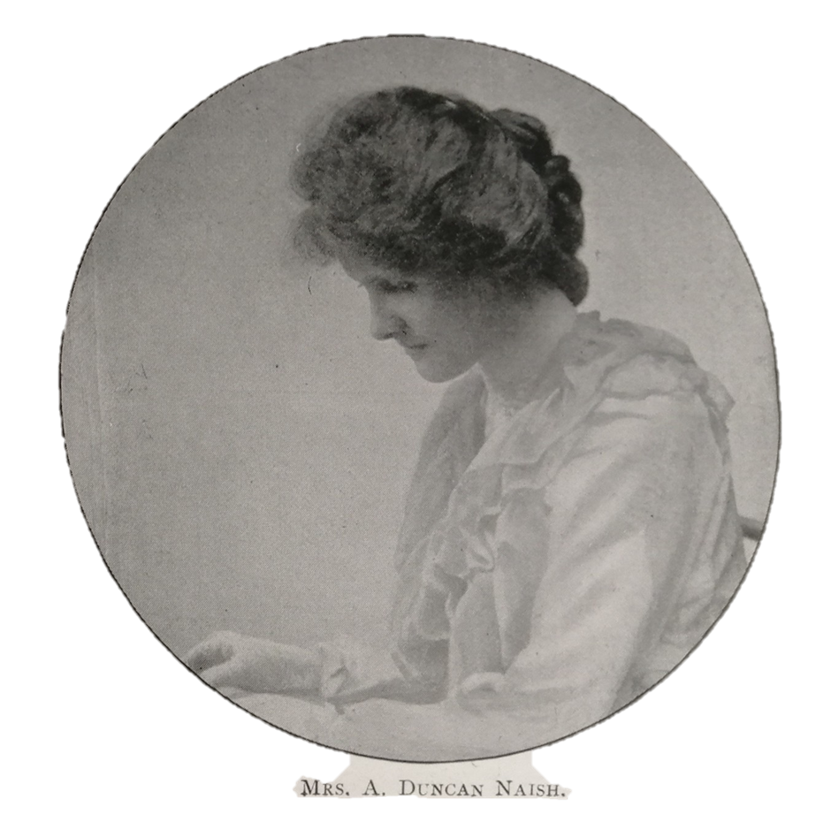
HERStory Project Presentation - Team 5
Winifred Rowntree
&
Henrietta Stannard
Presented by: Hannah Krull, Sophie Davies, Emily Bowen, Maria Witczak

Slide 2
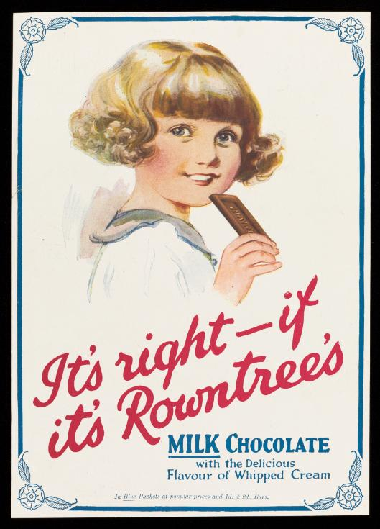
Winifred Rowntree
Winifred Naish née Rowntree
16 October 1884 - 11 March 1915 (age 30)
Youngest child of Joseph Rowntree (1 of 6 children)
A family of English quakers, who were involved in establishing many charitable organizations and trusts to effect social change (Joseph established 3)
9 April 1907 Married Arthur Duncan Naish
Had three children:
1908 Joseph Rowntree
1912 Richard Ellis
1915 Michael John
Rowntree’s Milk chocolate advertisement - YORCM

Slide 3
Honesty Girls Club (1902-c1940)
Provided entertainment and education for working class girls and young women in the Leeman Road area (York)
Needlework was compulsory but they could also learn blouse-making, millinery, part singing, ameteur dramatics, old english folk dancing and modern dancing, swimming, allotment gardening, nature studies and a sunday afternoon class
‘The fun and merriment’ of these classes was followed by ‘quiet reading...and hymn singing’
In 1902 the club originally had 24 members but by 1913 it had 116 members and they had acquired their own purpose built building.

Slide 4
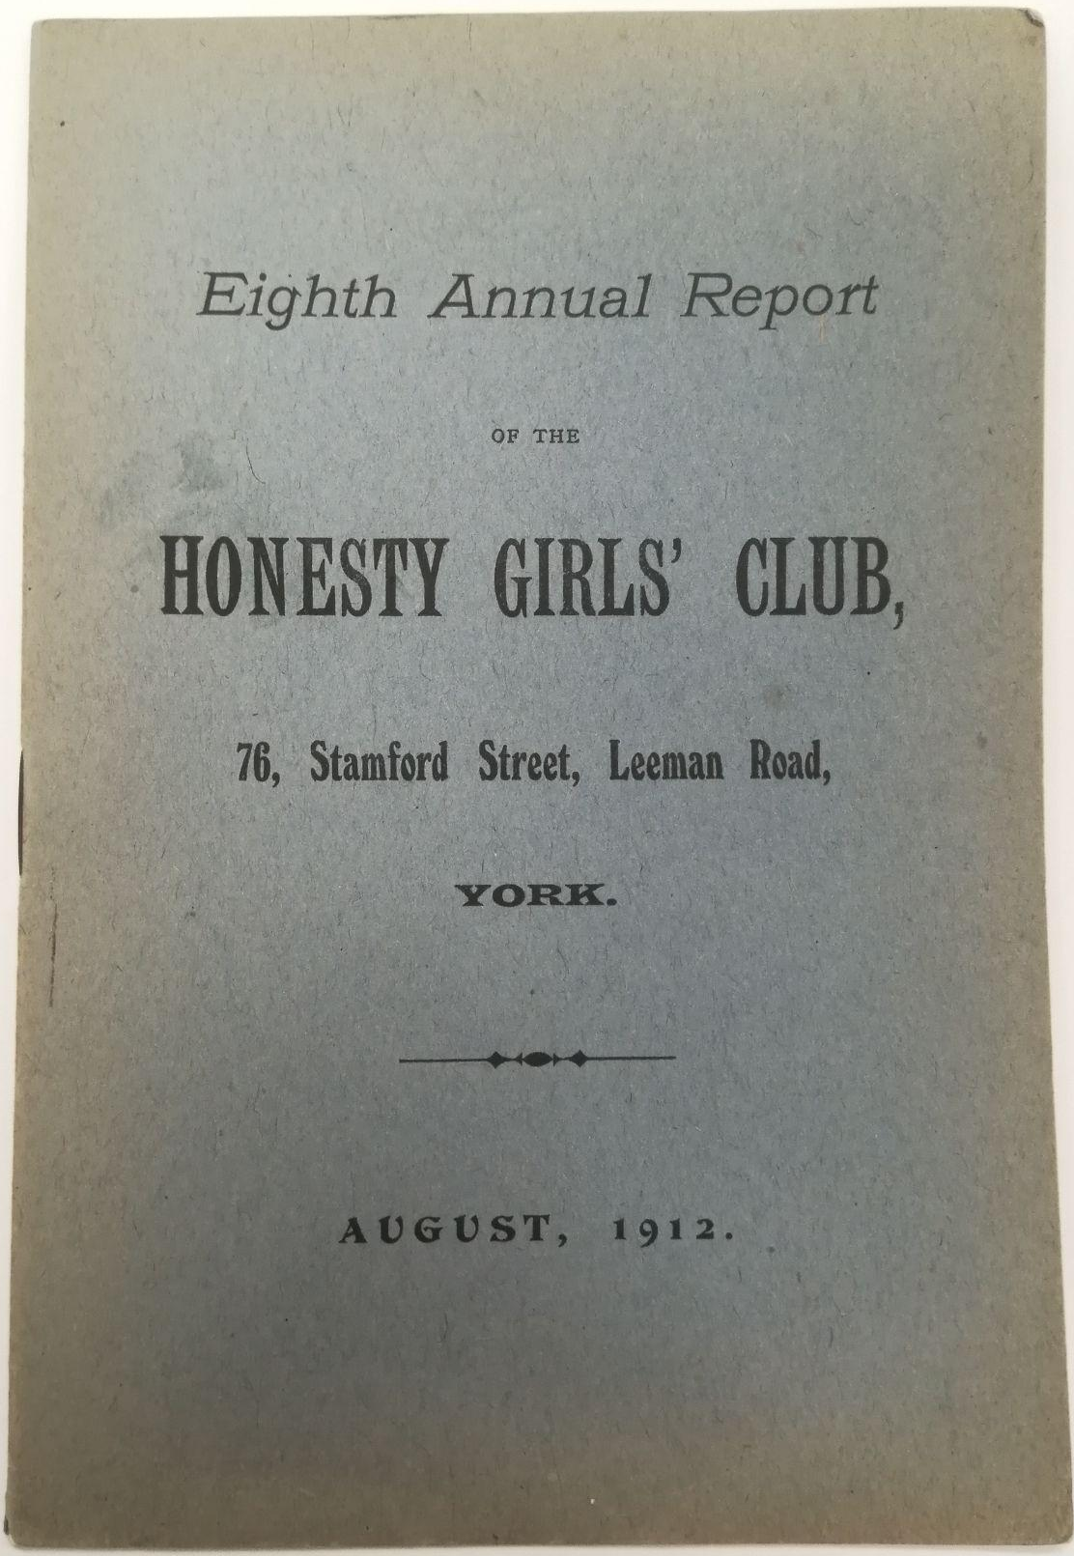
Club Organisation
Club ran by an elected council of 12 seniors
Organised into 5 age groups
They were able to attend until they were 25 or they were married
Certificate of membership after three years
9-11 able to attend ‘drilling classes’
5-9 able to attend play hour run by seniors
Junior meetings (Thursday) aged 11-14
Plain sewing, games and dancing
End with hymns and bible reading
Senior meetings (Monday) aged 15-25
Needlework and dancing
Walk around the gardens of Clifton Lodge in summer
End with hymns and bible reading
Cover sheet of the 8th Annual report of the Honesty Girls Club.
Borthwick Institute For Archives HGC/1/1

Slide 5
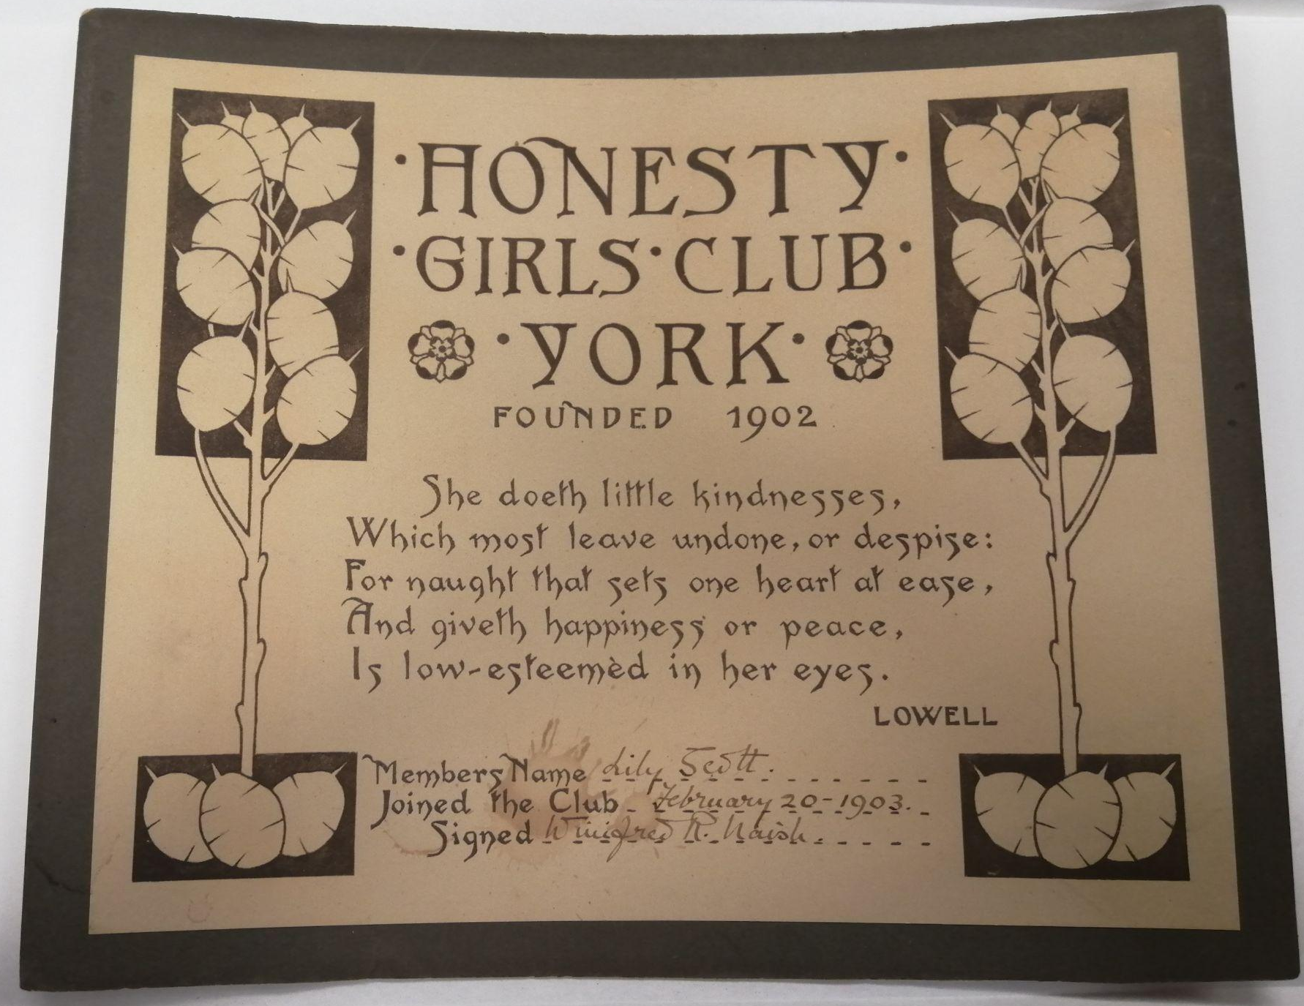
An example of a membership certificate from the year 1903 for a girl named Lily Scott.
Signed by Winifred Naish.
Borthwick Institute For Archives HGC/4

Slide 6
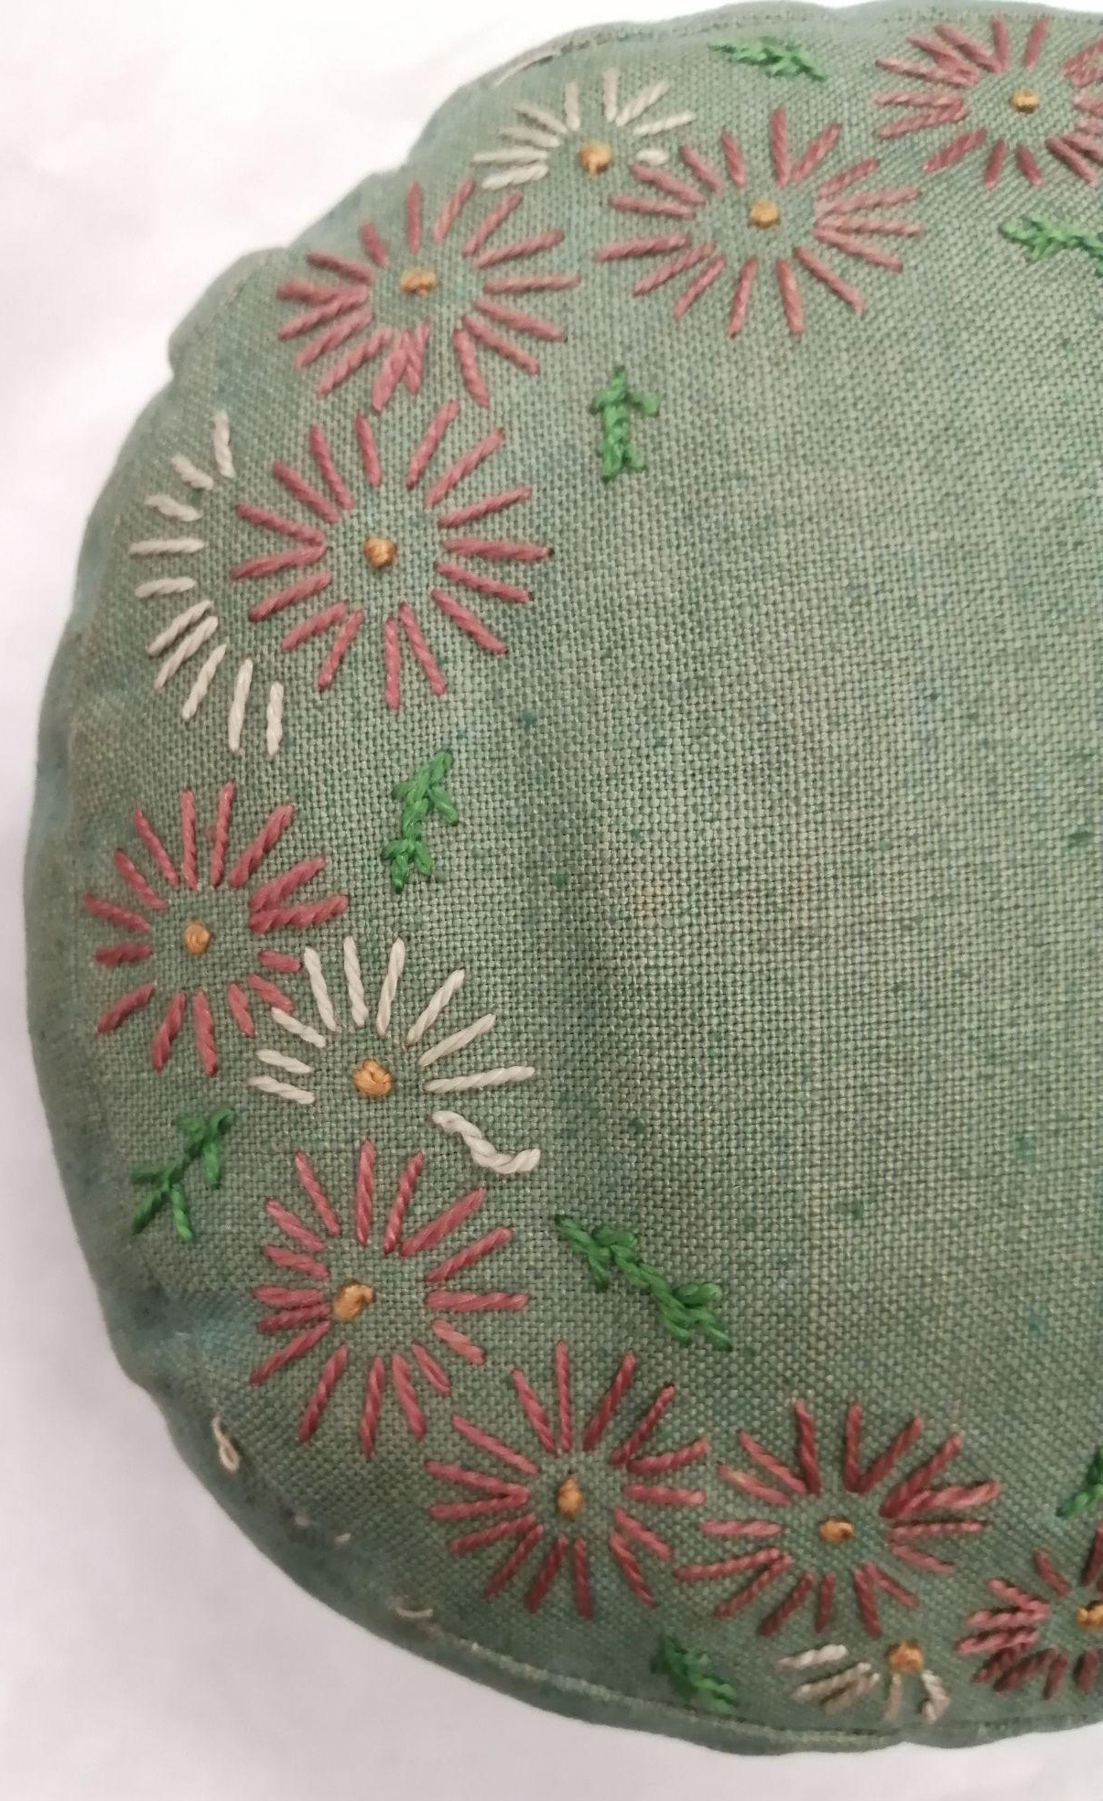
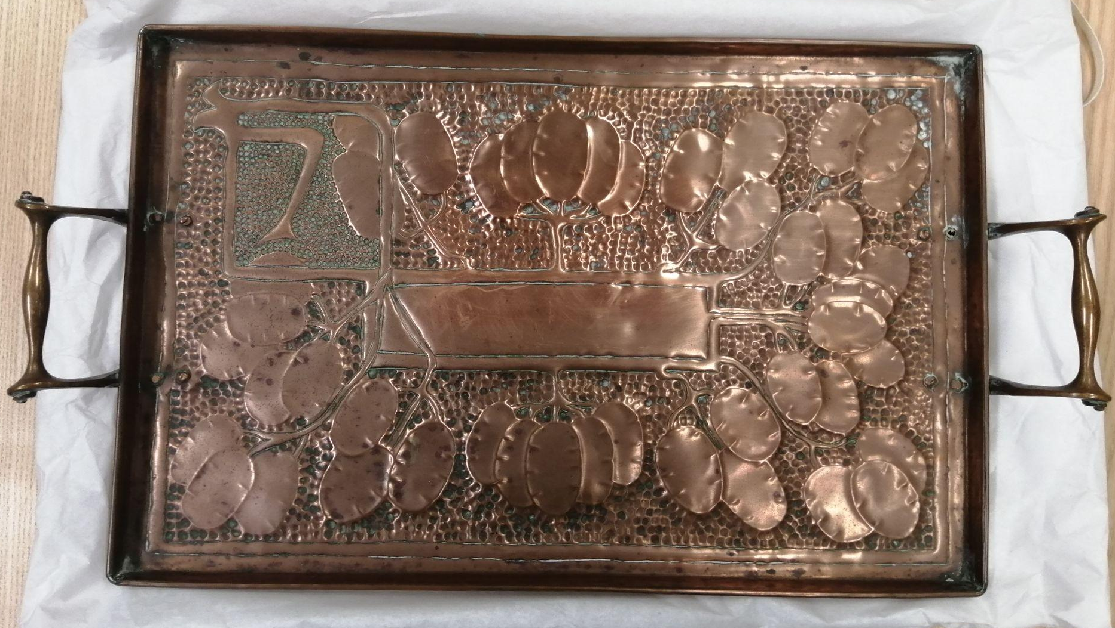
A copper tin and tray made by members of the Honesty Girls Club.
Borthwick Institute For Archives HGC/2-3
An embroidered cushion made by a member of the Honesty Girls Club.
Borthwick Institute For Archives HGC/2

Slide 7
Additional Activities
Tried to benefit the local community through initiatives such as:
‘Guild of Help’ - made baby clothes for local people out of recycled materials
‘Visiting Committee’ - called on any girl who missed a meeting to provide care and wellbeing support
Running events for the local community, such as the annual Christmas party for children in the local workhouse
Annual competitions were held such as a wildflower competition, in which the girl who collected the widest variety would be awarded a prize

Slide 8
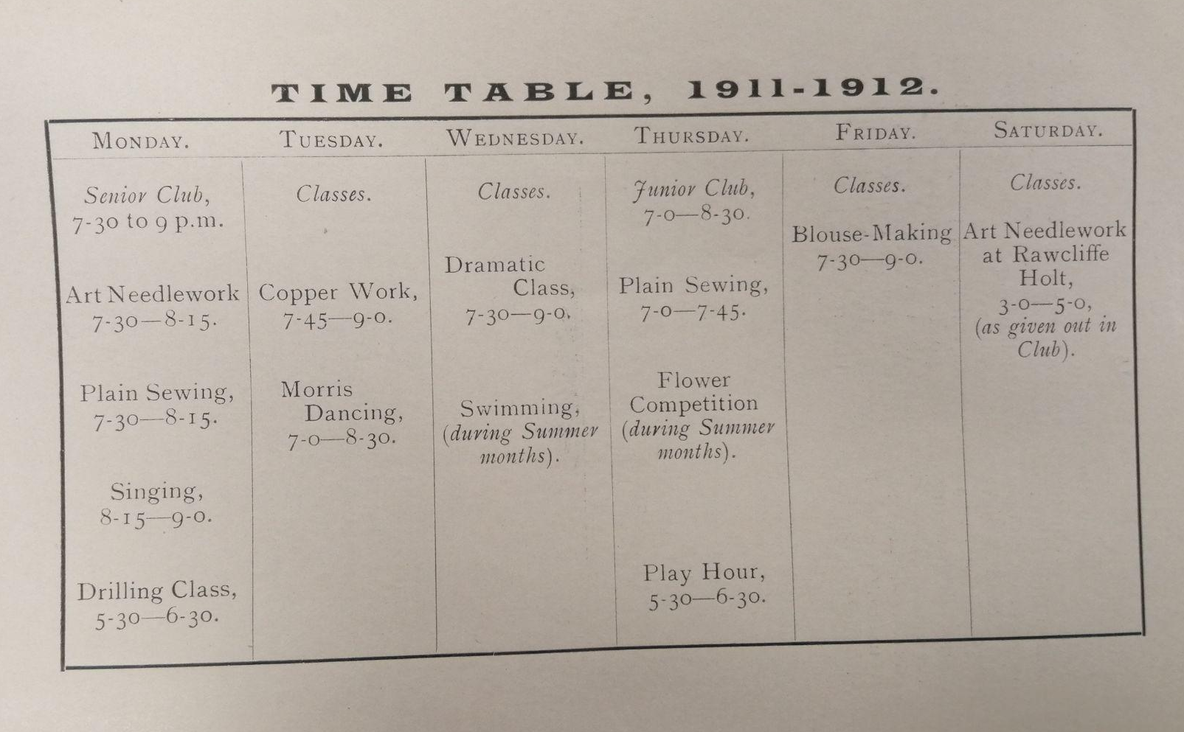
A time table from 1911, displaying the weekly rota of classes held at the Honesty Girls Club. Borthwick Institute For Archives HGC/1/1

Slide 9
Legacy of Winifred Rowntree and the Honesty Girls Club
1915 Arthur Naish took over as president supported by a vice-president, secretary and vice-secretary, all of whom were former members
However, the club was largely run by a committee of twelve girls annually elected from the senior group. These girls were responsible for running evening meetings, deciding which classes would run and finding teachers for them, and organizing any outreach programs
The club eventually ended in the 1940s as numbers failed to increase. The last annual report was published 1940

Slide 10
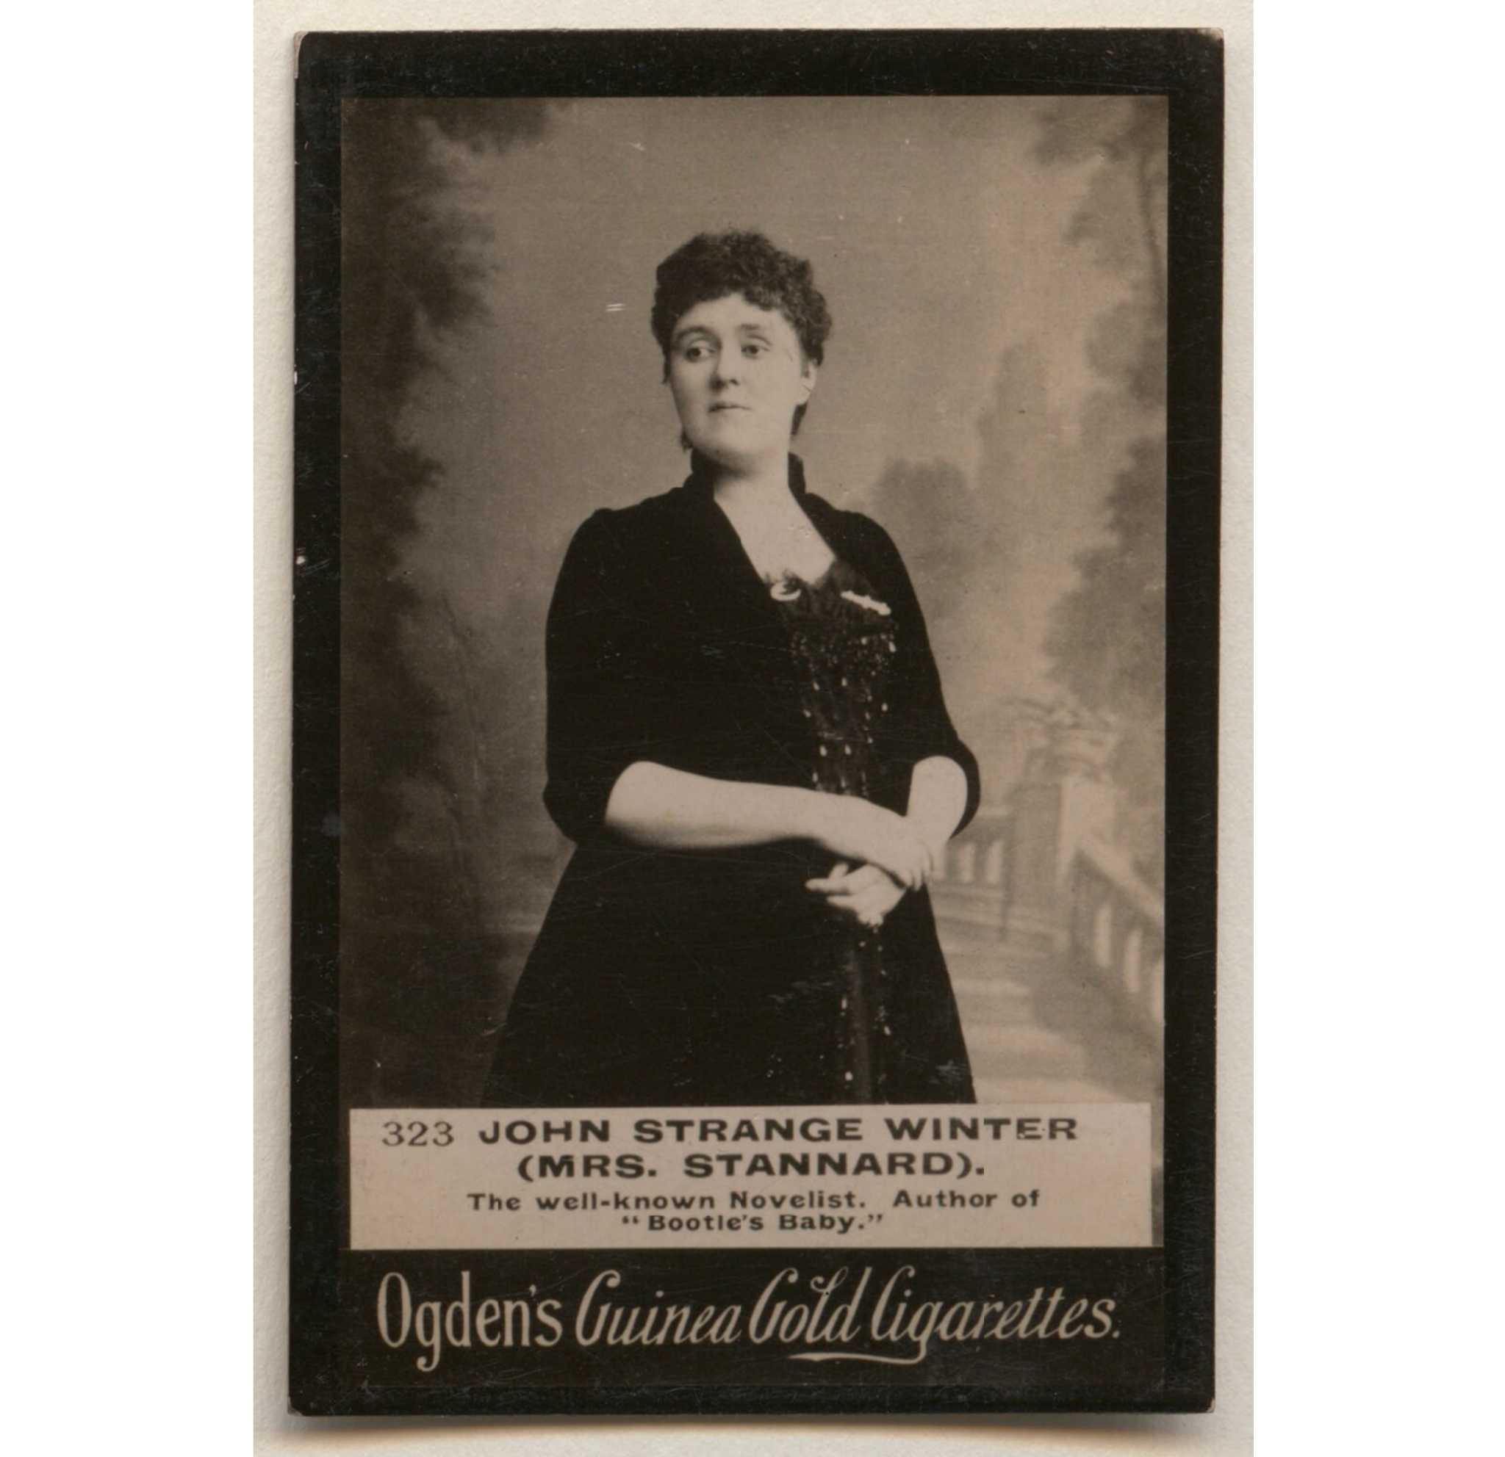
Henrietta Stannard
Henrietta Eliza Stannard, née Vaughan Palmer
13 January 1856 - 13 December 1911 (age 55)
Educated in Bootham House, York
Married Arthur Stannard in 1884 at Fulford, York
Had 4 children: Audrey (Betty), Eliot (Bootles), Violet (Beaufie), Olive
John Strange Winter cigarette card - National Portrait Gallery
Notes:
Born to Emily Catherine Cowling and Henry Vaughan Palmer
Married her husband February 26th 1884 in St Oswald’s Church, Fulford

Slide 11
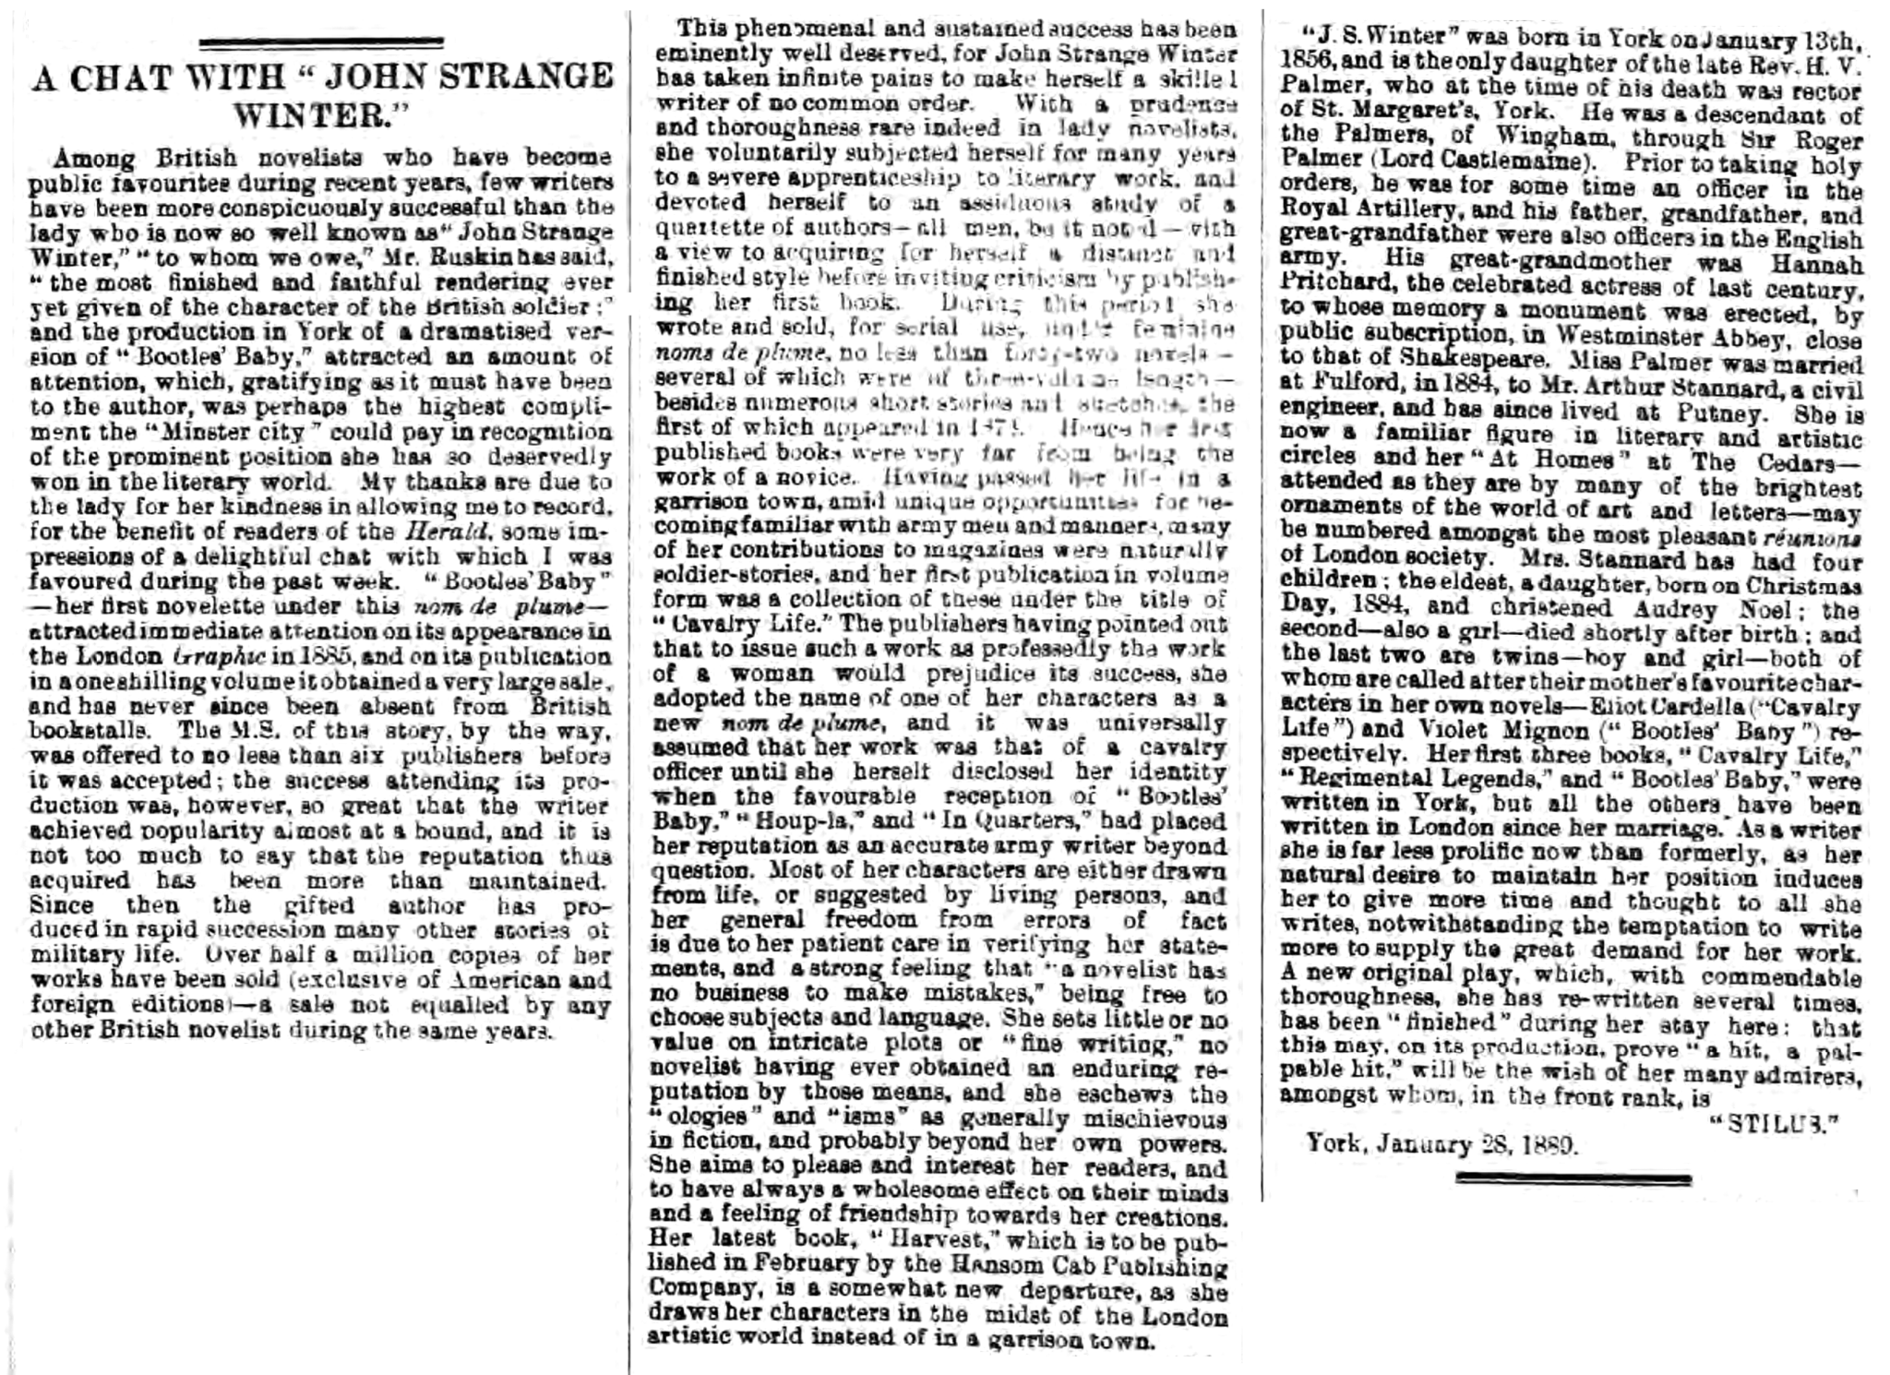
York Herald

Slide 12
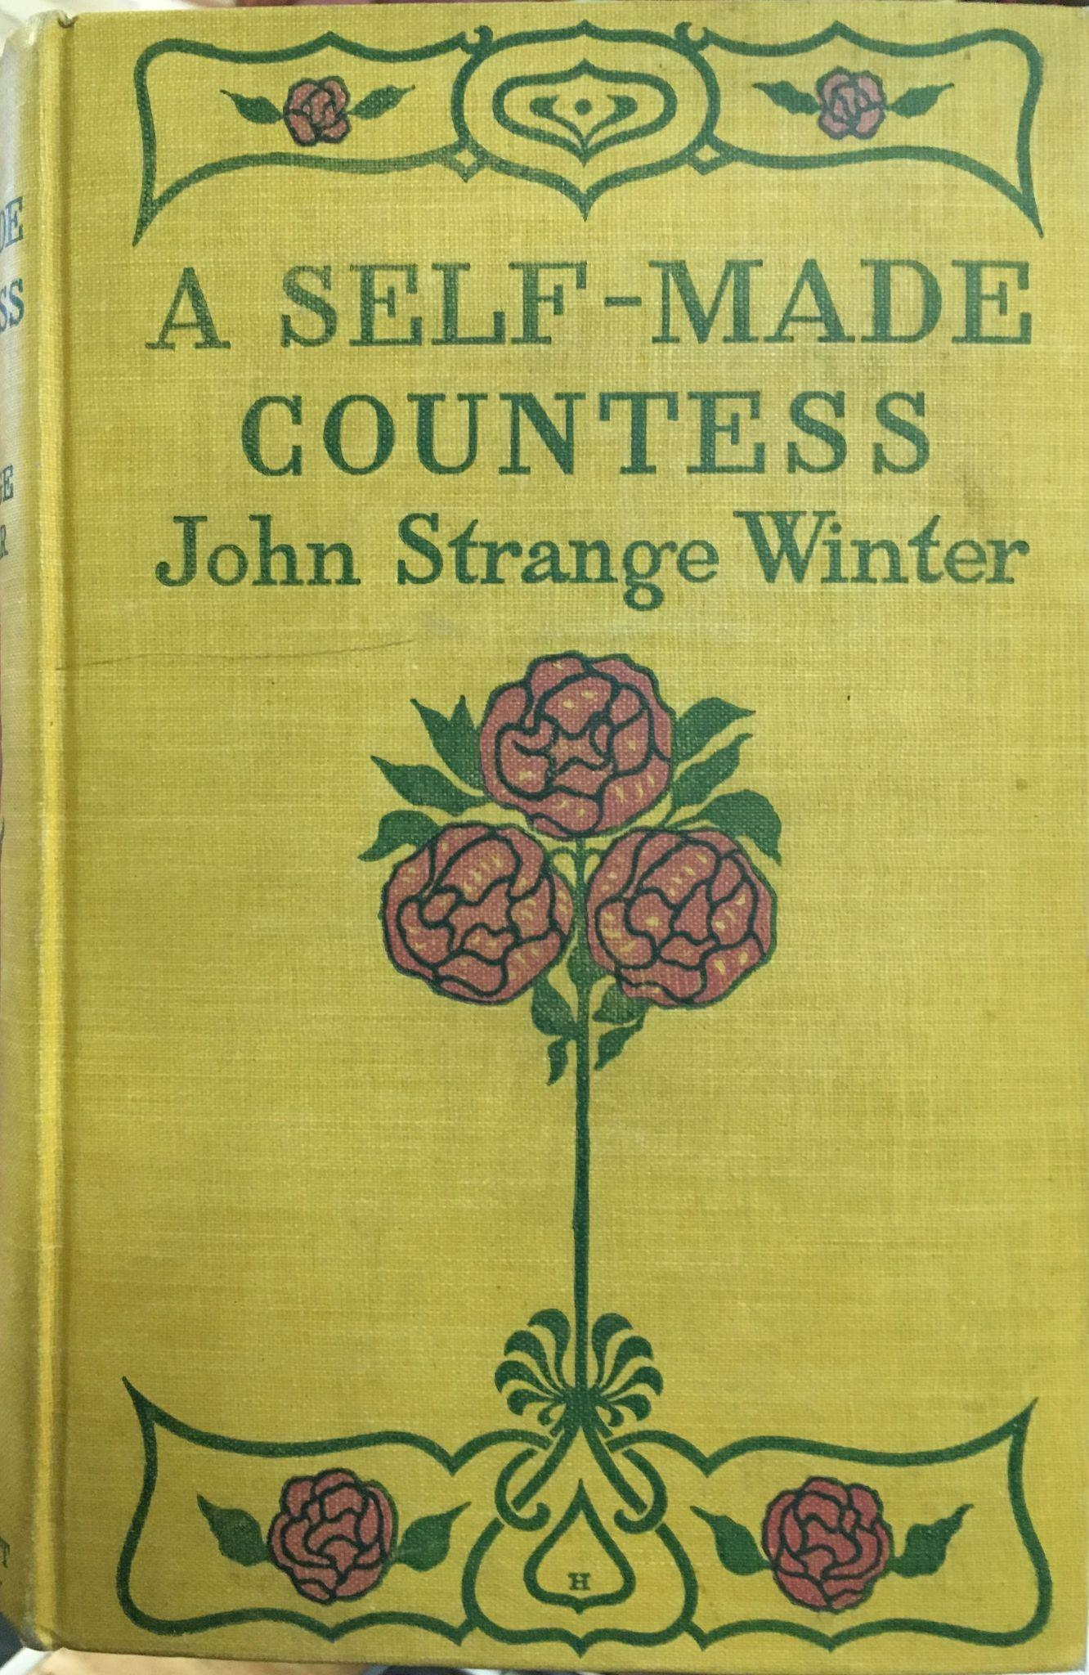
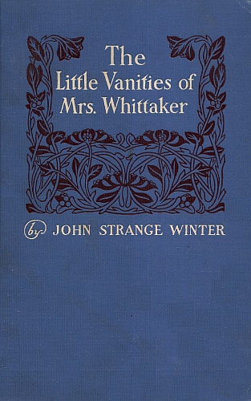
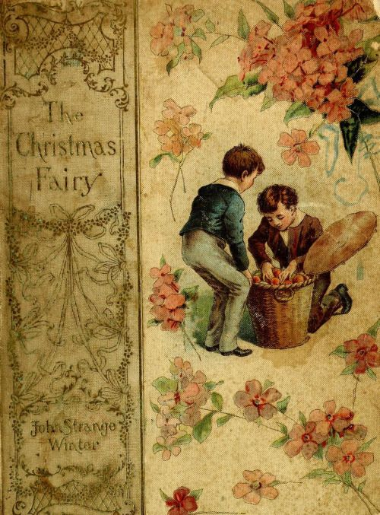
Writing Career
Wrote under the pseudonyms Violet Whyte and John Strange Winter
First story published at age 17
Wrote mainly military stories for and about middle class
Her most famous story was Bootles Baby: a story of Scarlet Lancers
Weekly Winter magazine
President of Writer’s Club (1892)
President of the Society of Women Journalists (1901-1903)
A Self-Made Countess by John Strange Winter - Browsers’ Bookstore
The Little Vanities of Mrs Whittaker by John Strange Winter - Loyal Books
The Christmas Fairy by John Strange Winter - Heritage Auctions
Notes:
First published in a York newspaper
As her father had been and officer in the Royal Artillery before becoming a rector, she was surrounded by army men from a young age - this is where she got a lot of her inspiration from
She had to write under a male pseudonym as publishers thought that military fiction written by a woman wouldn’t sell
Bootle’s baby was her most famous book, selling 2 million copies in 10 years
She started the Golden Gates magazine in 1891, which was later renamed to Winter’s Weekly
She was well-known in journalistic circles

Slide 13
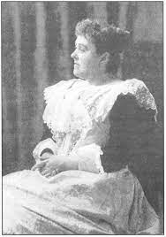
Life in London
Charity work
Open readings
Anti-Vivisection League
Anti-Crinoline League
Friendship with John Ruskin
Henrietta Stannard portrait - Oscar Wilde Society
Notes:
She settled in London in order to continue with her journalistic pursuits
She spent a lot of her time doing charity work, and would help to raise money for poor individuals in need, as well as campaigning against vivisection (operating on animals for experimental purpose), and the anti-crinoline league
She became good friends with art critic and author John Ruskin, who was a great admirer of her work. He said that she was “the author to whom we owe the most finished and faithful rendering ever yet given of the character of the British soldier” and was godfather to two of her children

Slide 14
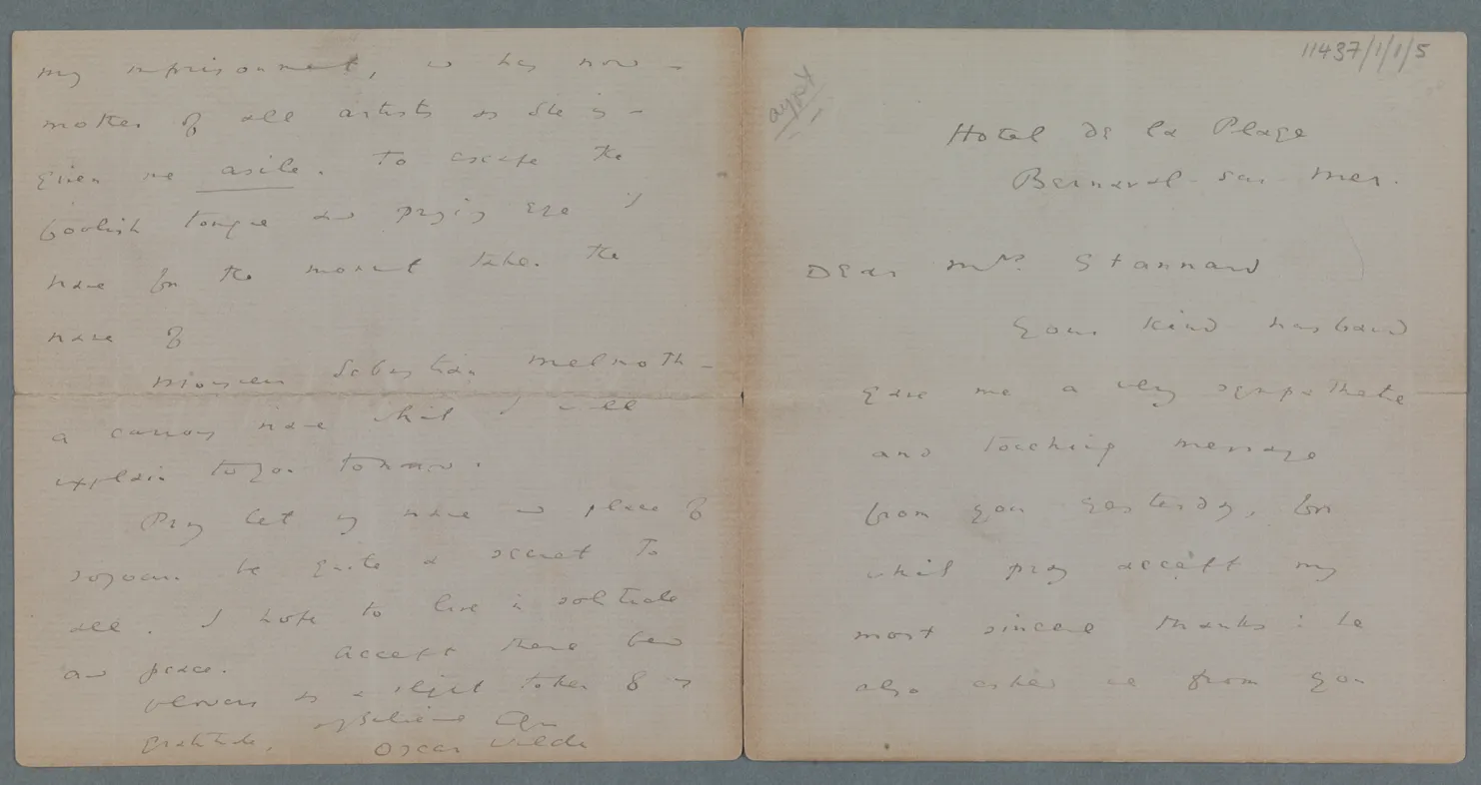
Dieppe
Moving to Dieppe
Husband’s illness
Learned chemistry and French
Contributed to town’s tourism
Oscar Wilde
Letter from Oscar Wilde to Henrietta Stannard - Trinity College Dublin
Notes:
A doctor advised the family move to Dieppe due to her husband’s poor health
She taught herself french by visiting weekly auctions, and dedicated herself to learning about french art, law and chemistry
She was apparently presented by the mayor of Dieppe with a diamond ring in recognition of her services to the town
It was in Dieppe she grew close with Oscar Wilde, who she became friends with whilst many of the English ostracized him

Slide 15
Other activities
Bankruptcy
Bankruptcy of publisher
Unsuccessful magazine
Toilet preparations
Hair and body lotions
Gold medal: colonial and indian exhibition in london 1905
international good exhibition in Paris 1906
food and health exhibition in London 1906
international hygiene exhibition vienna 1906
dravel exhibition london 1907
festival of empire 1911

Slide 16
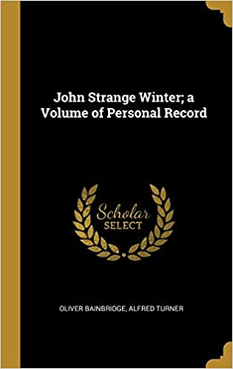
End of life
Health struggles
Breast cancer
mastectomy
Death: 13 December 1911 due to complications after an accident
Lived beyond her means and left only 547 pounds
Biography John Strange Winter: a volume of personal record was written by Oliver Bainbridge in 1916
Cover of biography - Amazon UK

Slide 17
Thank you for listening - we hope you enjoyed this insight into York’s forgotten history!

