Slide 1
Herstory Presentation:
Re-Humanising a Female Member of the Anti-Suffrage Movement: Edith Milner
Anna Curran and Sophie Marshall, Team 3
Edith Milner self-identified as “antagonistic to women’s suffrage, on social, moral, and political grounds”

Slide 2
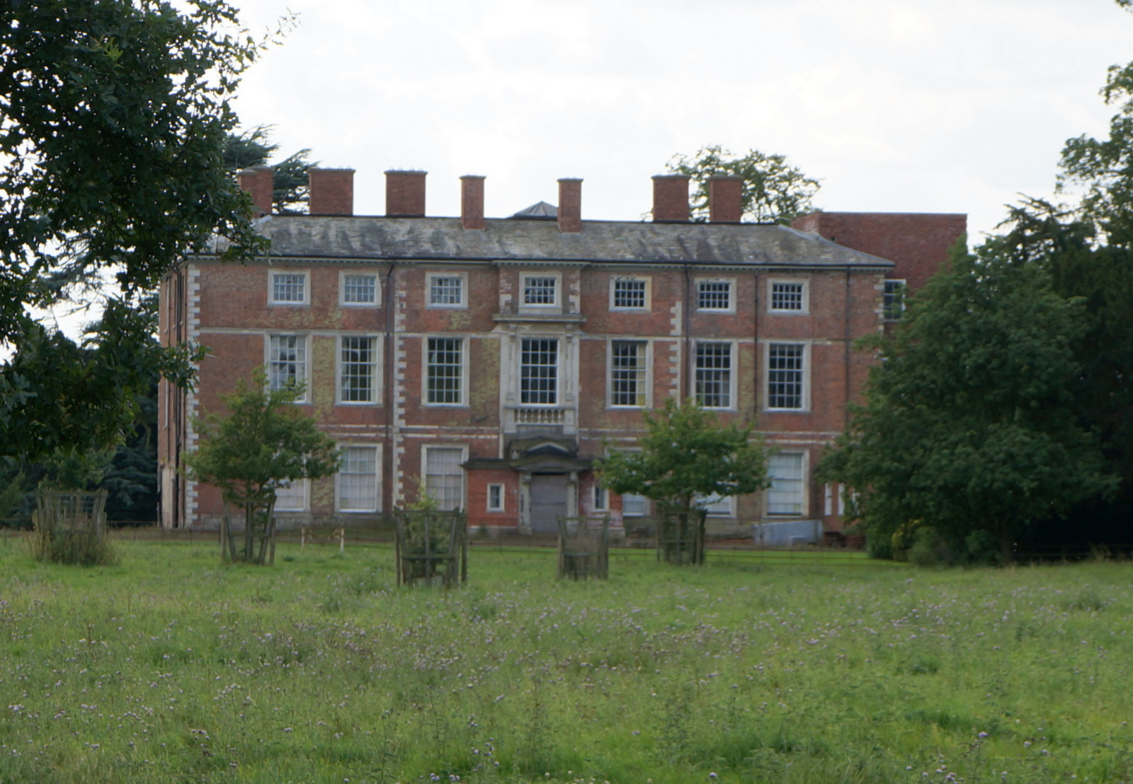
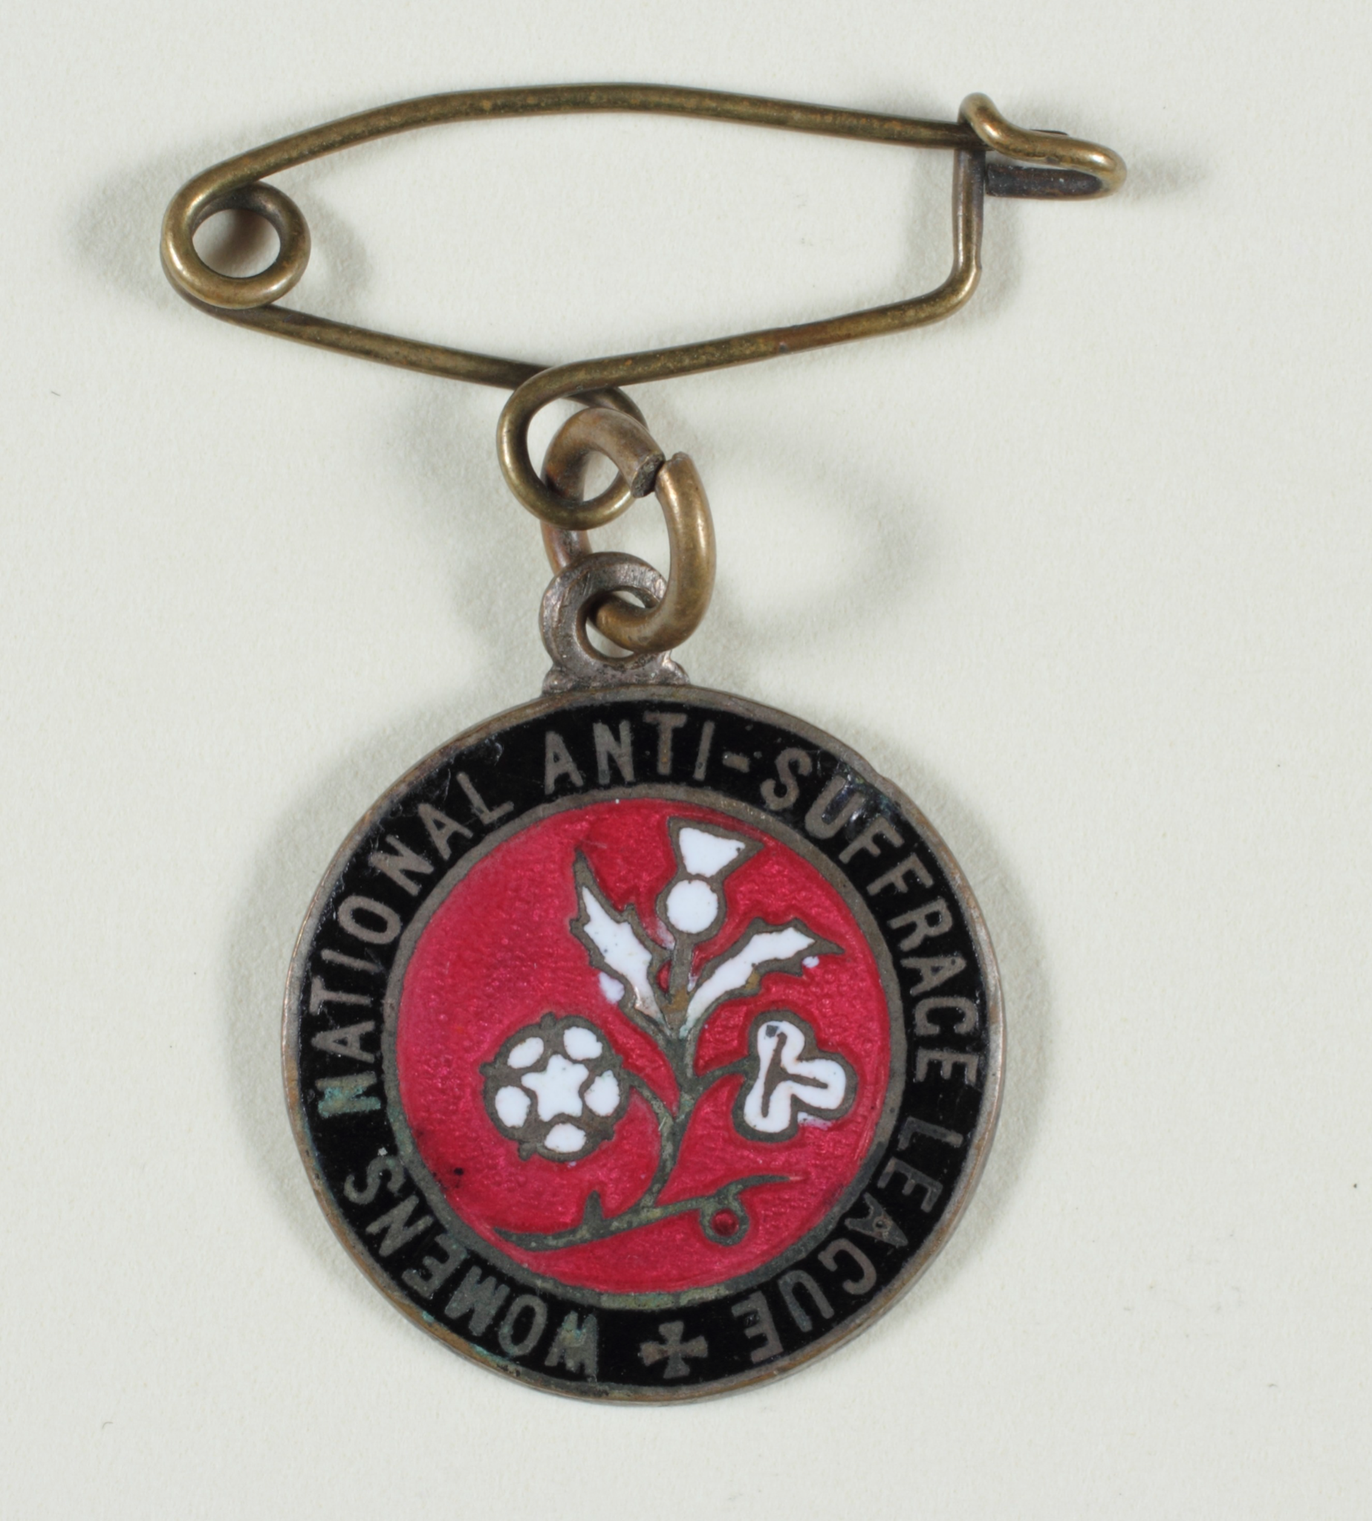
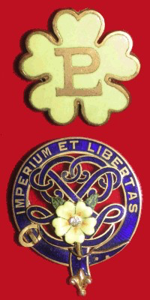
Edith Milner: Character Profile & Basic Information
Date of Birth: 30th April 1845
Date of Death: Spring 1921 (Age 76)
Place of Birth: Nun Appleton Hall, Bolton Percy (Selby)
Resided at Heworth Moor House, York
Independent Income
1879: Executive Committee Member of the York Charity Organisation Society
1883: President of the York Factory Girls’ Club
1888: York Boys’ Industrial School opening
1899: Prominent Role in the ‘Primrose League’
1908: Women’s National Anti-Suffrage League formed
1914: Milner steps down from her role in the Primrose League
Nun Appleton Hall, Bolton Percy (Selby), 2014
Badge from the WNASL
Badges from the ‘Primrose League’

Slide 3
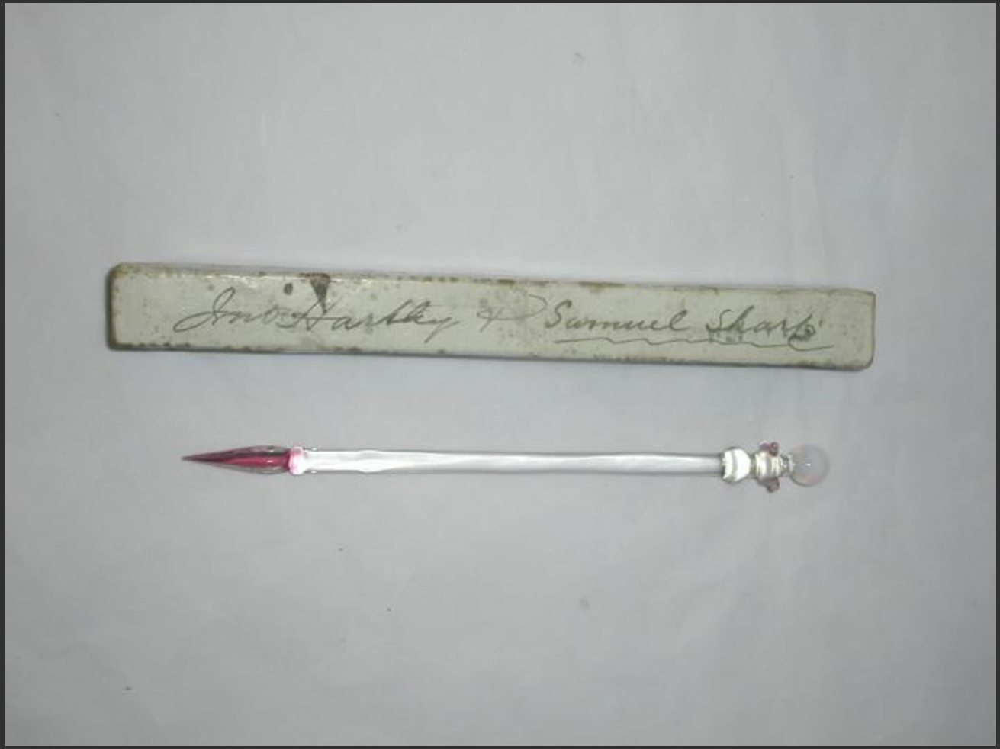
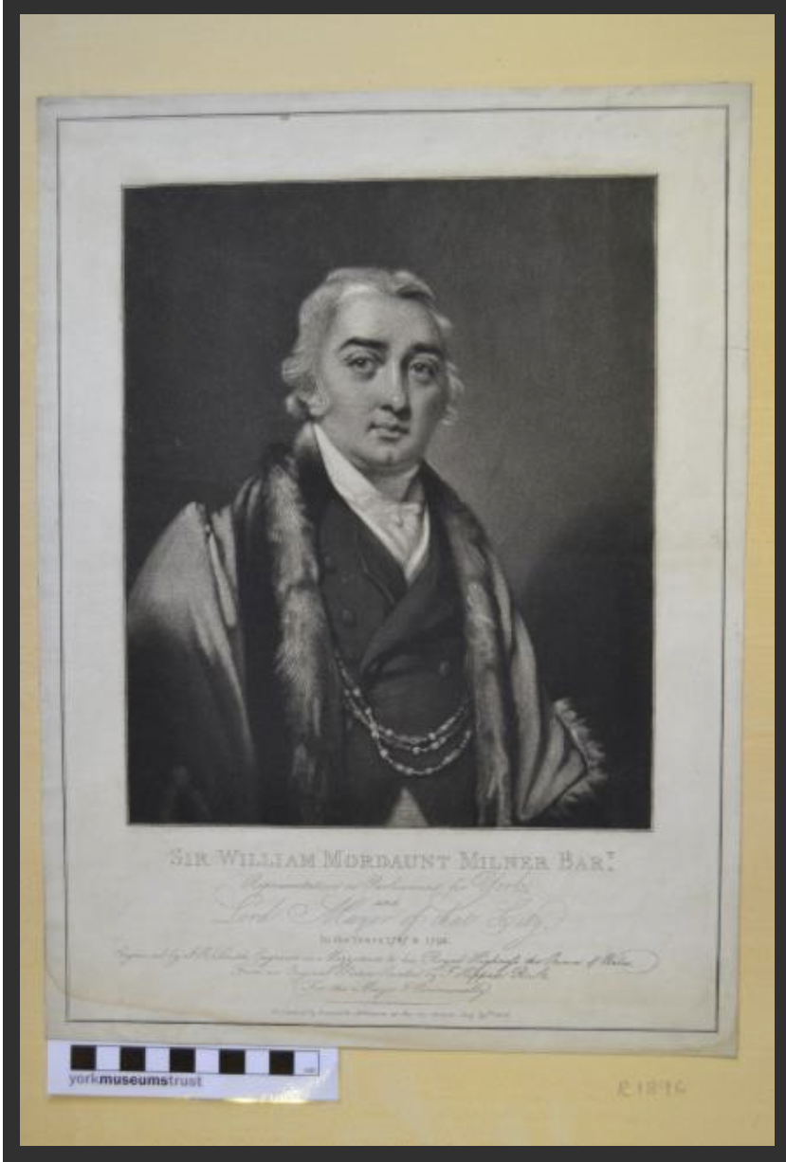
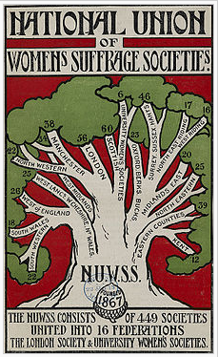
Links to the YMT
Edith regularly had her correspondence published in The York Herald
YORCM: 1962.141 Pen
YMT’s documentation of the York Suffrage Movement
How does Edith’s documented newspaper correspondence interact with Suffragette activism?
Insight into her family history
Telling of socioeconomic situation
Visual artefacts aid visualisation of Edith’s hobbies and political ties
Edith Milner’s Father
YORAG: R1896 Sir William Mordaunt Milner Barrister
N.U.W.S.S Pamphlet

Slide 4
Why is this interesting to the general public?
While the York Castle Museum has documented the suffrage movement in York, the anti-suffrage movement has yet to be thoroughly explored.
Milner’s position as a wealthy, female anti-suffrage campaigner helps to challenge the idea of anti-suffrage as misogynistic and anti-feminist.
Milner highlights the irony of women becoming politically mobilised to publicly campaigning against their own voting and political rights.

