Slide 1
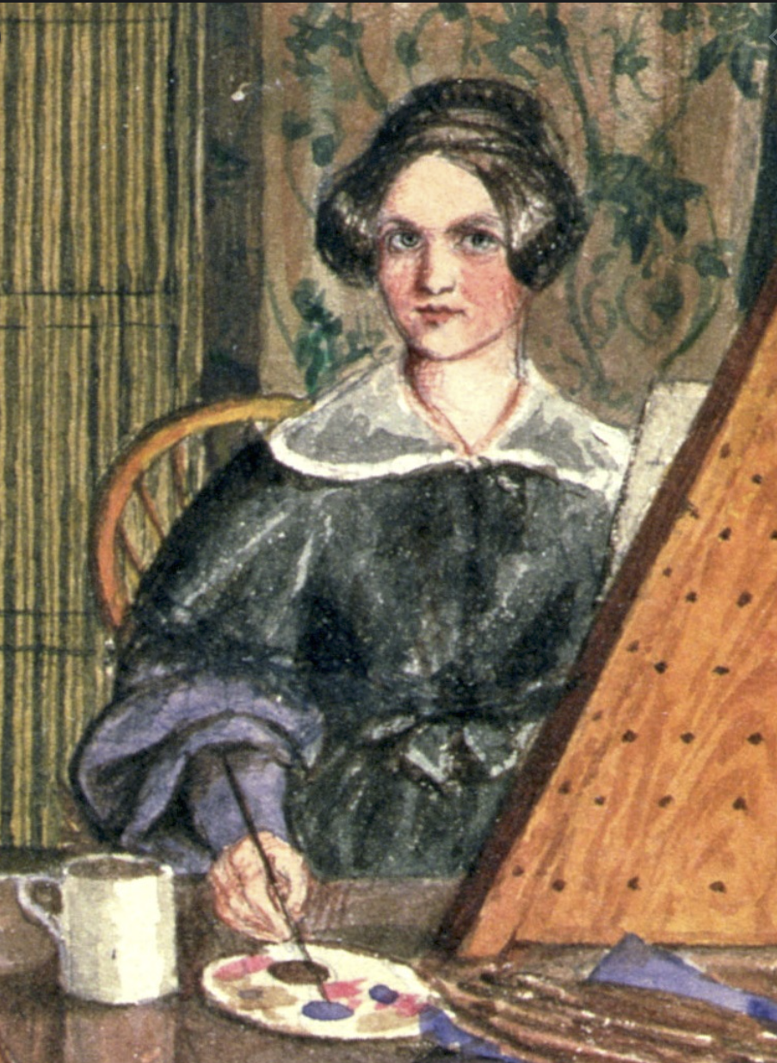
Mary Ellen Best
1809-1891

Slide 2
Early life
York watercolorist and feminist
Semi-professional artist in York upon leaving school
Most commissioners lived in or around York
“Costumes of Dusseldorf”, 1839
Painted subjects and interiors from all social classes and backgrounds
Embarked on several continental tours
“Costumes of Dusseldorf”, 1839
“Our Dining Room at York”, 1838

Slide 3
Continental Tours
1838
1834

Slide 4
Exhibitions and recognition
Frequently had paintings framed at the Repository of the Arts at Stonegate in York.
Awarded a prize in 1830 by the London Society for the Encouragement of Arts, Manufacturers and Commerce.
Her work was displayed at many public exhibitions.
It was a great achievement to be exhibited so widely.
“Portrait of Rosamond Robinson Junior”, 1836
Notes:
Her still life portrait of Rosamond Robinson Junior was praised by the Yorkshire Gazette following her last exhibition in 1836.

Slide 5
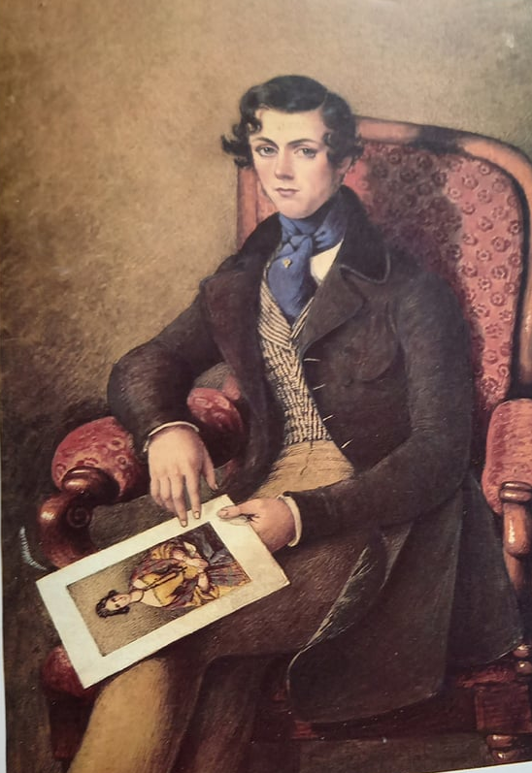
Life after marriage
“Portrait of Johann Anton Phillip Sarg”, 1840
She married Johann Anton Phillip Sarg in 1840 and stopped selling her paintings
They moved to Germany shortly after
Ellen provided the main source of income from her inheritance
Drastic change in her paintings following her marriage

Slide 6
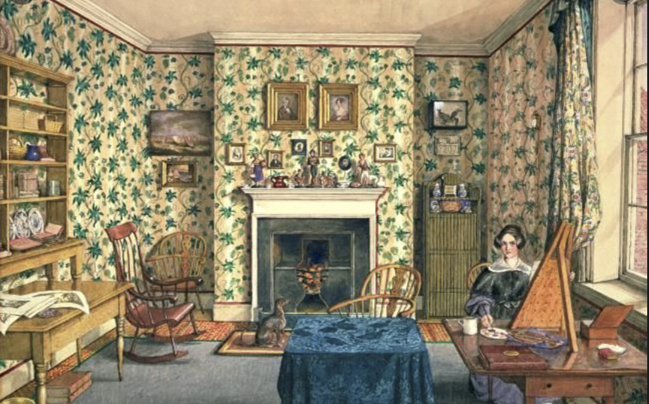
Artistic passion
Self Portrait in Painting Room’ (1837-1839)

Slide 7
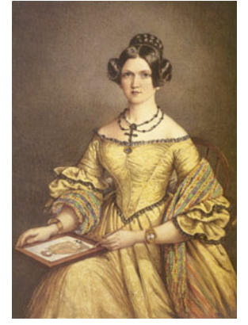
Self-portrait, 1839.

Slide 8
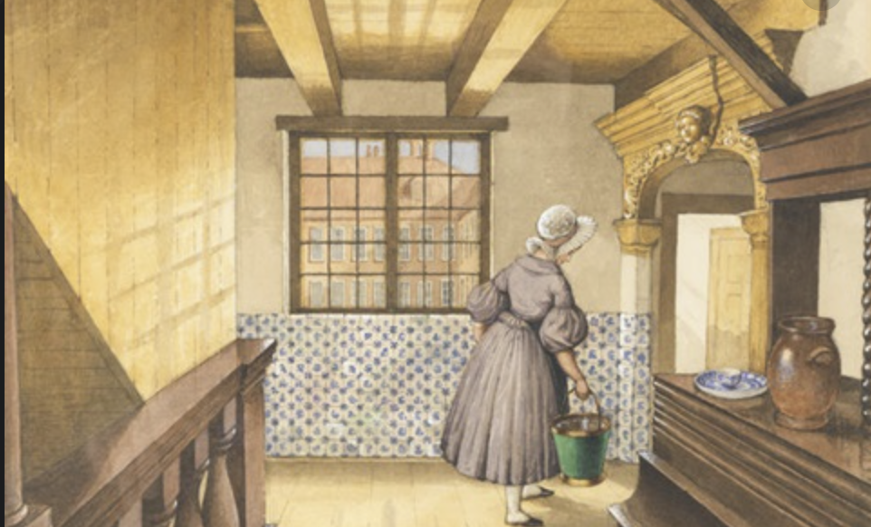
Feminist of her time?
Ellen noted that many of the Dutch charities were run by women and made a point of visiting them
⅔ of the people who commissioned her work were women- inclusion of women in her field
Ellen frequently painted women servants at work during her continental tours
“In the hotel, the Heeren-logement 1838”

Slide 9
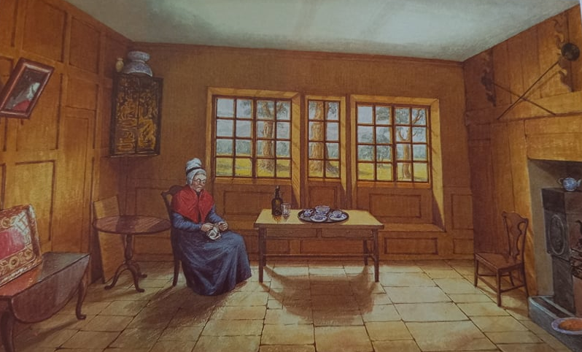
“Room at Bewerly Hall” 1830s
depicts the isolated existence of an elderly housekeeper

Slide 10
Struggles
Her albums make materially evident the difficult choices that had to be faced by female Victorian artists of Best's class
Self portrait 1845-46

Slide 11
Changes in style
“Royal Apartment in the Burg”, 1840/41
“Anthony, Frank and Caroline sledging on the ice, accompanied by the family dog” 1844

Slide 12
So why is she so important?
Insight into daily life in York (class, furniture, clothing)
Achievements/exhibitions in York
Rejected the conventional subject matter of early nineteenth century art and painted a vivid record of her life
Constantly negotiating her artistic ambitions and her middle-class status
Struggle with domestic role
Could provide further insight into migration to Germany (further research)

Slide 13
References
Woman's Art Inc., “Women's Worlds: The Art and Life of Mary Ellen Best 1809-1891 by Caroline Davidson”, Woman's Art Journal Vol. 8, No. 1 (Spring - Summer, 1987), pp. 51-52.
Caroline Davidson (1985). The World of Mary Ellen Best. Chatto & Windus Ltd. ISBN 0701129050.
Balducci, Temma (2015). "Negotiating Identity: Mary Ellen Best and The Status of Female Victorian Artists". Nineteenth Century Art Worldwide.
Mary Ellen Best - Self Portrait in Painting Room, York, 1837-1839. [Online]. Available at: https://arthur.io/art/mary-ellen-best/self-portrait-in-painting-room-york [Accessed 20 June 2021].

