Slide 1
Mary Anne Felgate
Group 6- Ana Velody, Lauren Cheetham-Birmingham, Meely Doherty and Hollie Tilling

Slide 2
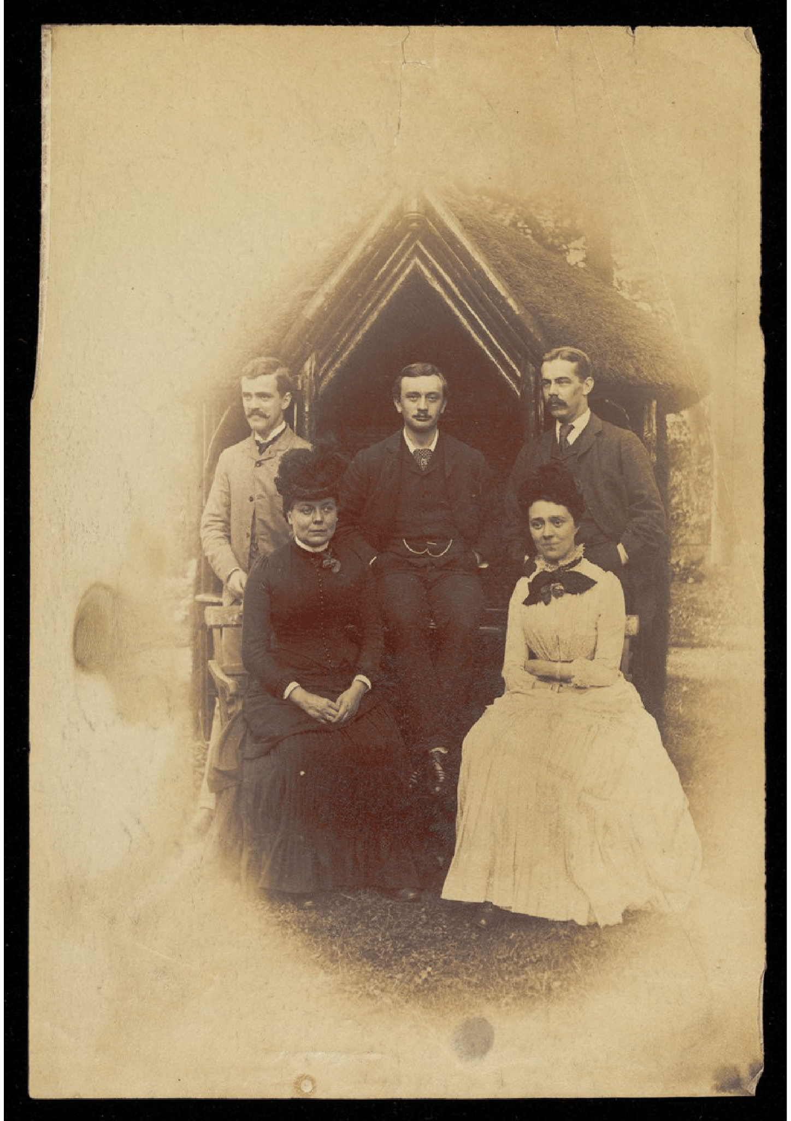
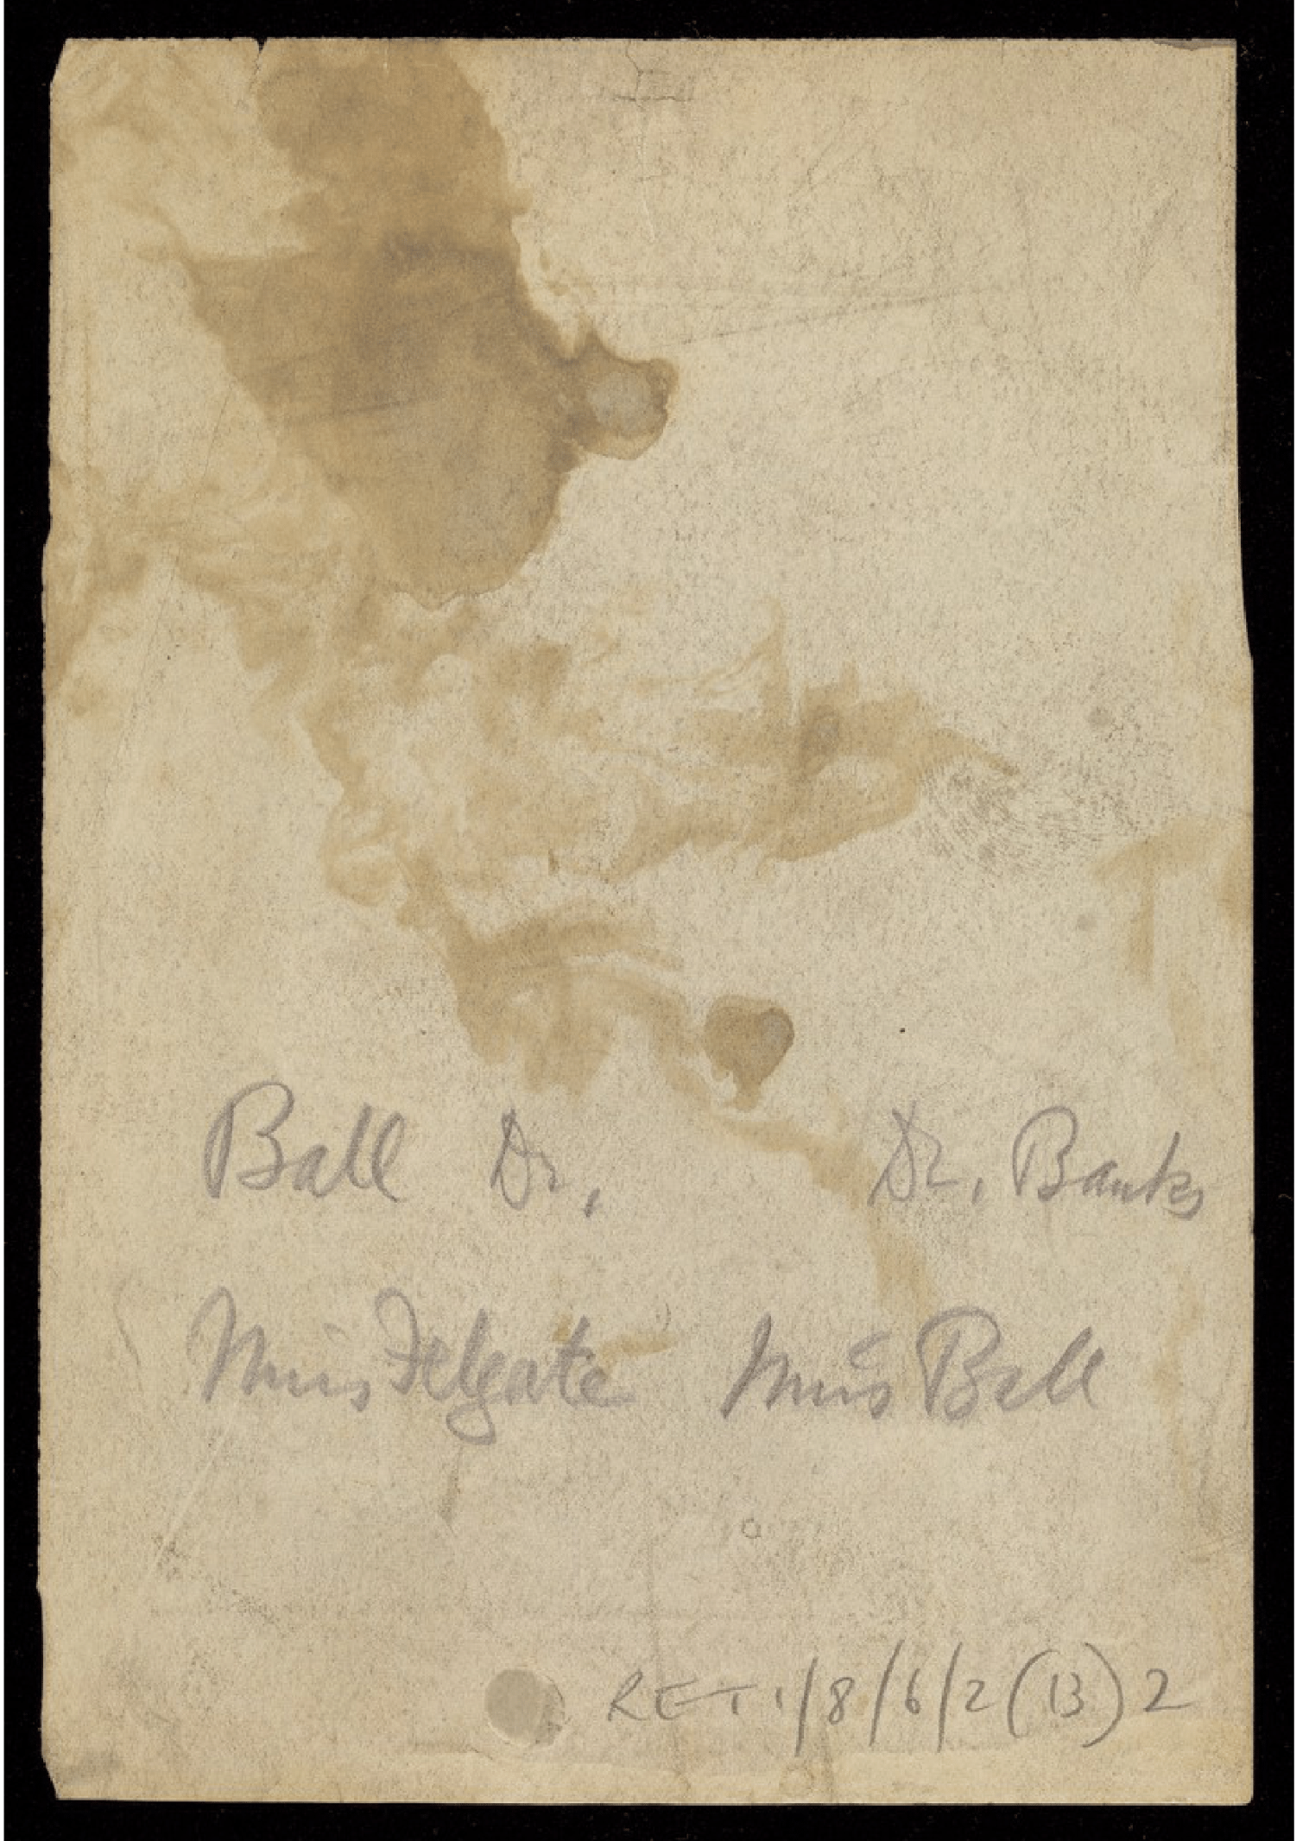
Who was she?
Notes:
Ana
Mary Ann Felgate, pictured in black on this photo here, was born in 1839, and worked at the Retreat in York, previously known as the ‘Friends Asylum for the Insane’ as a Lady’s companion.
She was born in Stepney, and is documented as living in lot of different places during her lifetime: so in 1861, she’s listed as living in Middlesex; by the 1881 census she was living in Kensington, where she works as a companion to a young woman, and she had moved to York by 1891, as by the census of this year she is listed as living in Walmgate. After finishing working in Yorkshire in 1910, she moved to live with her sister in Paddington. She never married and is listed as a spinster in 1911.
It’s her years living in York that ,to us, are the most interesting: she was a Ladies Companion at Belle Vue House (a residence which had been acquired by the Retreat to be a Ladies Villa in 1879). She is listed in four annual reports published in 1889, 1890, 1892 and 1900. The Retreat, or the ‘Friends Asylum for the Insane’ as it was then known, was one of the first asylums in the world that believed psychiatric patients should not be mistreated and should in fact be treated with care, support and company. Mary Ann’s role was vital for this process, and her position encouraged patients to feel comfortable and at home during their stay, which differed to inhumane treatments and neglect which at the time towards mental health patients was very commonplace.
This makes her role very significant to investigate- to take this further, as her role was very different to that of a nurse, what is a lady’s companion and what were her duties?

Slide 3
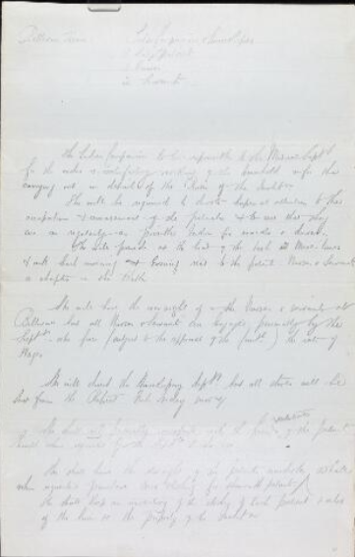
What is a Ladies’ Companion?
Notes:
Hollie

Slide 4
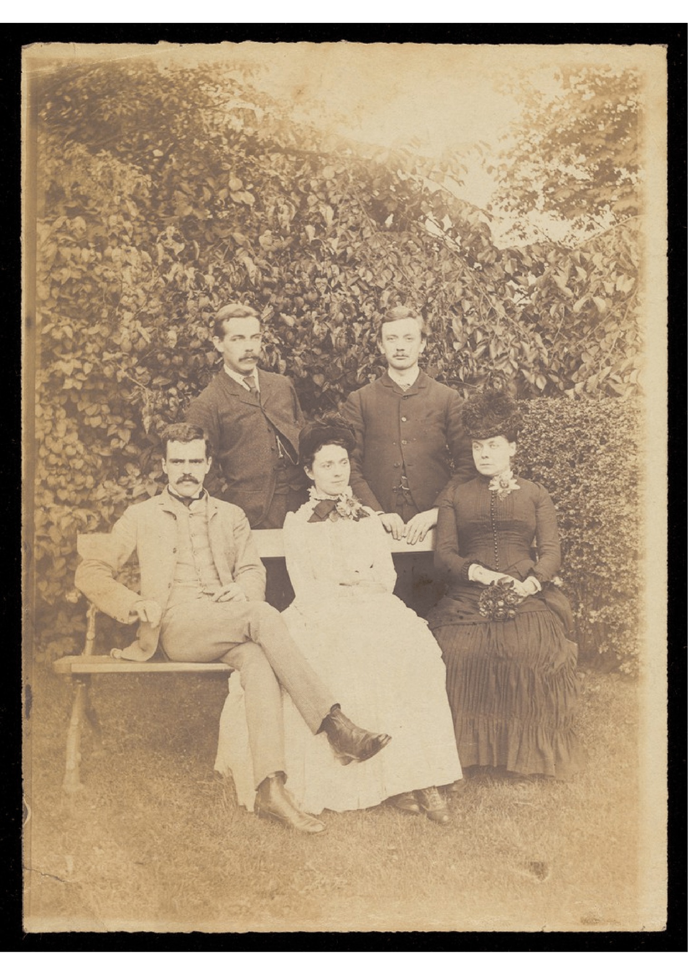
Her work at the Retreat
Notes:
Meely
1889, 1890, 1892 and 1900 reports
One of most senior member of staff
Refer to photo
1899 West Wing -> for nurses -> biggest expenditure of 1900
Destigmatising mental health

Slide 5
Why did we choose her?
Notes:
Lauren
Searching for a nurse originally, exploring Muncaster House at the Fever Hospital, Purey Cust Nursing Home and The Retreat.
Mary Anne Felgate was a Ladies Companion at the Retreat, previously known as the Friends Asylum for the Insane. While nurses and doctors are often well-recorded in the Retreat records, Mary’s role of lady’s companion is not so widely researched. Rather than being involved in the treatment of patients, she instead was a friend and comforter for them, helping them feel at home. We thought this was interesting as it embodies the humanisation of mental patients that the Friends Asylum’s founders were hoping to encourage in the psychiatric community.

Slide 6
Further Research Opportunities
Notes:
Ana
Some follow up areas of investigation we were studying: Mary Ann had an interesting family tree, with numerous siblings. At the end of her life, she was living with one of them; it would be interesting to know which sibling this was and what their occupation was.
As previously mentioned, Mary Ann also moved across the country numerous times in her life, and it would be interesting to find out whether this was typical for lady’s companions, and if she was the common stereotype for this role.
It would also be significant to compare the lady’s companions of upper class households with the lady’s companions of the asylum and whether their roles were similar. Moreover, to focus specifically on the Retreat, an area for further research would be how much input the lady’s companions like Mary had on running it/how involved they were in decision making processes/if they have any authority. It would be interesting to find out if they were treated as integral members of the pastoral care team at the Retreat or if they were dismissed or treated poorly.
Finally, to take this in the wider context, there is more potential research to be done when looking at how the Retreat's humane attitude and treatment of mental health patients is reflected in modern mental health treatment and attitudes today: what role did lady’s companions like Mary Ann Felgate have in this process and in changing attitudes to mental health? What is, over 100 years later, the modern equivalent of her role?
Thank you for listening

