Slide 1
‘We therefore, her pupils, had the great privilege of learning from one who was herself a learner,... We could not but catch something of that keen eager interest, we could not but feel how great and wide was the inheritance of the intellect, and how much it behoved us to strive to enter into it.’
Susanna Wells
“Lydia Rous” By Susanna E. Wells. (MOU/5/1/3/2) Borthwick Institute., 3
Figure1: ‘Susannah Wells’, Painting, The Mount School
Notes:
Susanna Wells wrote, of her experience studying under Lydia Rous, that: ‘We therefore, her pupils, had the great privilege of learning from one who was herself a learner,... We could not but catch something of that keen eager interest, we could not but feel how great and wide was the inheritance of the intellect, and how much it behoved us to strive to enter into it.’ Susanna’s desire to learn, and to be educated, was inspired by a woman, her teacher, and by exploring Susanna’s life, we can continue to educate and inspire women in York to pursue learning in whatever form they choose.
Introduce Susannah- in relation to the quote; why we chose the topic

Slide 2
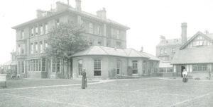
The school is described as having a ‘broad staircase’ with three upper stories.
The hall was covered by ‘a large opaque glass roof’.
Each bedroom had six beds per room.
Every Sunday ‘50 young ladies and 8 or 10 teachers parad[ed] along streets, attired in modest and sober apparel and bonnets of all shapes and sizes’ on their walk to Church.
Figure 2: ‘The Mount School’, The Mount, https://www.mountschoolyork.co.uk/about-the-mount-school/history-heritage/
School Life at The Mount 1875 to 1876 by student Mary J.Taylor
Item MOU/7/4/1/3 - School life at The Mount 1875 to 1876 (1877)
Pg. 3. 12. 29.
Notes:
The school is described as having a ‘broad staircase’ with three upper stories. The hall was covered by ‘a large opaque glass roof’. Each bedroom had six beds per room.
There were four different classes, each class corresponded with ability rather than age, the first class was filled with the highest achievers on exams, and the fourth class held the lowest achievers.

Slide 3
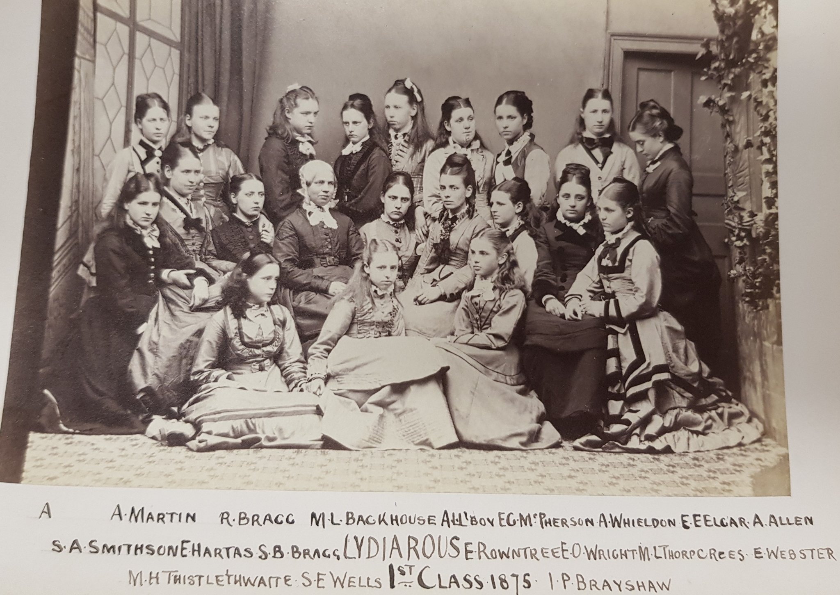
Figure 3: ‘1st Class 1875’, School Photograph, Borthwick Institute of Archives, (1875)
Notes:
Why Susannah was there

Slide 4
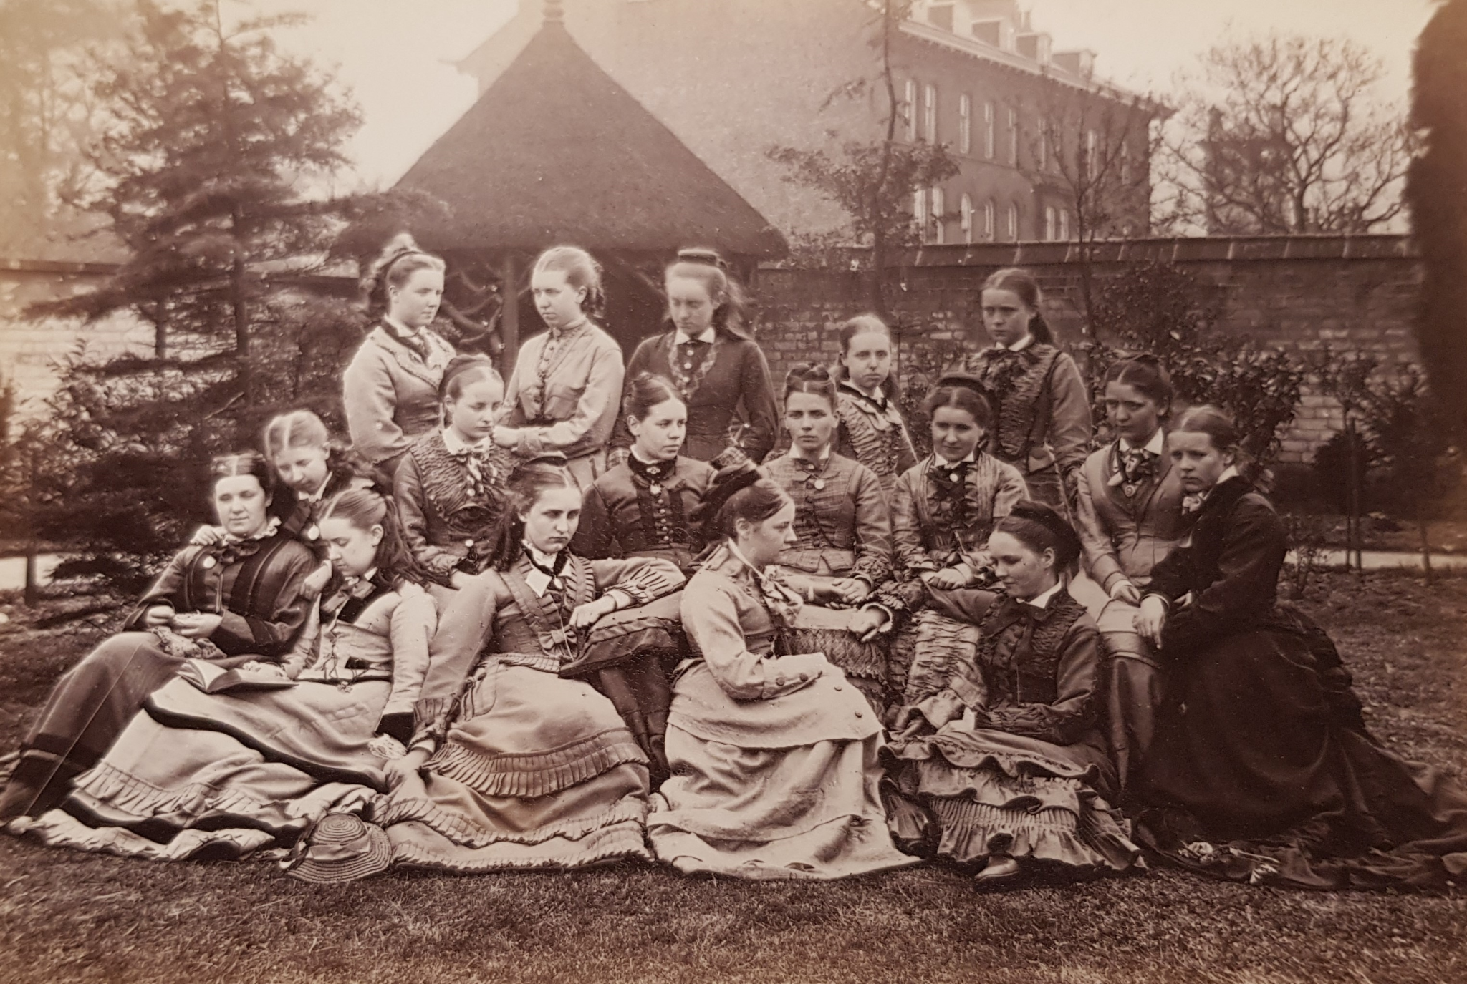
Figure 4: ‘Leavers 1876’, School Photograph, Borthwick Institute of Archives, (1876)
Notes:
Quaker Education and gender

Slide 5
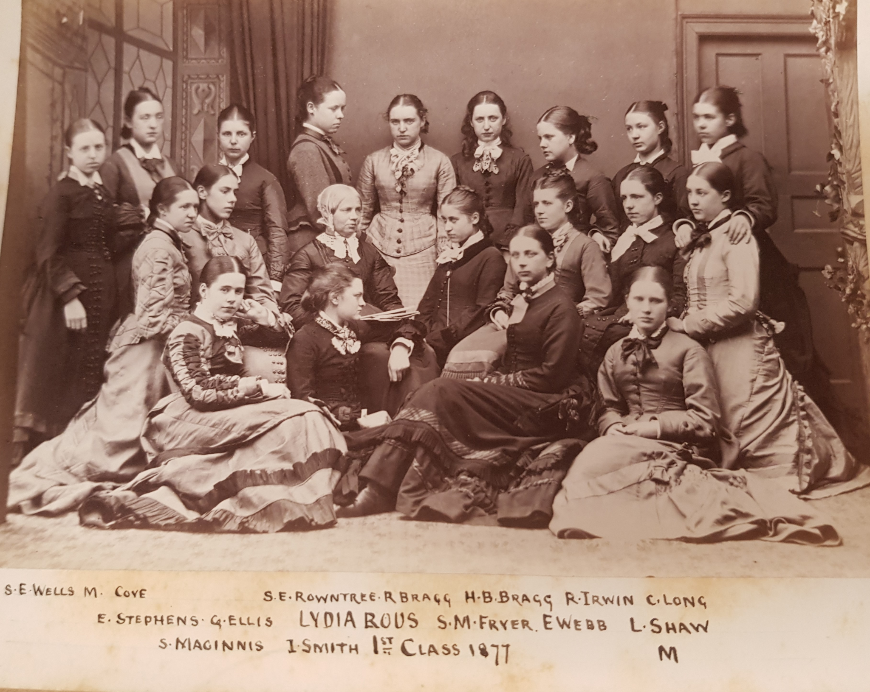
Figure 5: ‘1st Class 1877’, School Photograph, Borthwick Institute of Archives, (1877)
Notes:
-Going to University
-Academic achievements
-Extra curricular

Slide 6
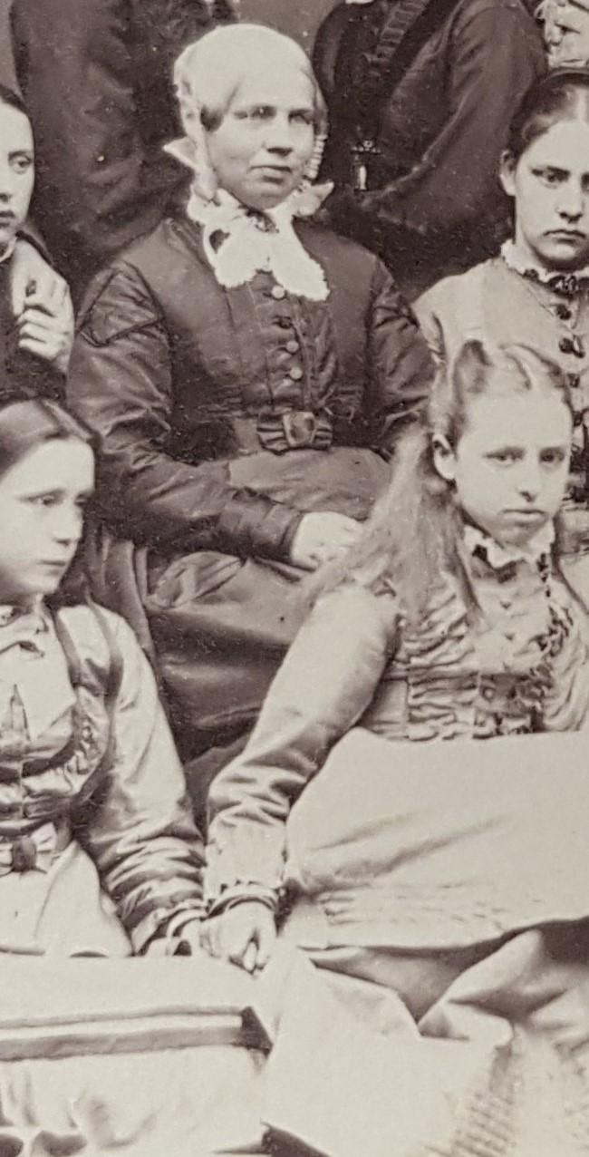
Conclusions
1881 Census, Via Ancestry.co.uk
Notes:
-Conclude our point; women inspiring women
-Issues we have had
-University of London student
-Looking at Susanna shows the importance that Quaker education had on York and the lives of certain women

