Slide 1
Lucy Sturdy
By Jess, Ariane, Ivor, Molly and Ruby
(AKA Team Quintuple Dragon)

Slide 2
Background and Family
Born in 1860, in Carlisle, England
Moved to Bradford in 1871
Industrial revolution → urbanization
A family of cotton weavers
Extremely poor working conditions in the mills
Was stealing easier for Lucy to support herself and her family?
‘John Sturdy’ (1861).
‘John Sturdy’ (1871).

Slide 3
Background and Family
DOB: 1860
Birthplace: Dublin, Ireland OR Carlisle, England
John and Ann Sturdy
Moved to Bradford, 1871
Industrial revolution → urbanization
A family of cotton weavers
Extremely poor working conditions in the mills
‘John Sturdy’ (1861).
‘John Sturdy’ (1871)

Slide 4
Marriage and Children
Marries Thomas Freeman in Bradford, 1875
Freeman arrested three times for being drunk and disorderly, imprisoned in HMP Wakefield
In the same year, Lucy gives birth to their daughter, Ann Freeman
Ann appears in census records (1881), living with John and Ann Sturdy
‘Thomas Freeman and Lucy Sturdy’’ (1875).
‘Ann Freeman’ (1881).

Slide 5
Lucy’s Convictions
She was charged 7 times in the Bradford and Leeds area 1874-1885, with the theft of coats, boots, postal stamps and money.
1874 Bradford, stole 2 petticoats, imprisoned for 1 month.
1875 Bradford, stole boots from the Stafford Boot and Shoe company and tried to sell them to a pawnbroker, imprisoned for 3 months.
1878 Bradford, stole a jacket, imprisoned for 1 year and was given 2 years of police supervision.
1880 Bradford, 2 separate charges of stealing coats, imprisoned with hard labour for 5 years in Leeds,, and 2 years police supervision.
1884 Leeds, stole jacket, coat and shawl, imprisoned for 9 months.
1885 Bradford, stole a coat and postal order.
It is likely Lucy was stuck in a cycle of poverty and imprisonment.
Ivor

Slide 6
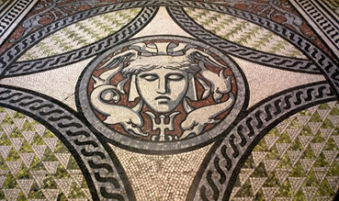
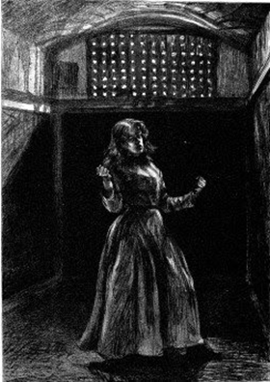
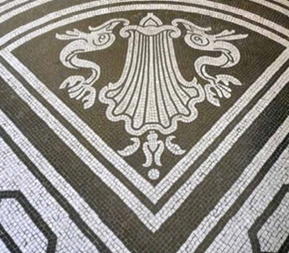
Lucy’s Life in Prison
1880 Lucy sent to the first purpose-built female prison, in Woking.
5 years of hard labour, but released on license earlier.
Women’s prison labour at Woking involved Mosaic production.
Women’s highly gendered ‘rehabilitation’.
Focused on domesticity, motherhood and women’s moralising role in society.
Deviance from proper feminine behaviour.
Effect of solitary confinement on women’s mental state.
Yates, D. (2021). Woking Female Prison, 1869-1895. Available: https://institutionalhistory.com/homepage/prisons/major-prisons/woking-female-prison-1869-1895/. Last accessed 30th Nov 2021.
Ivor
Notes:
1880 Lucy was sent to the first purpose-built female prison in the UK, in Woking
It had been established in 1869, and by the 1880s held around 300 inmates.
Lucy was given 5 years hard labour, but must have been released from prison on license, as she was convicted again in 1884.
The women’s prison used much less arduous labour than men’s, since women were not believed to have the capacity for difficult physical labour.
The inmates were given off-cuts of marble which they then cut down to size and arranged in a pattern to create mosaics.
Some of the mosaics in St Paul’s Cathedral are believed to have been made by inmates at Woking
Prisoners were often confined inside all day due to their believed inability to do outdoor work.
The prison had a focus on rehabilitation which was designed around Victorian gendered values of domesticity and motherhood
Trained in domestic work.
Women were expected to have a social, moralising role in society, and so by breaking the law they were deviating from this role.
Women required saving twice, firstly from their criminality and then from their deviance from anticipated female behaviour.
Female prisoners were kept in solitary confinement for the first few months of the sentence, where they ate, slept and worked.
Female prisoners were often volatile, depressed and suicidal during their confinement, commonly had mental breakdowns where they would destroy everything in their cell - factor in Lucy’s lunacy diagnosis?
Deprived of conversation as a disciplinary tool, as this was seen as the appropriate punishment for women’s social role.

Slide 7
The 1885 Trial
York Herald (1885). Editorial: Yorkshire Assizes, 12 Nov 1885
Jess
Leed’s Times (1885). Editorial: Bradford, 22 Aug 1885
Notes:
So here we have two newspaper articles reporting on the arrest and trial of Lucy Sturdy in 1885. The first article from the York Herald details how Lucy was charged with stealing a coat and a postal-order form a warehouse in Bradford. Mr Thompson appears for prosecution. Dr Tempest Anderson, medical officer from the York Castle Prison, certified that she was insane. The next article from Leeds Times gives us more detail about the crime itself. Titled ‘A sturdy and roughish hand’, Lucy is charged with stealing a coat, value 15s, and a postal order, value 10s, from W. H. Lister, on the 13th August. The prosecutor was the manager at Messrs. Lister and Sutcliffe’s Globe Mill and the items were stolen right from his office. Lucy was noted as a weaver or a millhand at the time, so perhaps this was her boss she was stealing from.
If we look into the criminal records at the time to support these articles, we find that W. H. Lister was one William henry. Lucy committed the crime on the 13th August 1885, and was tried almost two months later on the 6th November 1885, where she was found to be insane by the jury.

Slide 8
Admission to The Asylum
Admitted to North Riding of Yorkshire Lunatic Asylum at Clifton, York on December 5th 1885.
Name: Lucy Sturdy
Age: 25
Education: None
Marital status: Married to Tom Freeman
Occupation: Weaver
Children: 2, youngest 16 months
Mental Illness: Melancholia, cause unknown, first episode of which lasting 4 months
Crime Felony, unfit to plead
on admission here was in a state of most acute mania talked about having married the Prince of Wales or the Lord Lieutenant who had taken her child to India and left it in the woods. The Prince of Wales took her [dog?] away from her. The Queen made her a new [dress?]. Still frequently asks for her child.
~ Dr Tempest Anderson
Jess
Notes:
A month after her trial, on 5th December, she was finally admitted to the North Riding of Yorkshire Lunatic Asylum at Clifton, York. She was 25 years old, uneducated, a weaver, married to Tom Freeman, and mother of 2, the youngest of which was 16 months old. She was admitted melancholia, an episode which had apparently lasted 4 months up to this point. Dr Tempest Anderson gave the following statement as evidence for her insanity:...
It could be argued here that she was faking insanity to avoid imprisonment. At this point she had spent 3 months in Armley Jail in Leeds, a place infamous for hangings. We can assume her experience here wasn’t pleasant, and she pleaded insane to avoid even harsher conditions. It is perfectly plausible, however, that she was suffering from melancholia, perhaps linked to post-partum depression after the birth of her second child who only appears here in her admission to the hospital. After a lifetime of poverty and crime, is it unreasonable for any women to struggle with mental illness?

Slide 9
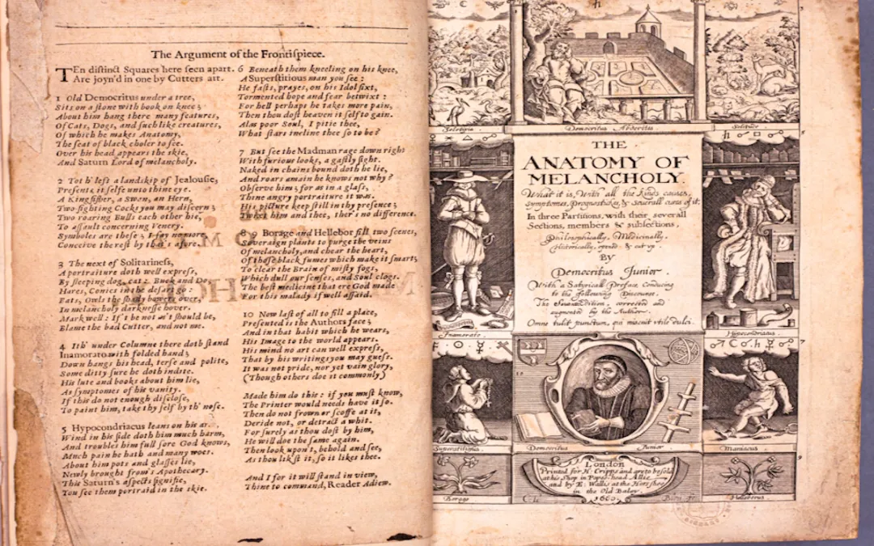
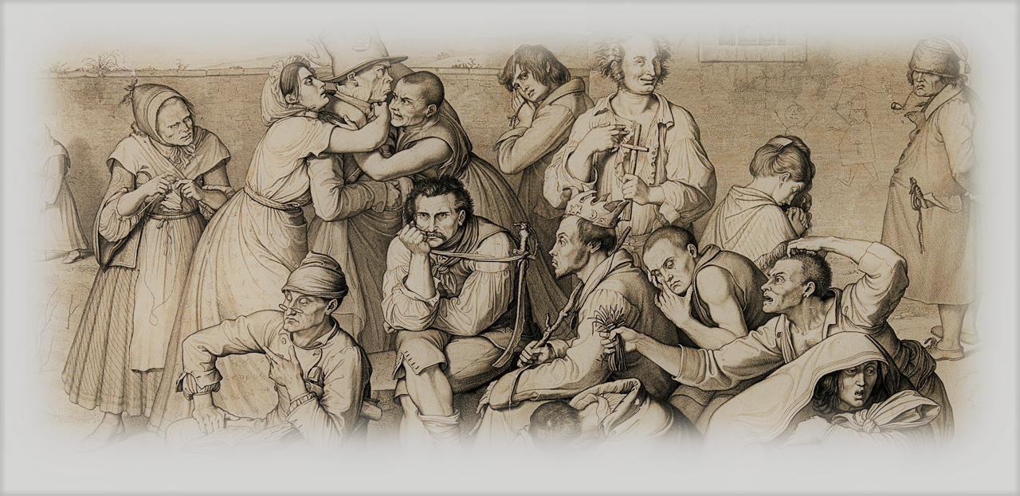
Melancholia in the late 19th century
By the end of the century, melancholia was not only one of the most common forms of mental disease diagnosed in British asylums, it was also one of the most written about in medical literature.
it was perceived as a form of mental disease in which emotion was the main, or only, faculty affected, and as such it could present without delusion of thought.
In European medical literature the term melancholia had traditionally been deployed to describe various manifestations of delusional madness characterised by sadness, grief, and despair.
Victorian medical psychologists spoke of a ‘depression of spirits’, or an ‘emotional’ or ‘mental’ depression when describing melancholia
The term was predominantly used as a way to describe the overall state of the melancholic mind, and as a way to contrast melancholia with mania—the opposite state of ‘mental excitation’.
Credits: Talking Humanities blog
Credits; A Victorian Mental Asylum - Science Museum Ariane

Slide 10
Loose Ends & Conclusion
‘Lucy Sturdy’ appears in a 1939 census record, born in 1861, occupation ‘unpaid domestic duties’.
Another ‘Lucy Sturdy’ dies in 1943, however she was also born in 1861. This may be the same Lucy as above or not. We can’t be sure whether these records relate to the woma74n we have been talking about, and it is loose ends like these that exist for many women in the records.
Lucy’s story is one of hardship and survival, a narrative not uncommon for working-class women in Victorian York. Trapped in a cycle of crime and survival, Lucy is just one victim in a wider historical trend, and that is why she is important.
Ariane

Slide 11
Life in The Asylum
Lucy only spent a total of one month in the Clifton Lunatic Asylum. Below is the documentation of her behaviour within this period.
1885, December 7th: ‘Scarcely spoken when spoken to’ and refuses to talk of her former life.
1885, December 24th: Doesn’t speak unless spoken to, and does some needlework.
1886, January 6th: Sturdy steals a pair of scissors and cuts the straps on a nurses keys, hiding them.
Her Escape:
1886, January 27th: Sturdy ‘escapes into the night’ on the 21st
1886, February 8th: No recovery of her, is thought to be in Bradford
1886, June 16th: Still no recovery, thought to have left Bradford
1887: January 24th: Still missing from the asylum, ‘nothing has been heard of her’
1887, October 10th:
‘On the authority of the Secretary of State, she was today taken off the asylum books – She wins’
Borthwick Institute for Archives, 1885, Female Case Book, [Archive Record], available via Borthwick Institute for Archives: NHS/CLF/6/5/59/2394, York.

