Slide 1
Mary
Ann
Craven
1826 - 1900

Slide 2
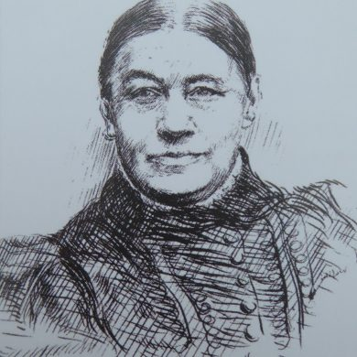
Who was Mary Ann Craven?
Notes:
Greet and thank
Introduce
What we have been doing over the last four weeks
Our research aims (1) Uncover her identity as a mother, wife and widow and gain an insight into her personality
Sources
Summary
Born 15th September 1826
Inspired at a young age
Strength and courage
Became a widow, full time business
Pass to Seren
First image (L to R) is an extract from page 2 of ‘The “Art, Trade and Mystery of a Confectioner”’ from May 1949, held in the Borthwick Archives, CRAV box 3, accessed 23/11/21.
Second image (L to R) is a hand drawn sketch of Mary Ann Craven from Dinah Tyszka, ‘Mary Ann Craven (1826-1900)’ (York Civic Trust) < Mary Ann Craven (1826-1900) – York Civic Trust > accessed 24th November 2021.
Third image (L to R) is a clipping of promotional material ‘One Woman’s Courage’ produced between c.1963-1984. Is held in the Borthwick Archives, CRAV box 2, accessed 23/11/21.

Slide 3
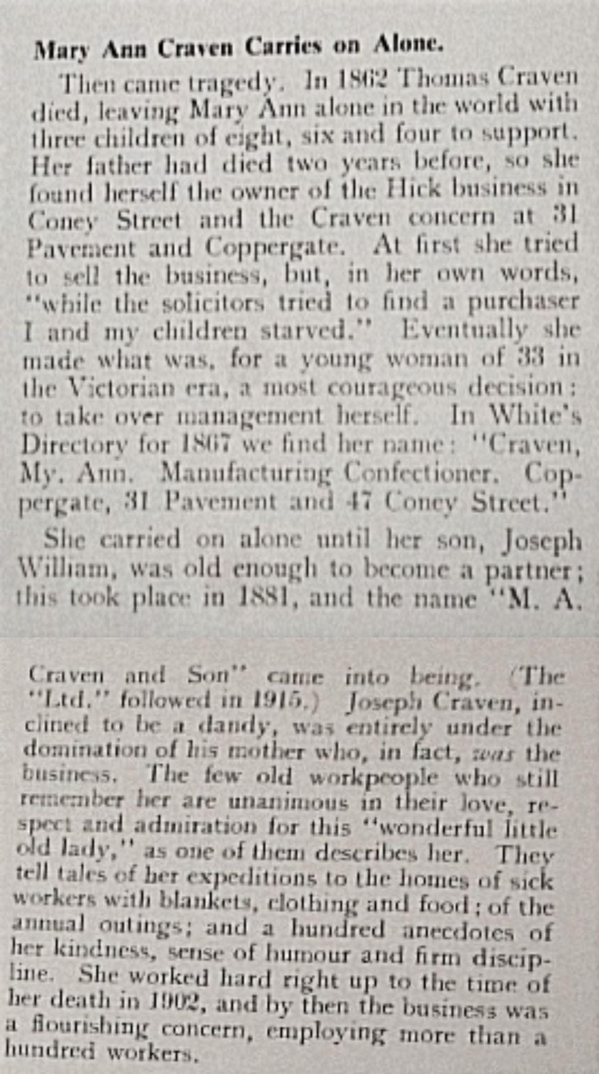
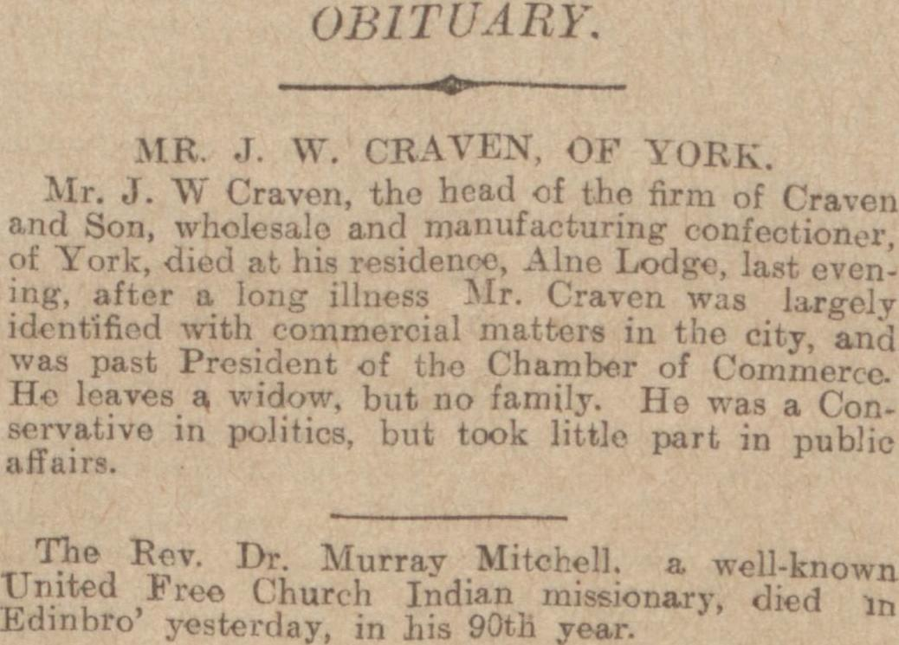
Family, Marriage & Widowhood
Joseph Hick: Mary’s father, partner of ‘Kilner & Hick’ confectionary.
Thomas Craven: Mary’s husband, married in 1851.
3 young children to bring up after her father and husband passed away.
Carried on the business for another 40 years.
Notes:
First Image (L to R) is an extract from page 9 of ‘Issue 15398 Births, Deaths, Marriages and Obituaries’ Sheffield Daily Telegraph (Sheffield, 16th November 1904) 9, accessed 24th November 2021.
Second image (L to R) is an extract from page 2 of ‘The “Art, Trade and Mystery of a Confectioner”’ from May 1949, held in the Borthwick Archives, CRAV box 3, accessed 23/11/21.

Slide 4
Business
Under Mary Ann, M.A. Craven & Son Ltd thrived and grew, becoming a well established and wealthy company.
Notes:
As Seren has mentioned, with the deaths of her father and husband, Mary Ann combined Craven and Kilner & Hick to form M.A. Craven & Son Ltd. Under Mary Ann’s leadership, this unified company went on to be massively successful, this success continuing generations after her death in 1900. Mary Ann took up this leadership position mid-way through the Victorian era, a period where it was incredibly difficult for women to hold positions outside of the home as a result of the stringent social conventions on womanhood. Middle-class women were expected to remain in the private, domestic sphere, and yet Mary Ann was able to make the transition into the masculine dominated public sphere. It is likely that Mary Ann’s status as a widow would have aided her, as upon the death of her husband Mary Ann became legally recognised within the law again as her own person, rather than the property of her husband, making it far easier for Mary Ann to own her own property.
Not only was Mary Ann able to take up the role of leading M.A. Craven & Son Ltd, but she thrived doing so for forty years. The strength of her character was well known and she had a reputation for being formidable. A pamphlet produced in May 1949, entitled ‘The “Art, Trade and Mystery of a Confectioner”’ recounts the history of M.A. Craven & Son Ltd, making specific note of Mary Ann’s role in the business. Mary Ann is described as being ‘the business’, even when her son joined in 1881, he did not surpass her in status. The maintenance of control and strength of character which Mary Ann exhibited was also noted in a later piece of promotional material produced c.1963-1984 entitled ‘One Woman’s Courage’ referring specifically to Mary Ann and her past with the company. Mary Ann’s legacy within her own company can be seen in later products such as the ‘Mary Ann Dairy Toffee’, Mary Ann’s name is used in the companies market, her presence remains and legacy built upon, as can be seen in both these images dating long after her death.
First image (L to R) is of a selection of M.A. Craven & Son Ltd products from c.1980s, held in the Borthwick Archives, CRAV box 1, accessed 23/11/21.
Second image is of a storefront in August 1958 which uses Mary Ann’s name to promote their products, held in the Borthwick Archives, CRAV box 2, accessed 23/11/21.

Slide 5
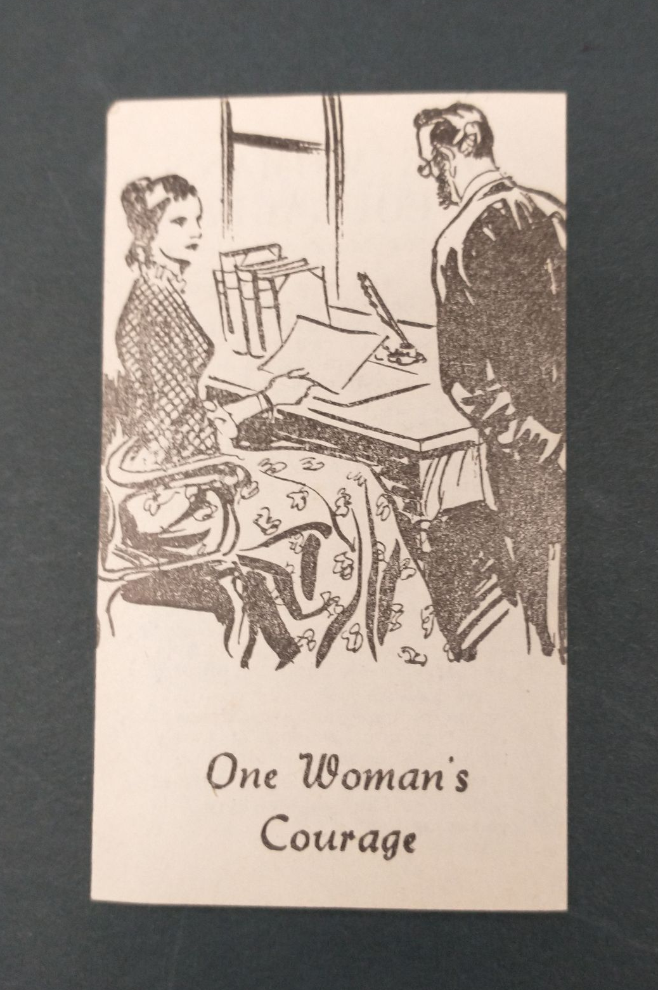
Charity Work
Mary Ann was known as having a kind personality and to frequently visit the homes of sick workers with items including “blankets, food and clothing”.
Notes:
What these documents also note is the high levels of respect her workers had for her. She was described as being a ‘wonderful little old lady’ and amusingly was said rather short and so had a chair built to enable her to oversee her workers. It is her active engagement with the community which is emphasised in these accounts of Mary Ann. This can be seen most clearly in her charity work in the city of York. Whilst her most well-known legacy continues to be in confectionery, Mary Ann’s kindness and care is also frequently noted, as she is said to have visited her sick workers, providing them with ‘blankets, clothing and food’. Mary Ann’s dedication to her works and care for their well-being curates a nuanced picture of Mary Ann as both a business leader and as a socially conscious citizen of York.
First image (L to R) is an extract from the local newspaper detailing the death of Mary an Craven. Reference → Anonymous, ‘Issue 15337 Multiple News Items’ York Herald (York, 4th August 1900) 6. Accessed from ‘Multiple News Items’ (Gale Primary Sources) < Multiple News Items (york.ac.uk) > accessed 1st December 2021.
Second image (L to R) is a clipping of promotional material ‘One Woman’s Courage’ produced between c.1963-1984. Is held in the Borthwick Archives, CRAV box 2, accessed 23/11/21.

Slide 6
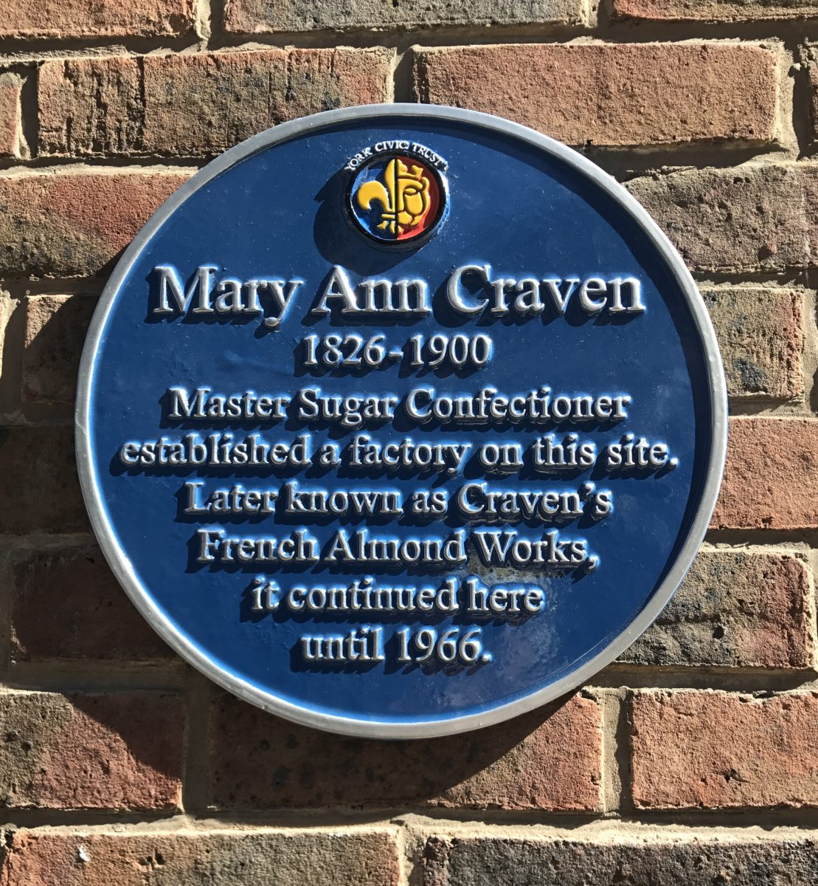
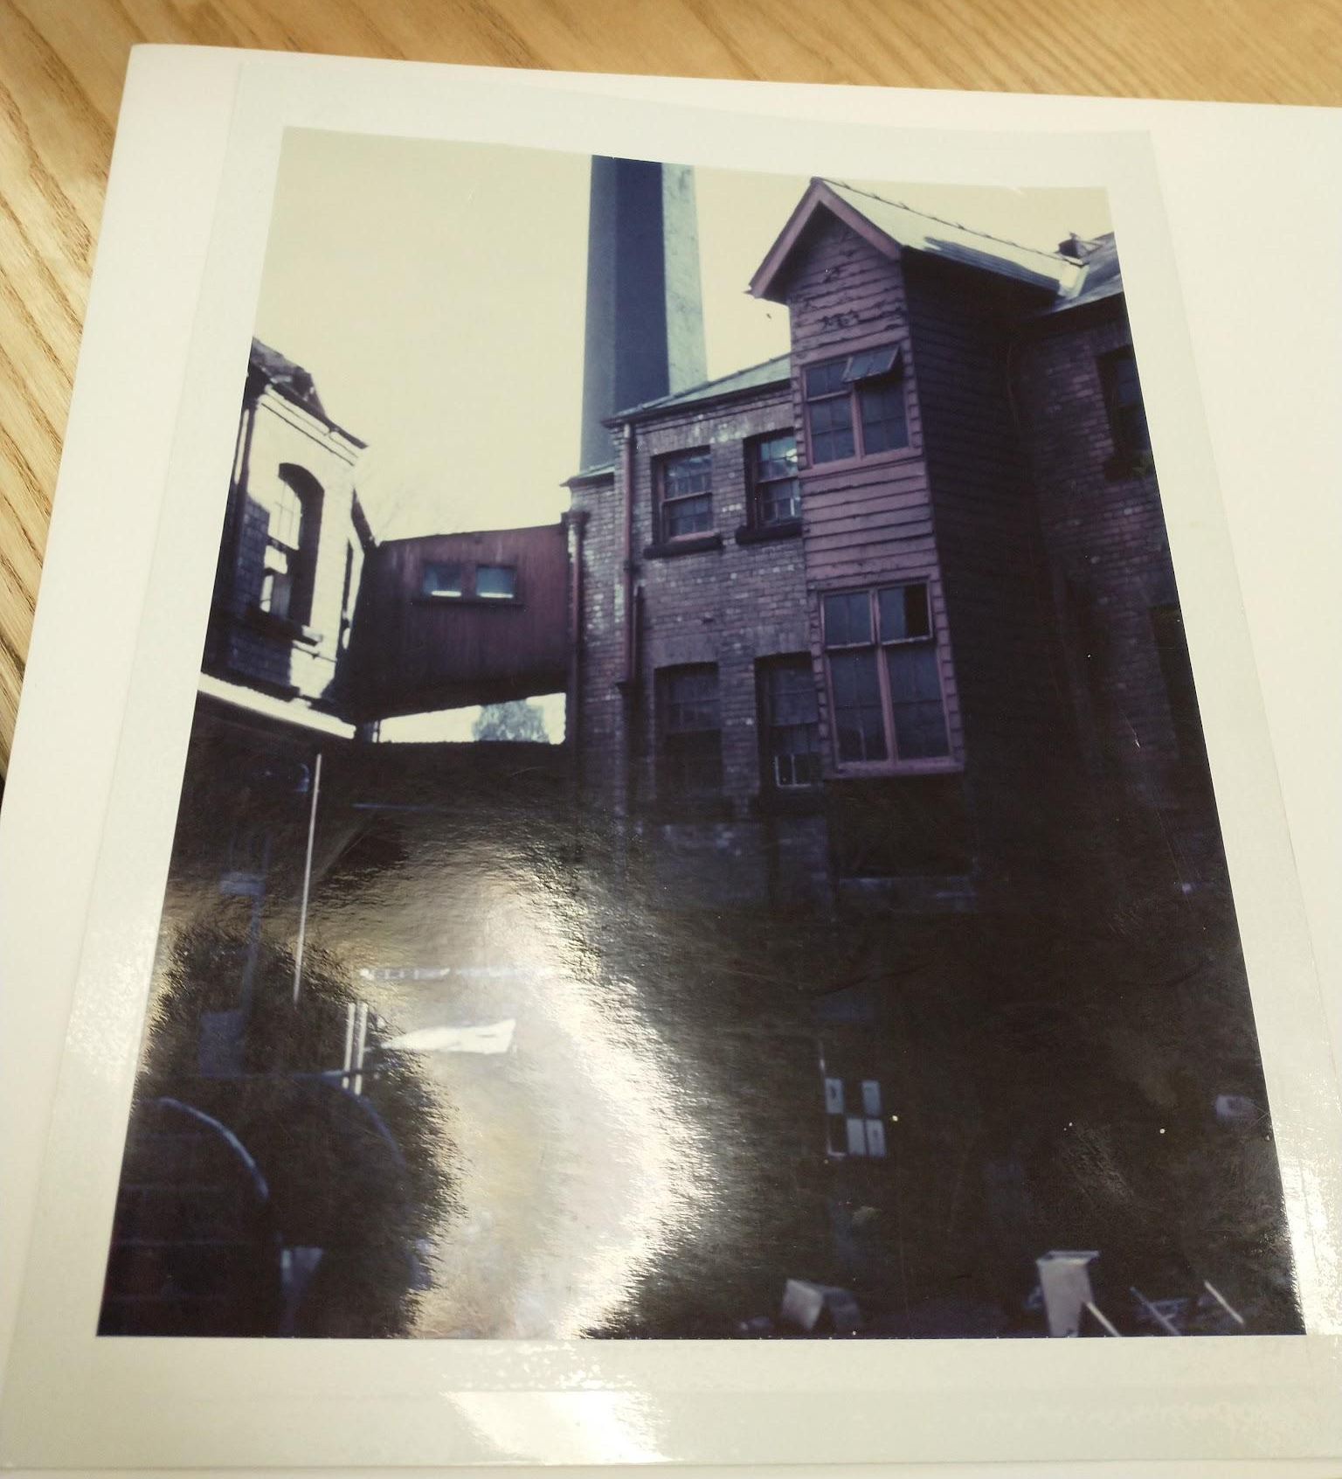
Links to York
Remained in York for her entire life.
Significant Locations:
47 Coney Street
Coppergate
Foss Island Road
The Shambles
21 Pavement Heworth Croft
Heworth Green
All Saints Church
York City Cemetery
Notes:
First image (L to R) is an image of her mural located by Cafe Nero in Coppergate, YO1 9NT, accessed from Dinah Tyszka, ‘Mary Ann Craven (1826-1900)’ (York Civic Trust) < Mary Ann Craven (1826-1900) – York Civic Trust > accessed 24th November 2021.
Second image (L to R) is photo of the Craven factory in 1996. Is held in the Borthwick Archives, CRAV box 1, accessed 23/11/21.

Slide 7
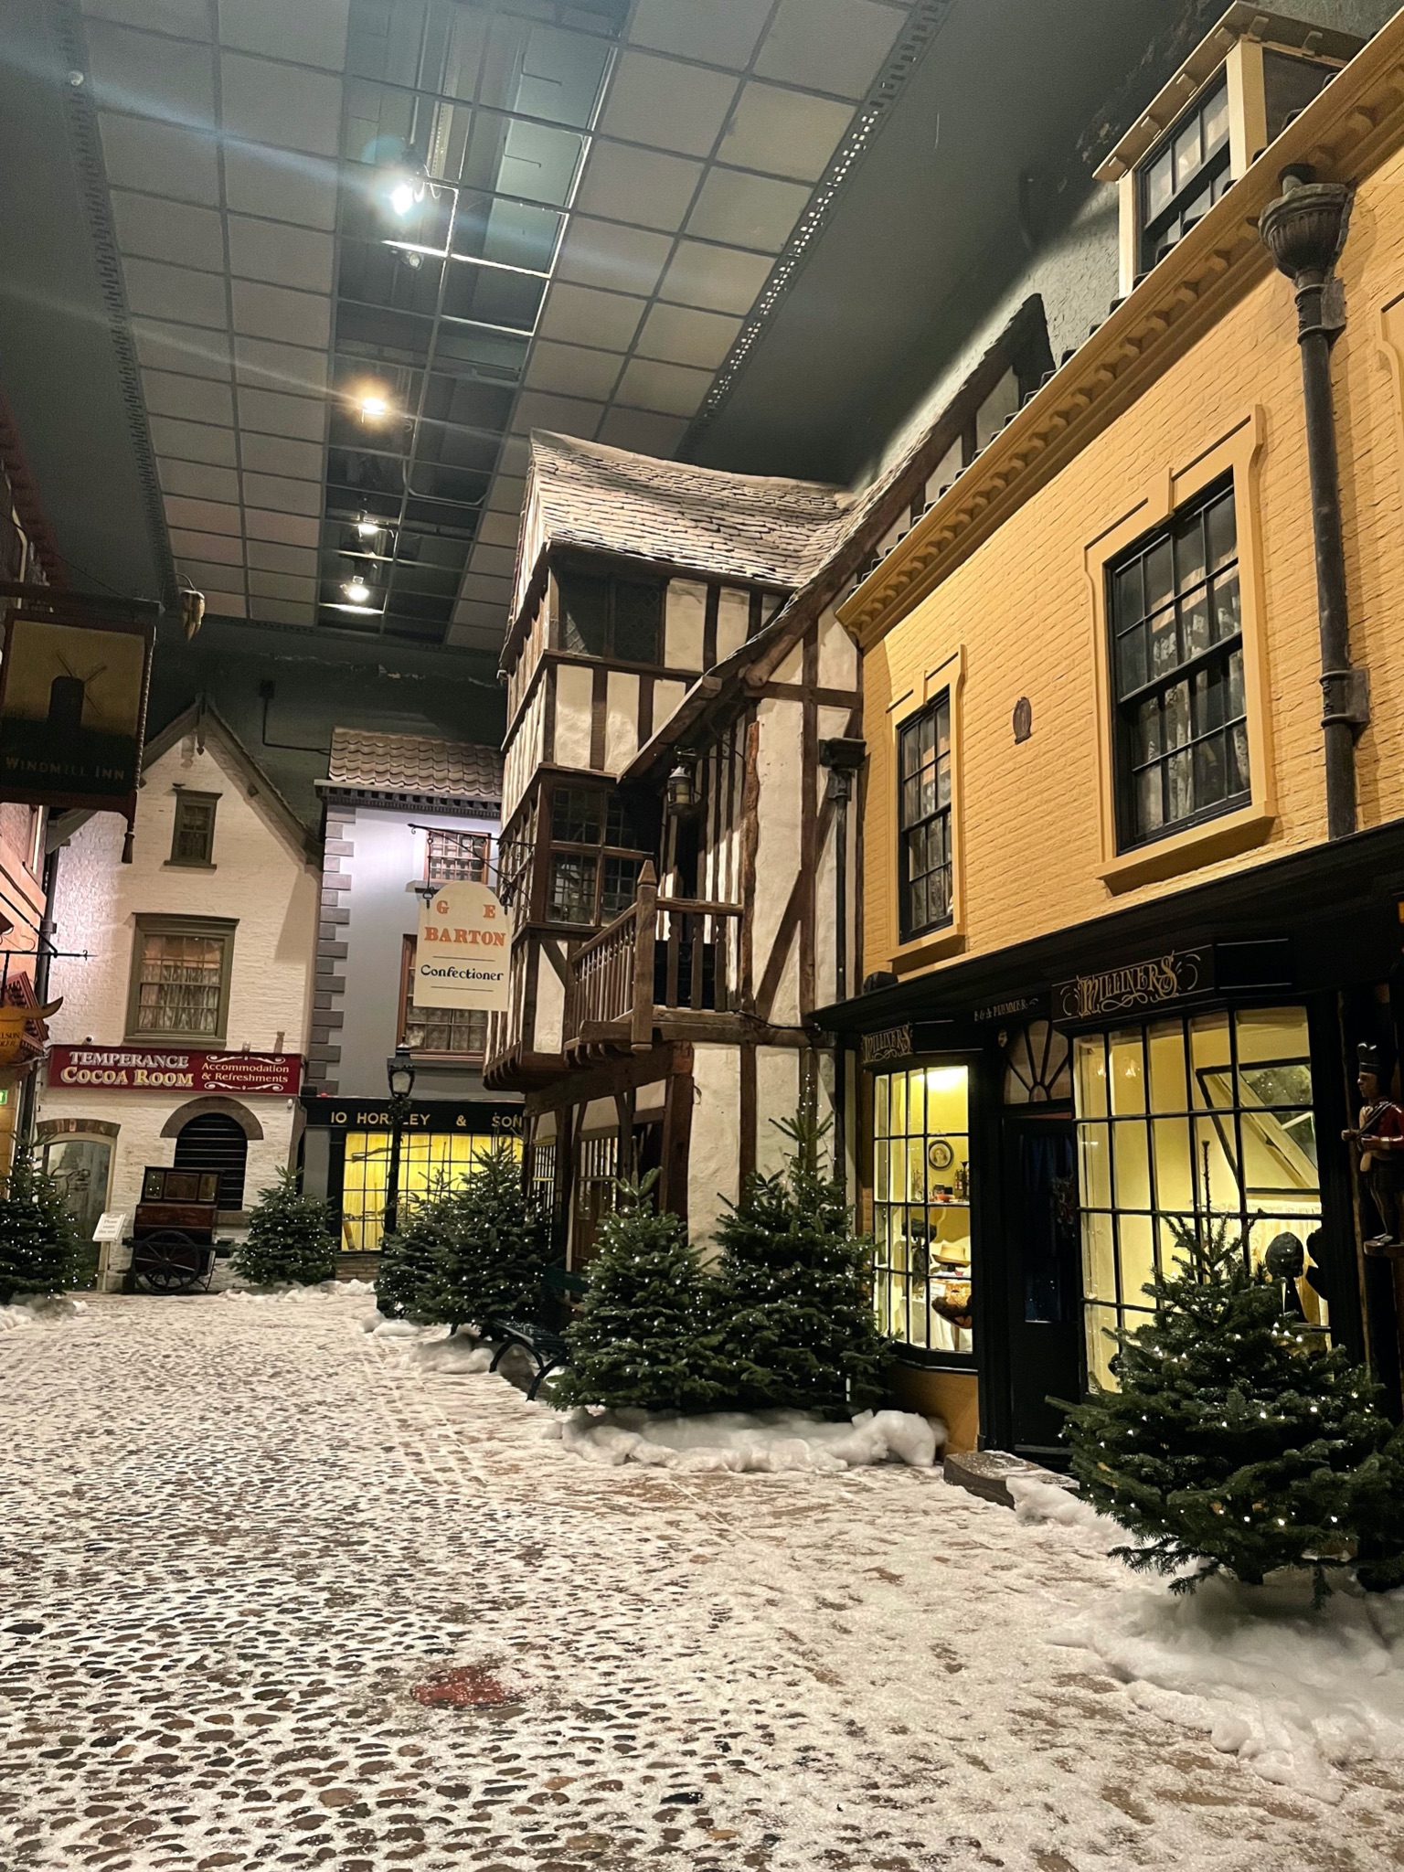
Links to Museum
Link to the suffragette movement.
Sweet shop storefront in the Victorian street display.
Archives about confectionery industry.

Slide 8
References
Anonymous Author, ‘Issue 15337 Multiple News Items’ York Herald (York, 4th August 1900) 6. Accessed from ‘Multiple News Items’ (Gale Primary Sources) < Multiple News Items (york.ac.uk) > accessed 1st December 2021.
Anonymous Author ‘Issue 15398 Births, Deaths, Marriages and Obituaries’ Sheffield Daily Telegraph (Sheffield, 16th November 1904) 9. Accessed from ‘Births, Deaths, Marriages and Obituaries’ (Gale Primary Sources) < Births, Deaths, Marriages and Obituaries - Document - British Library Newspapers (york.ac.uk) > accessed 20th November 2021.
Anonymous Author, ‘The “Art, Trade and Mystery of a Confectioner”: The History of M.A. Craven & Son LTD York’, Specialised Publications LTD (Surrey, 1949) 2.
Charles B Night, ‘M.A. Craven & Son Limited: History of the Company’ (1948) York.
Dinah Tyszka, ‘Mary Ann Craven (1826-1900)’ (York Civic Trust) < Mary Ann Craven (1826-1900) – York Civic Trust > accessed 24th November 2021.
Jennifer Aston and Paolo Martino, ‘Risk, success, and failure: female entrepreneurship in late Victorian and Edwardian England’ 2017(7) Hoboken Wiley, 837, 843.
‘Mary Ann Hick in 1826’ (Find my Past) <Record Transcription: England Births & Baptisms 1538-1975 | findmypast.co.uk> accessed 24th November 2021.
‘Mary Ann Hick in 1851’ (Find my Past) <Record Transcription: England & Wales Marriages 1837-2005 | findmypast.co.uk> accessed 24th November 2021.
‘M.A. Craven & Son Ltd’ (Borthwick Catalogue) < M.A. Craven &amp; Son Ltd - Borthwick Catalogue (york.ac.uk) > accessed 24th November 2021.
Sonia A Bedikian, ‘The Death of Mourning: From Victorian Crepe to the Little Black Dress’ 2008(57) Omega Journal of Death and Dying, 35, 38-39.

Slide 9
Thank you!
Any Questions?

