Slide 1
HERStory telling the unheard stories of York’s women.
Sarah Smithson 1845-1928.

Slide 2
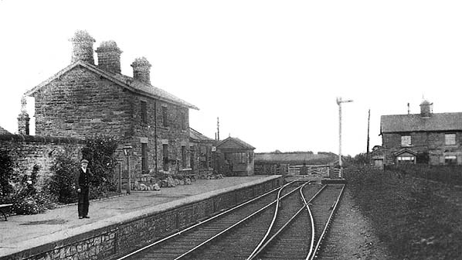
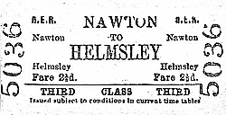
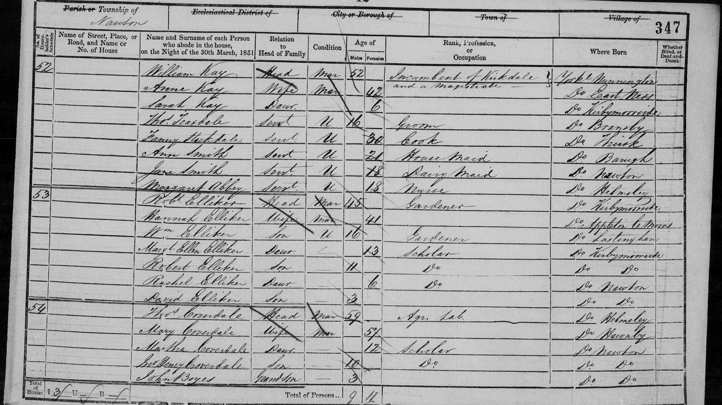
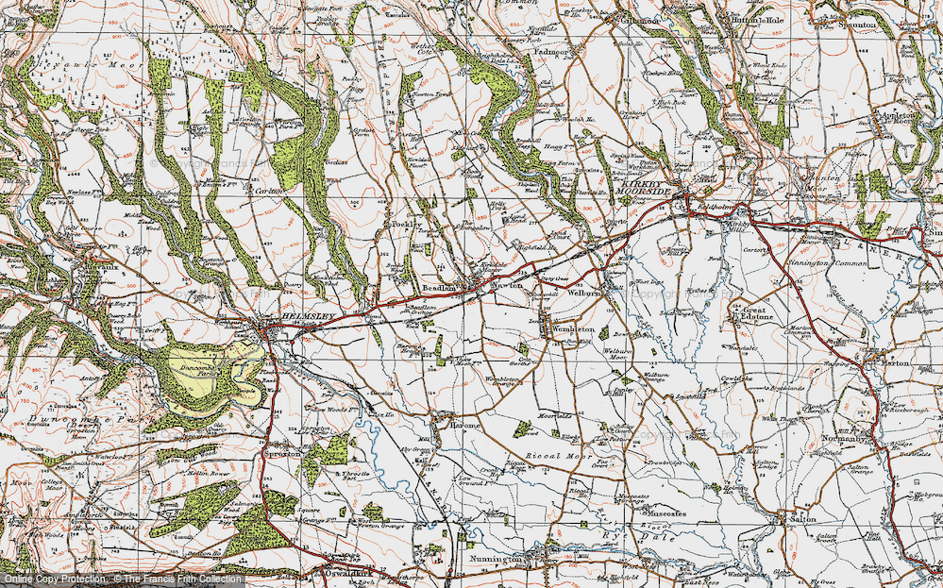
Early life

Slide 3
education

Slide 4
Mrs. e. w. smithson.

Slide 5
Adult life

Slide 6
Political career

Slide 7
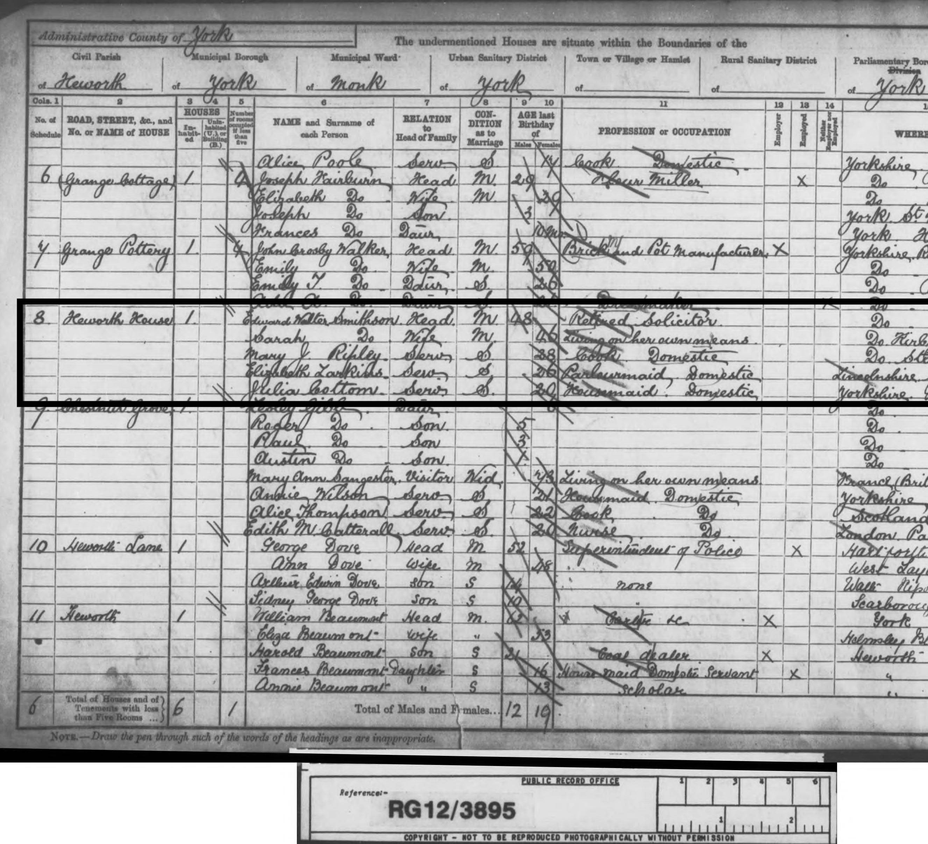
heworth

Slide 8
Death certificate

